Slide 1
Timeline of WWII and the Holocaust

Slide 2
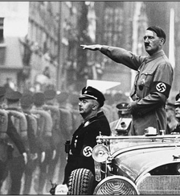
1933
Hitler pressured the German president, Paul von Hindenburg, into appointing him chancellor (head of the government)
As chancellor he was able to gain even more power.

Slide 3
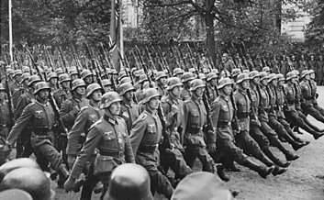
1935
Germany no longer recognized the Treaty of Versailles or its restrictions.
Hitler announced his intention to totally rebuild Germany’s military, which broke the rules set by the treaty.

Slide 4
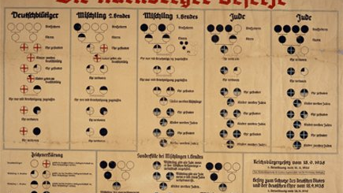
1935
Germany enacts, Nuremberg Laws
Took away German Jews’ citizenship
Banned marriages/sexual relations between Germans & Jewish people
Identify “Jew” not by religion but ethnic – one Jewish grandparent
Banned Jewish people from military, universities, hospital, and restricted from any jobs

Slide 5
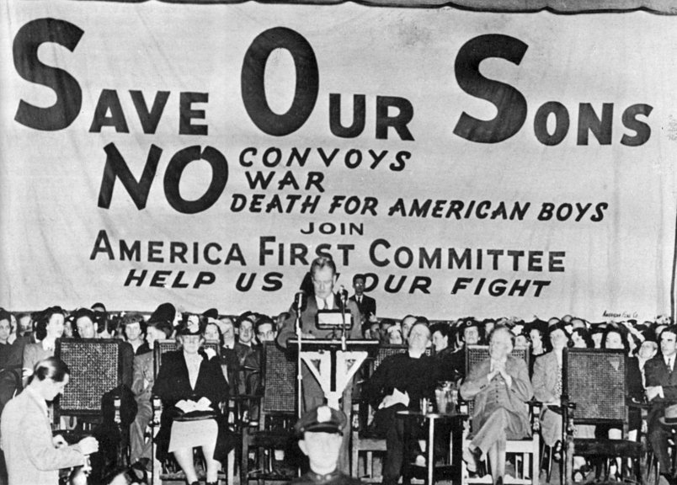
1935
US passes Neutrality Acts
doesn’t wish to get involved in another European conflict/war

Slide 6
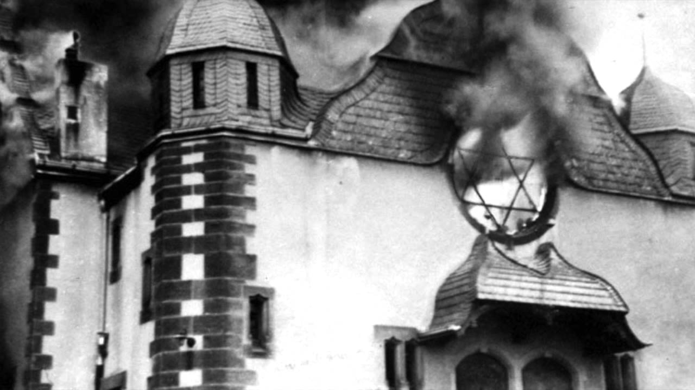
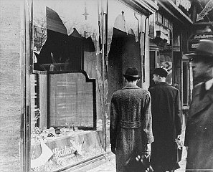
1938
Germany began invading its neighboring countries.
Annexed Austria – was welcomed
Kristallnacht, “Night of Broken Glass”
wave of violent anti-Jewish attacks throughout Germany & occupied territories

Slide 7
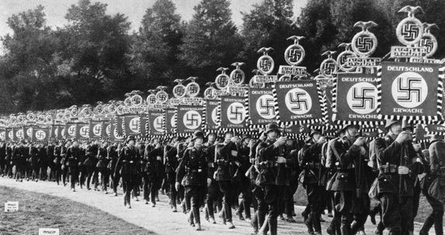
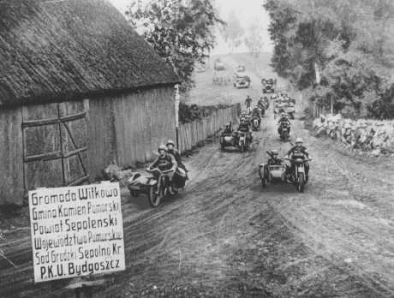
1939
Germany attacked/invaded Poland on Sept 1st 1939
Britain and France joined forces to fight against Germany, and World War II begins in Europe.

Slide 8
1939
US provides aid to the Allies by
Lend-Lease: US “lent” war materials to Great Britain
Atlantic Charter: US secretly meets with Britain to commit to defeating Germany

Slide 9
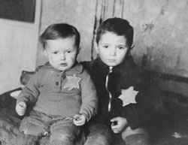
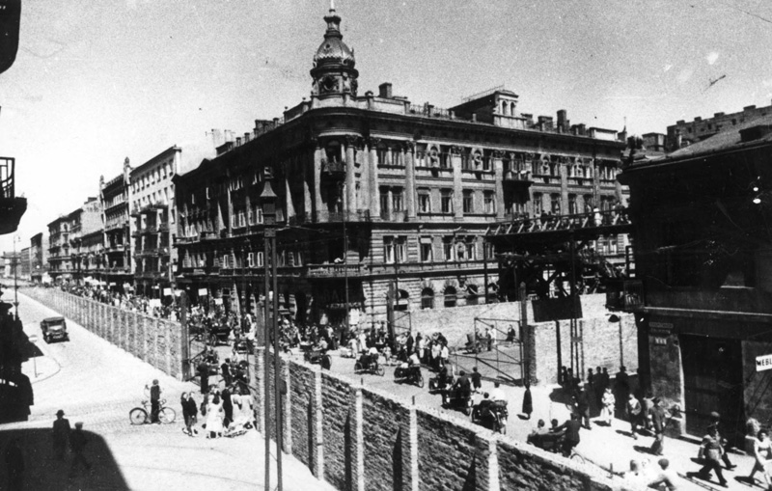
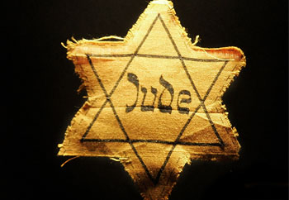
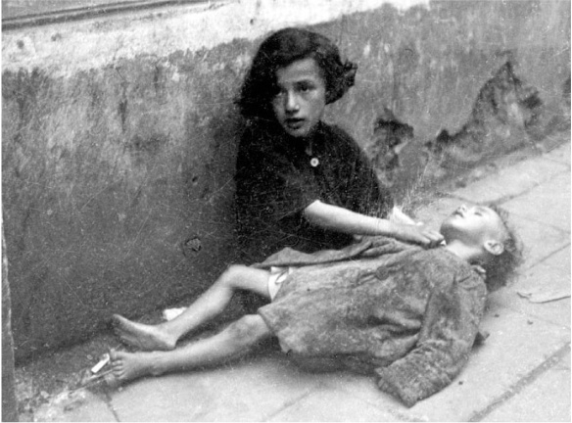
1939
Polish Jews are forced into ghettos & to wear Star of David on body at all time

Slide 10
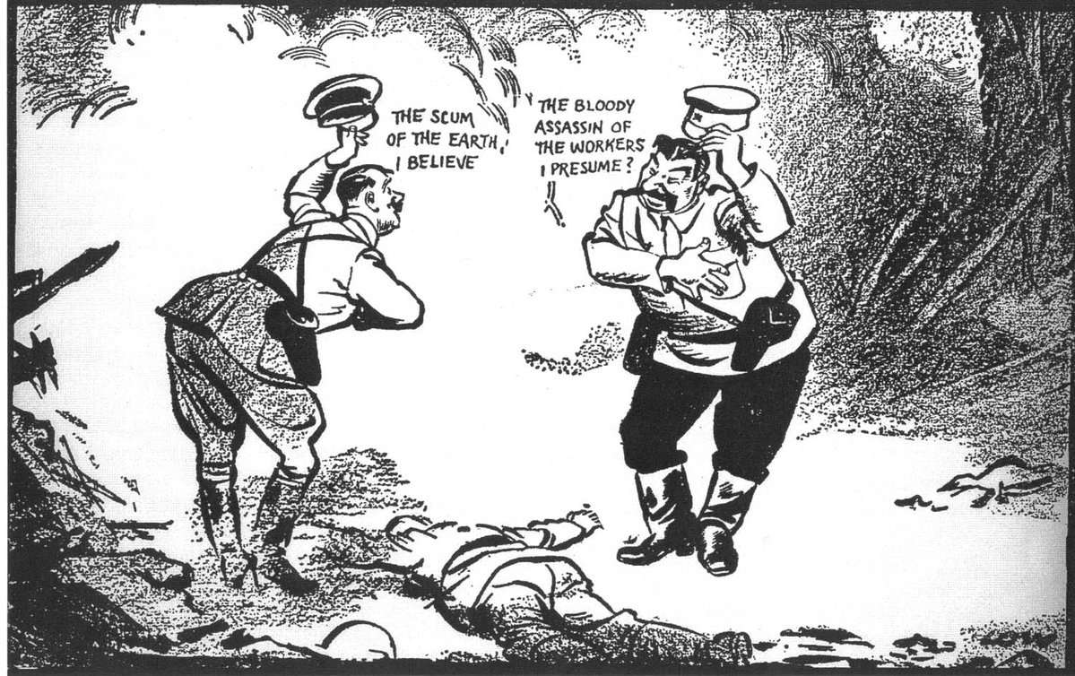
1939
Nazi-Soviet Pact (Germany Soviet Non-aggression Pact)
Neutrality pact between Germany and USSR
Divide up Poland

Slide 11
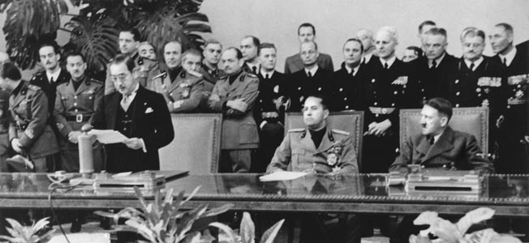
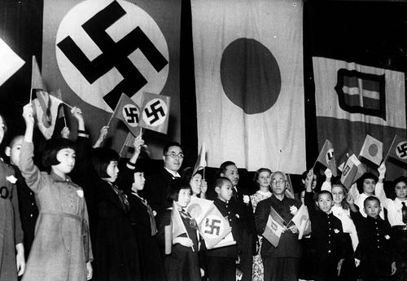
1940
Tripartite Pact was signed by Germany, Italy, and Japan → Berlin Tokyo Rome Axis

Slide 12
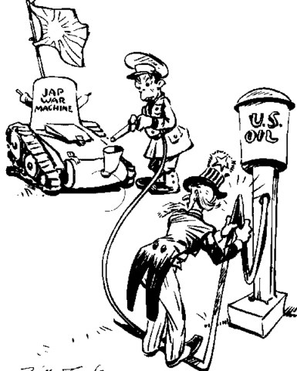
1940
US places embargos (trade restrictions) on Japan because of the Tripartite Pact

Slide 13
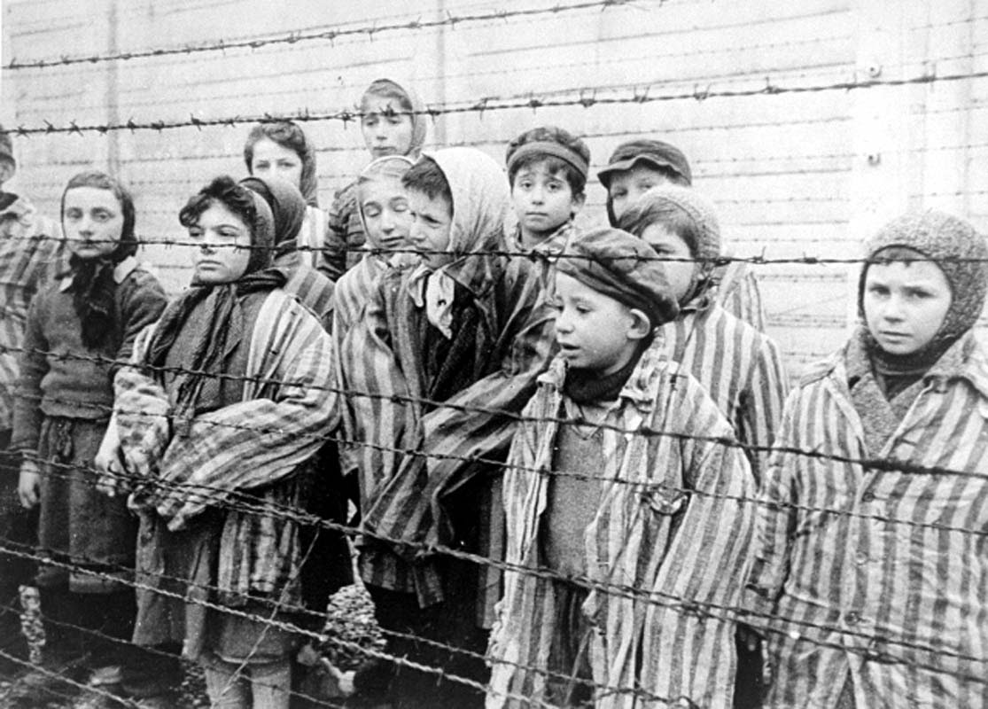
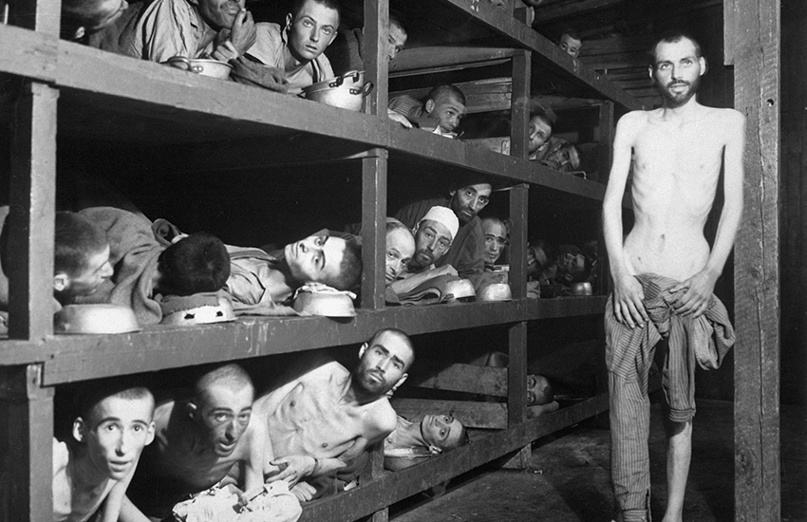
1940
Nazis deport German Jews to Poland.
Concentration camps are set up to mass murder Jewish people and any the Nazis saw as “undesirables”

Slide 14
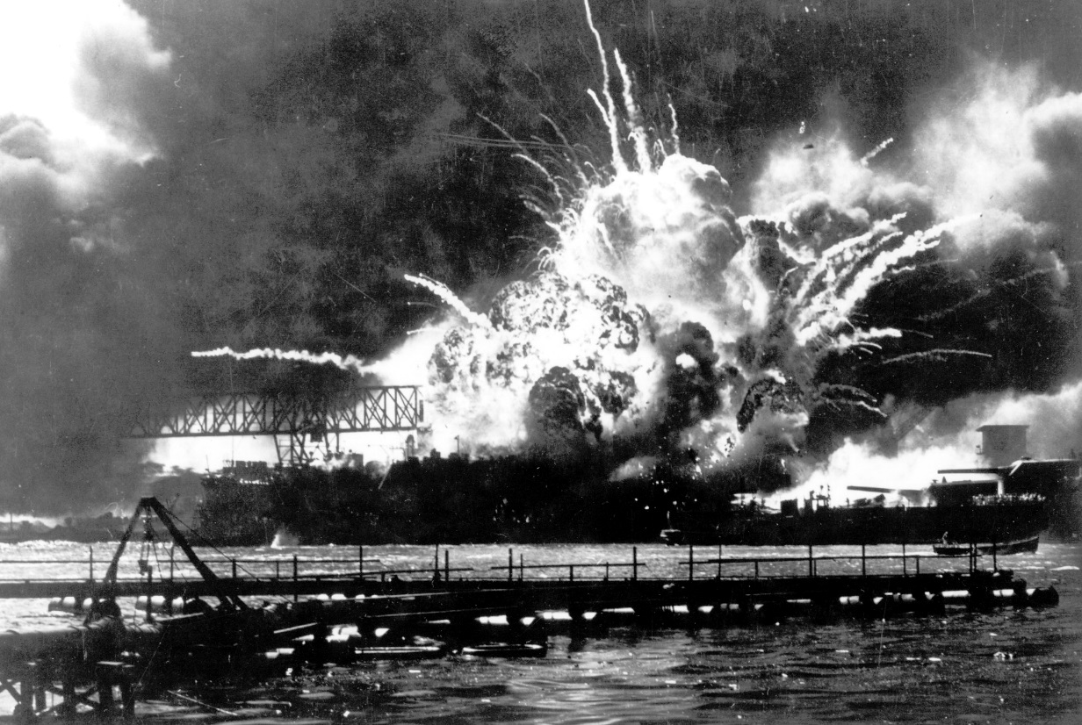
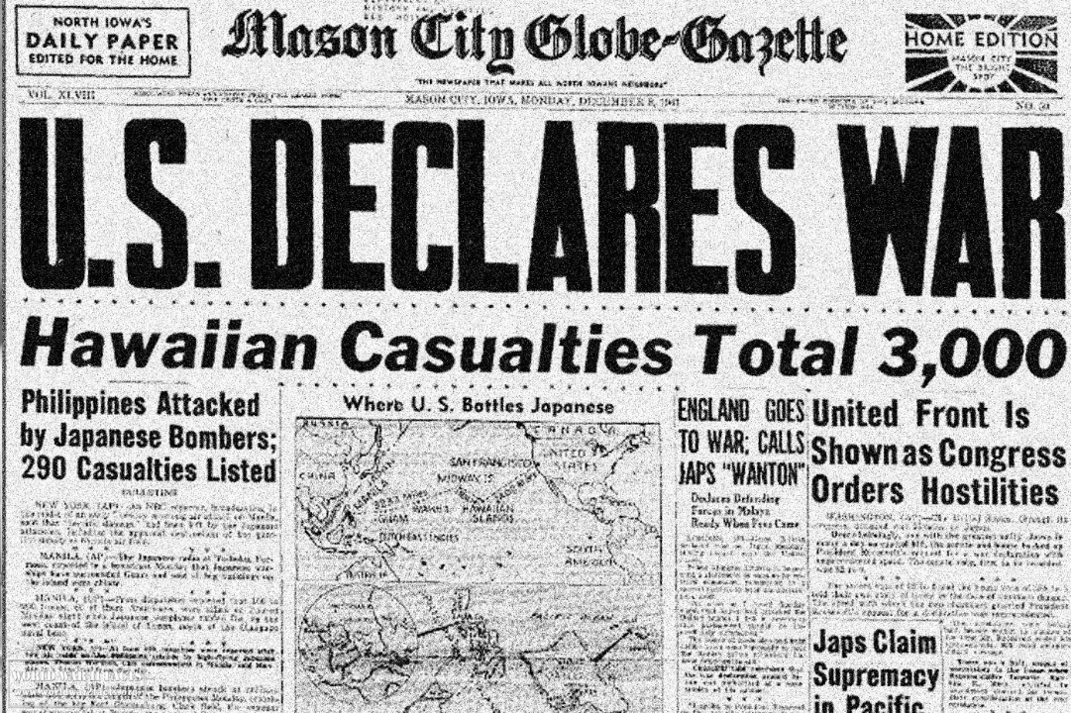
1941
Japan attacks US base at Pearl Harbor, Hawaii
US declares war on Japan → Germany & Italy honoring their pact with Japan declares war on US

Slide 15
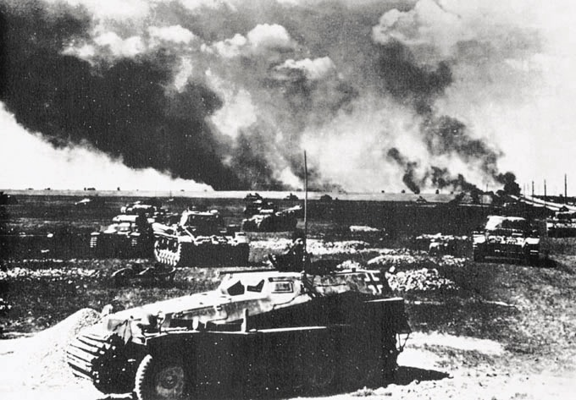
1941
Germany attacks USSR, kills 33,000 Russian Jews

Slide 16
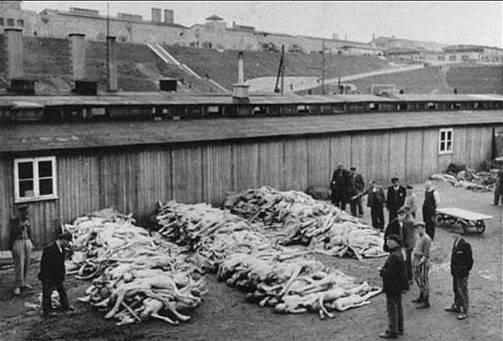
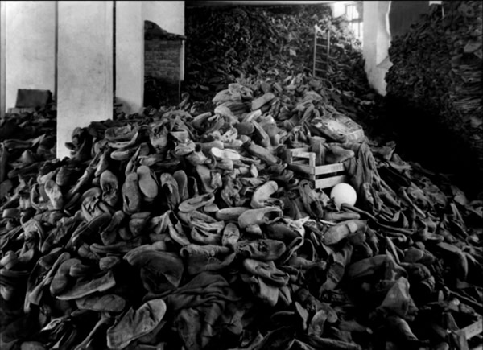
1942
Nazis began discussing a “Final Solution” to Jewish problem.
Mass deportation of Jews from Germany, Greece, and Norway to extermination centers.

Slide 17
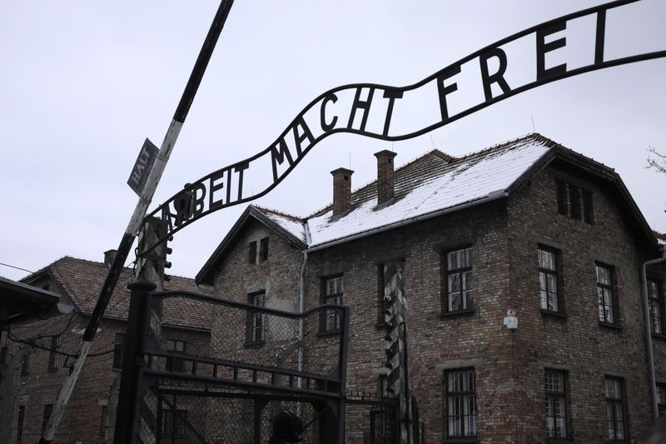
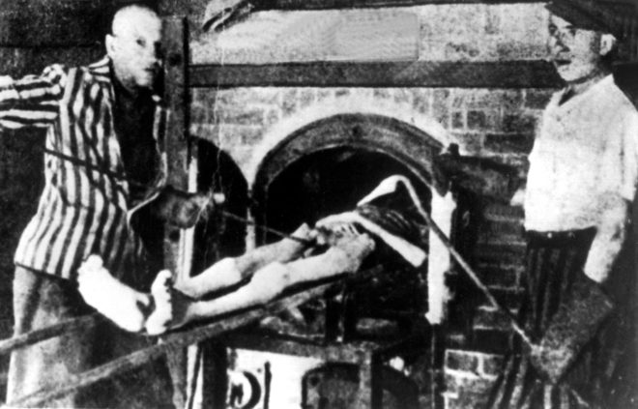
1944
Nazis take over Hungary, deport 12,000 Hungarian Jews a day to Auschwitz to die

Slide 18
1945
Allies liberated the concentration camps and discover the horror
Hitler commits suicide (April) – Germany surrenders soon after
US drops Nuclear Bombs on Hiroshima and Nagasaki (August)
WWII ends in Asia

