Slide 1
How to register an account with NoodleTools

Slide 2
www.noodletools.com
Click on the blue Log In button

Slide 3
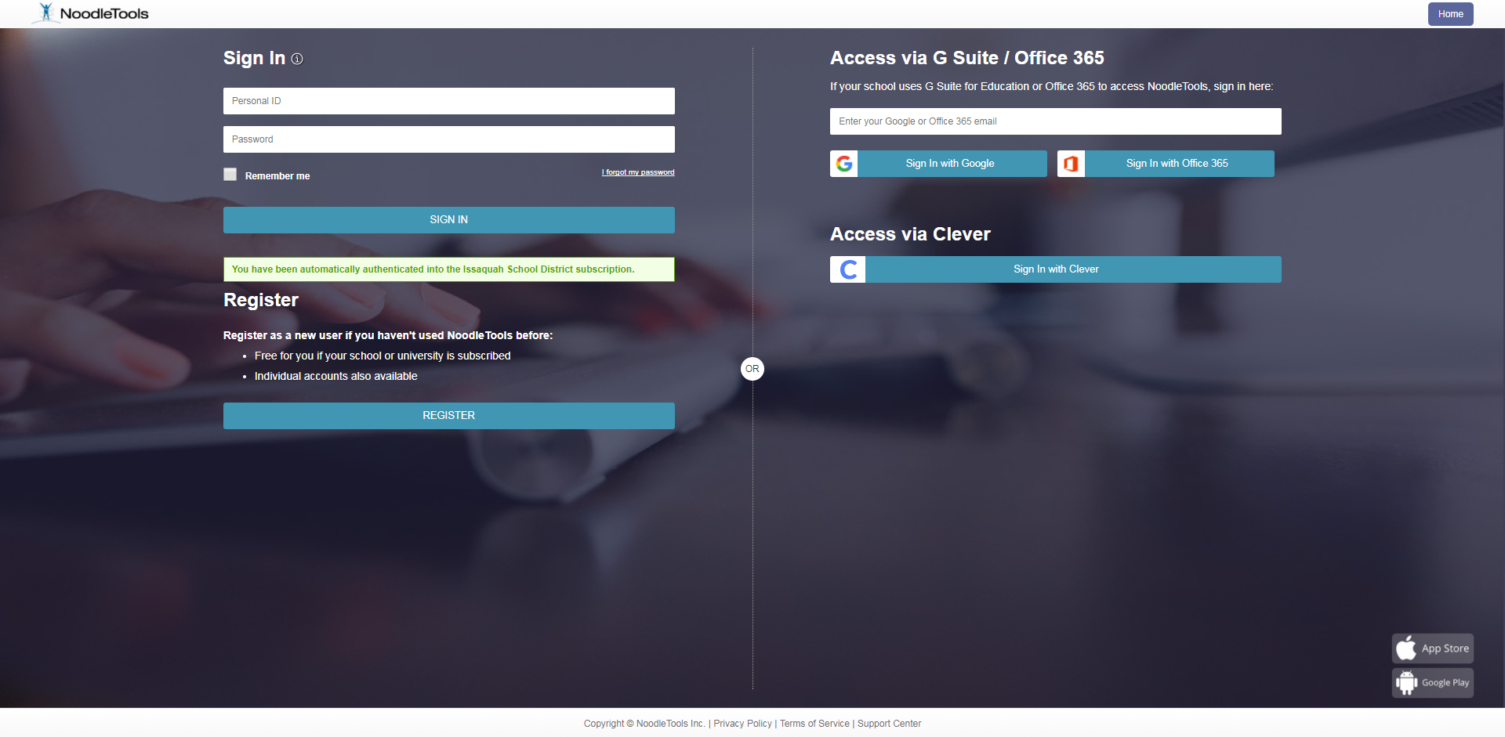
Click on the blue Register button

Slide 4
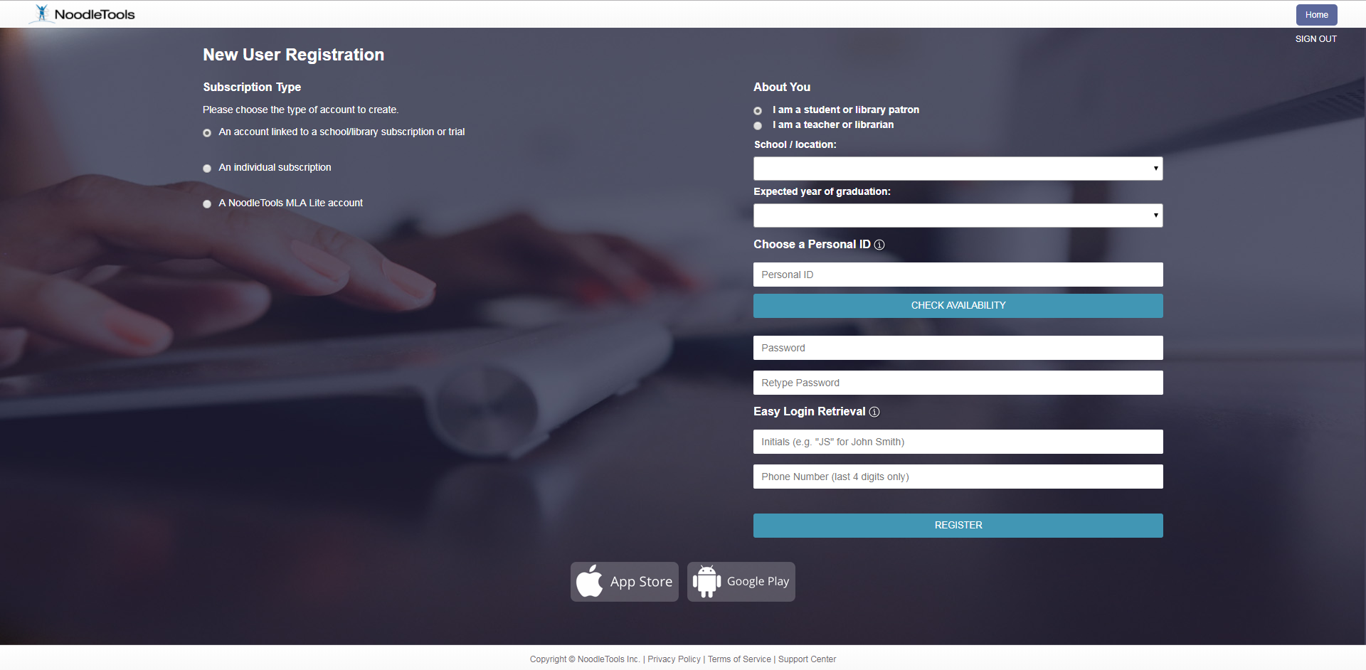
Fill out the registration
Make sure you put in Skyline High School for School/Location
Create your own Personal ID – make sure it’s appropriate
Click register

