Slide 1
The end of World War II
May 8, 1945

Slide 2
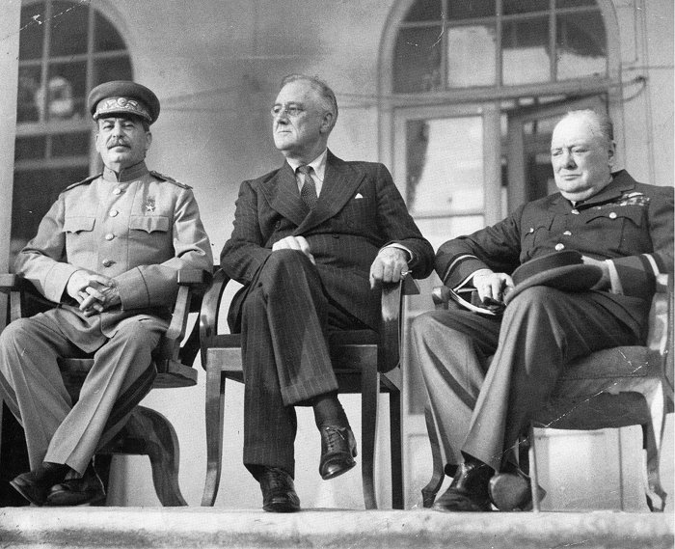
Tehran Conference (11/1943)
Strategy meeting between Stalin, FDR, Churchill (in Tehran, Iran)
Took place after the Anglo-Soviet invasion of Iran
Iran was neutral but Allies believed Iran was friendly with Axis
Also wanted Iran’s oil for the Allies
Discussed about Allies relationship with Turkey and Iran, strategies towards Japan, goals after the war

Slide 3
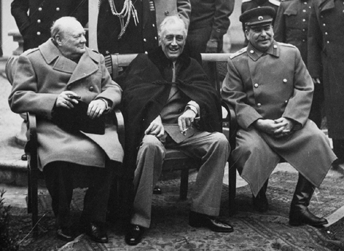
Yalta Conference (2/1945)
Churchill, Stalin, FDR meet at Yalta (in Russia) and agree to divide up Germany at the end of the war

Slide 4
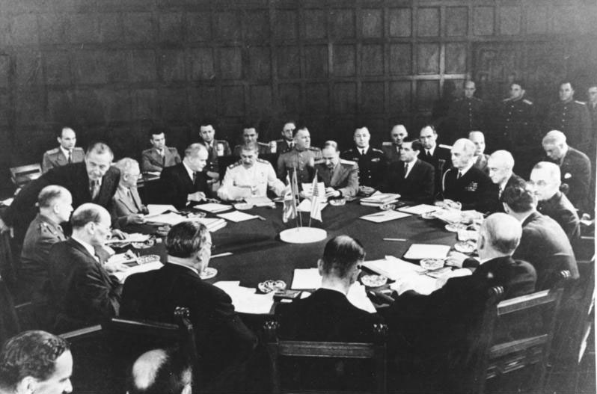
Potsdam Conference (7-8/1945)
Truman (US), Attlee (UK), and Stalin (USSR) meet again at Potsdam (in Germany) and agree to two more things:
free and fair election in Europe after the war
USSR jumps in and helps in Japan
Truman tries to scare Stalin by telling him about atomic bomb, but Stalin already knows (spies)

Slide 5
End of the war
Russians invades Germany from the east
6 million troops
Britain, France and US invade from the west
3 million troops
Hitler commits suicide
Germany surrenders May 7, 1945
New Chancellor Karl Doenitz signs unconditional surrender papers May 8, 1945

Slide 6
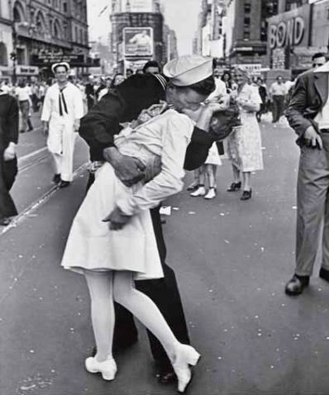
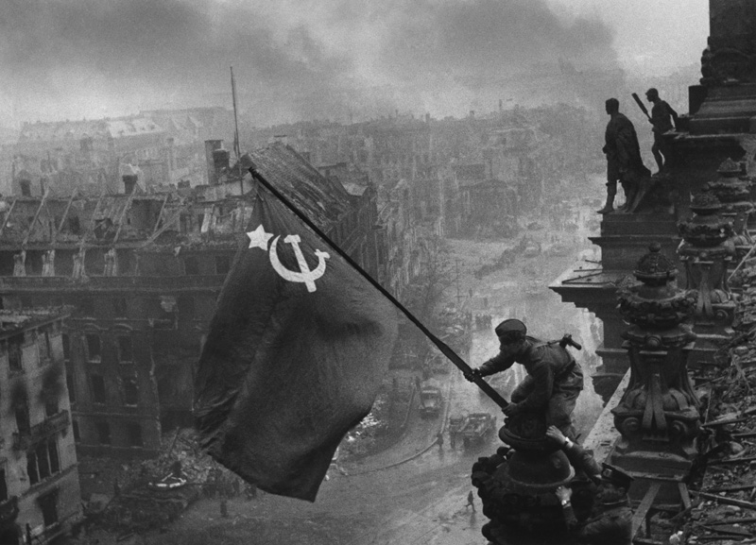

Slide 7
Aftermath
Many great cities left undamaged
Brussels, Paris, Rome, Prague
Many others severely damaged or destroyed
Huge sections of London in ruins
Warsaw (Poland) was 95% destroyed
Central Berlin – 95% destroyed
Rotterdam (Netherlands) – 90% destroyed

Slide 8
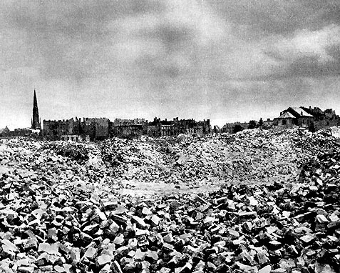
Warsaw 1945

Slide 9
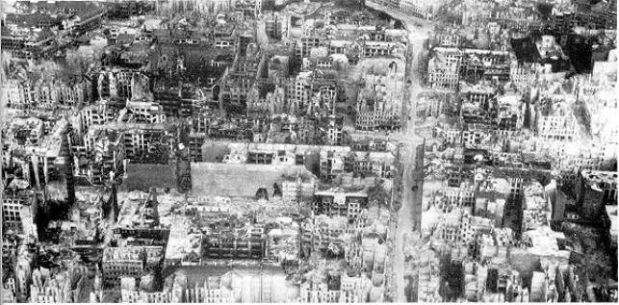
Berlin 1945

Slide 10
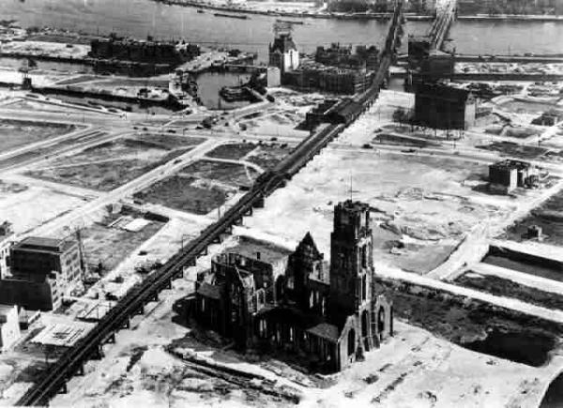
Rotterdam 1945

Slide 11
Aftermath
Millions of people displaced
Homes, cities, families lost
Survivors of concentration, labor and POW camps
Agriculture disrupted
Famine and starvation become widespread right after the war
No infrastructure for economics to resume
Some governments survived
Scandinavian countries, Netherlands, Belgium, Britain
Some of course did not
Germany, Italy
France – Vichy France was a puppet state
Communism becomes very attractive…

Slide 12
Marshall Plan
Created by Sec. of State George Marshall
13 billion $ (roughly 5% of GDP) went to rebuilding Western Europe
Would have been more but USSR would not let Eastern Europe take it
Europe did not have to pay it back
Most went to Britain and France
Mainly from 1947-1951
Helped contain communism

Slide 13
Divided Germany
UK, US, and France combine to form West Germany and hold free and fair elections
USSR installs puppet government into East Germany—the country will not fully reunite until 1989
Problem is, Berlin is also divided and it sits in the heart of the USSR zone (now East Germany)

Slide 14
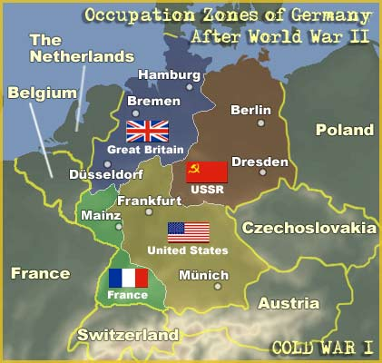
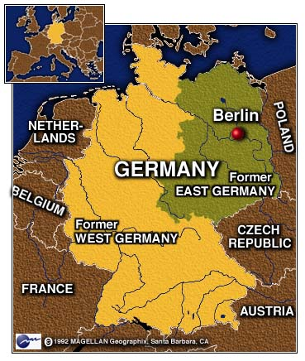
A divided Germany

Slide 15
United Nations
Wilson’s League of Nations had failed
US never joined it
Unable to prevent WW II
Allies create United Nations at meeting in SF
HQ in NY
April 1, 1945 – UN Charter approved
US, China, USSR, Britain and France are the five permanent members of the Security Council
Sec. General (António Guterres, Portugal)
Can veto any policy approved by the General Assembly
Good at providing humanitarian aid but not stopping/prevent armed conflicts

Slide 16
Nuremberg Trials
Allied Military Tribunal = first trials of war criminals in history
Choose Nuremberg because it was location of famous Nazi party rallies
4 countries (USA, France, UK, USSR) each have one judge and a legal team (head judge = UK head lawyer = USA)
US has most of key Nazis so USSR has to work with us
22 Nazi leaders put on trial
Conspiracy to wage war
Waging aggressive war
War crimes
Crimes against humanity
Some commit suicide before standing trial (Hitler, Goebbels, Himmler, Bormann, Rommel, Ley, etc.)
Eleven sentenced to death, 10 (Goering commits suicide) Nazi officers hanged in October 1946
Other acquitted (3) or given varying sentences
Precedent for future war criminals and ICC today

Slide 17
WWII Unit Test (Friday, 5/18)
Fascism
Mussolini’s beliefs/ideology
How does he view the individual? State? Religion?
Hitler & Nazism
How does he view the individual? State?
Beliefs on race
Scope & sequence of WWII (key events of the war – review your timeline)
Dunkirk film
Scope & sequence
Purpose of non-linear storytelling
End of WWII
Everything from your outline

