Slide 1
Citations using “noodle”

Slide 2
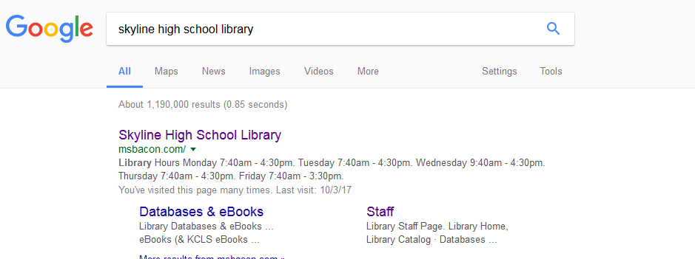

Slide 3
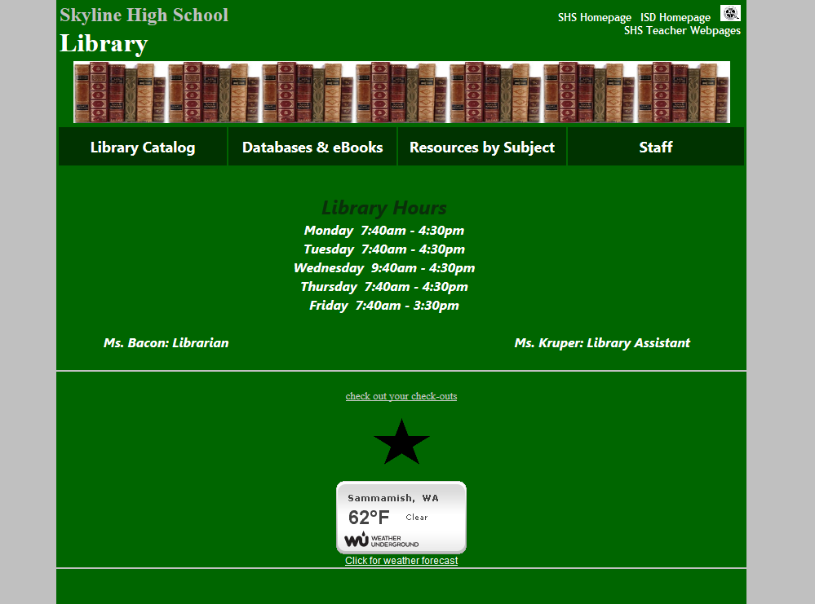

Slide 4
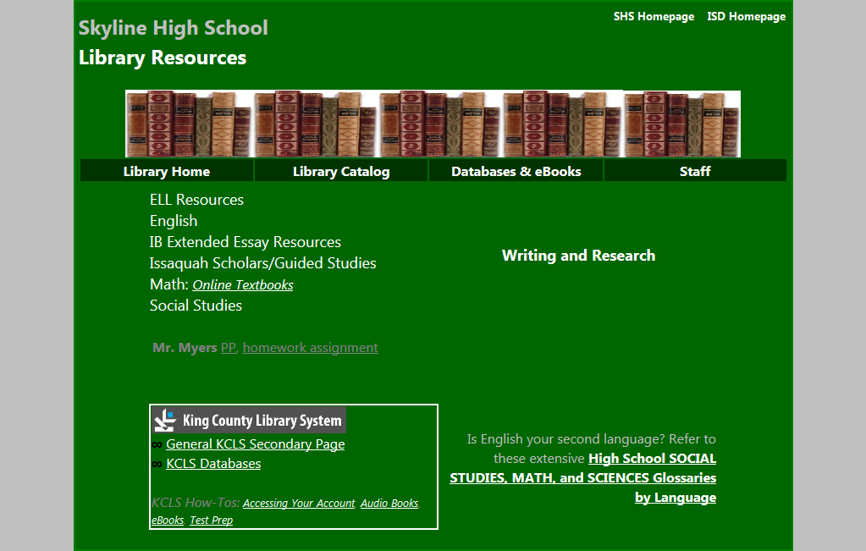

Slide 5
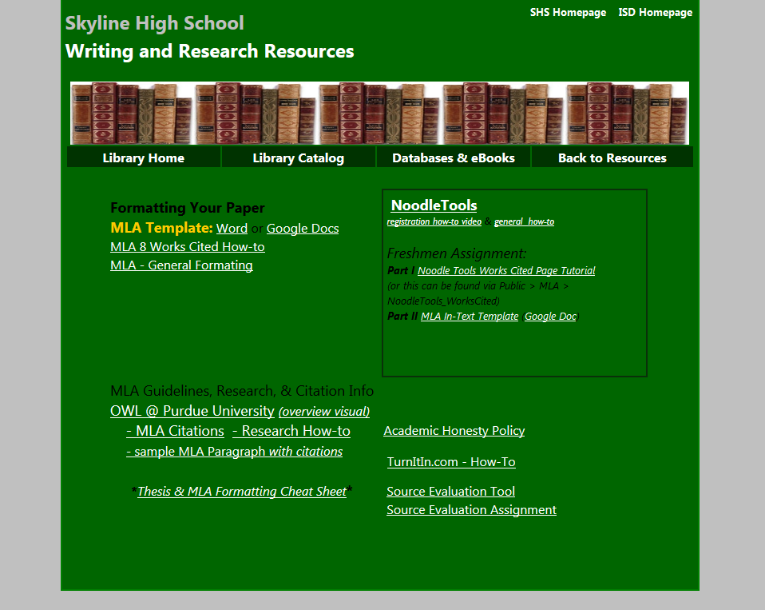

Slide 6
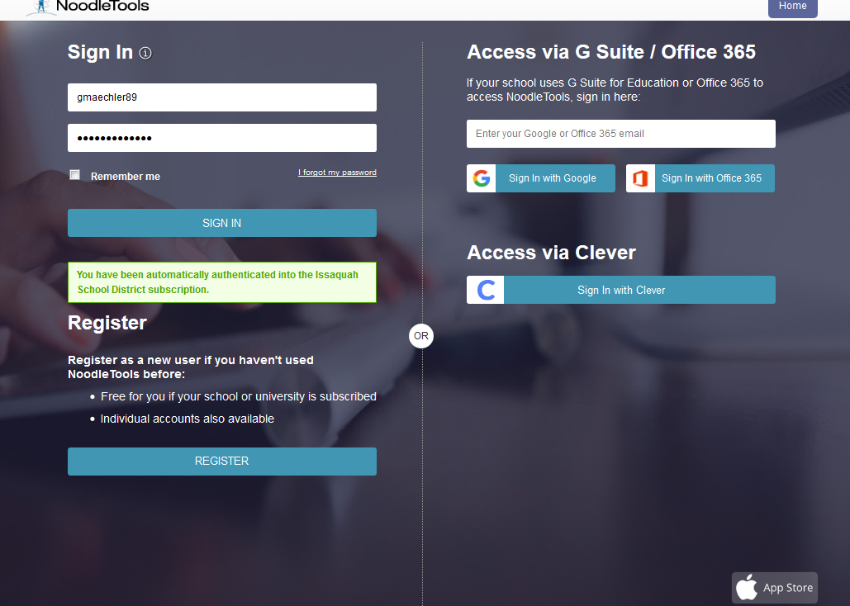

Slide 7
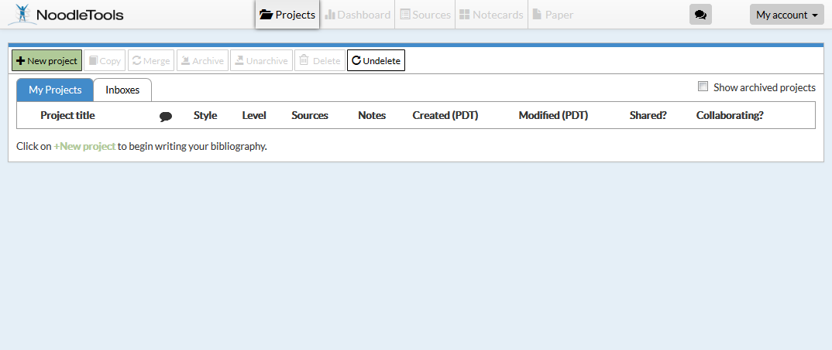

Slide 8
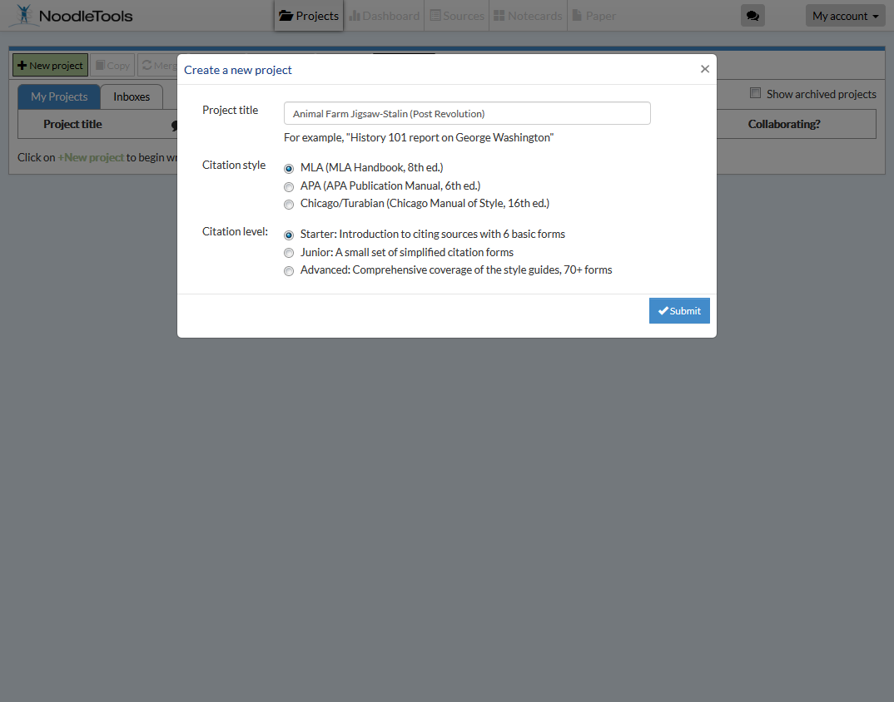

Slide 9
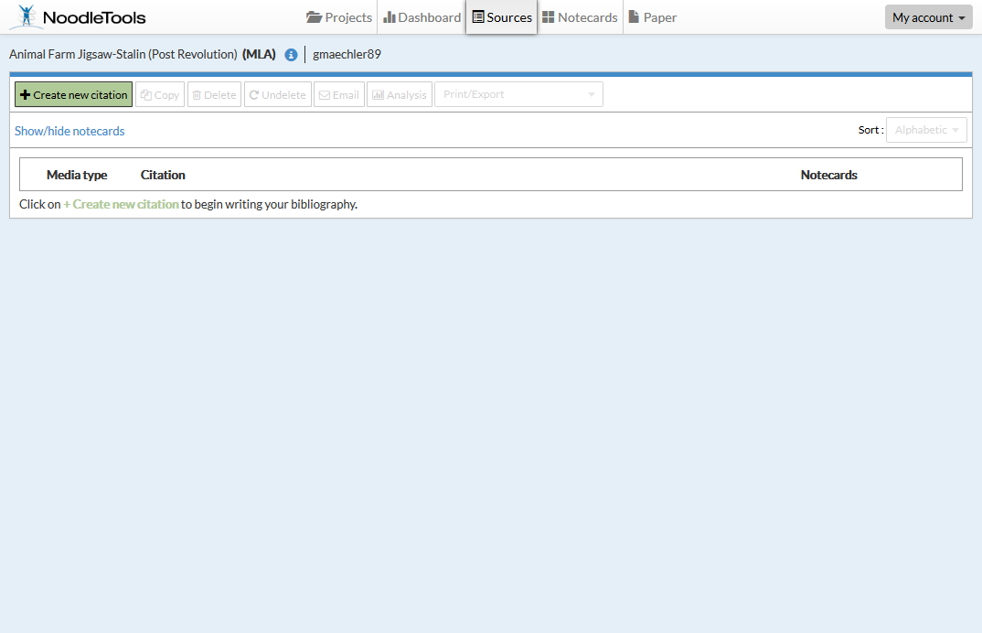

Slide 10
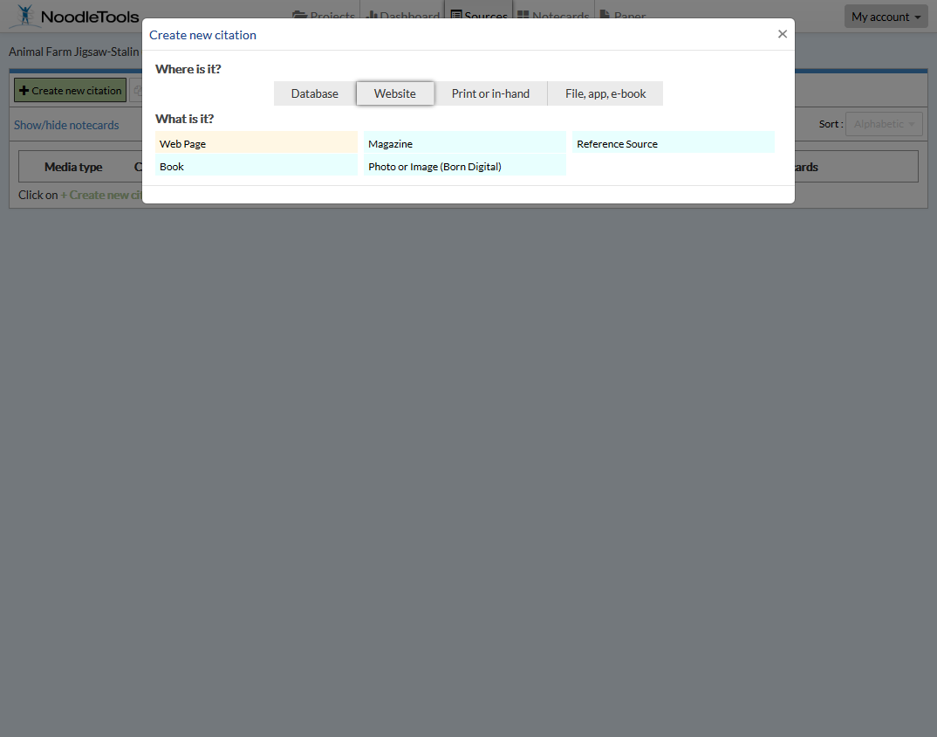
Choose a text type

Slide 11
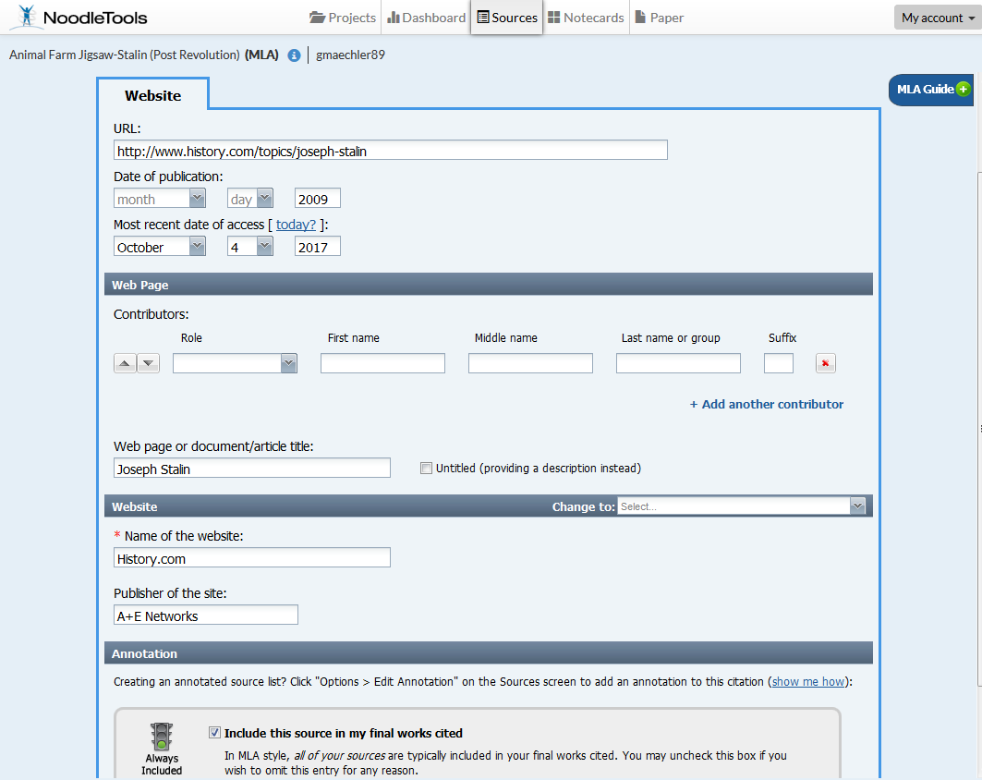
CLICK
SUBMIT

Slide 12
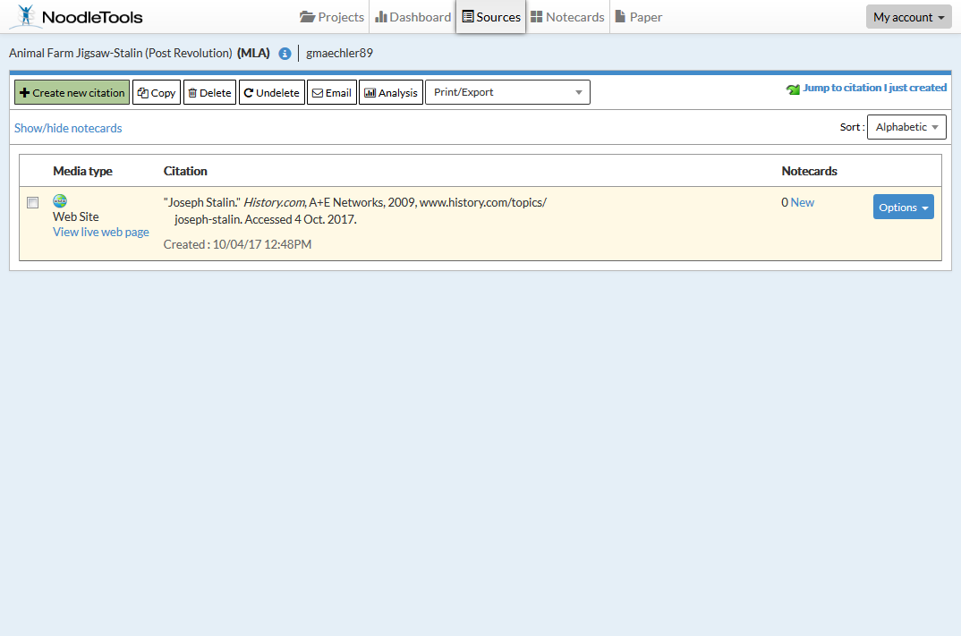

Slide 13
Download as MS word document
Works Cited
"Joseph Stalin." History.com, A+E Networks, 2009, www.history.com/topics/joseph-stalin. Accessed 4 Oct. 2017.

Slide 14
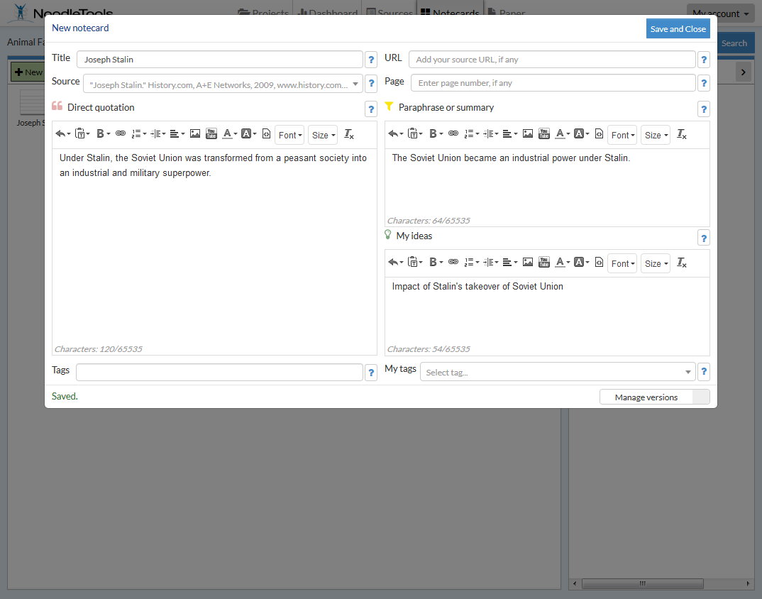

Slide 15
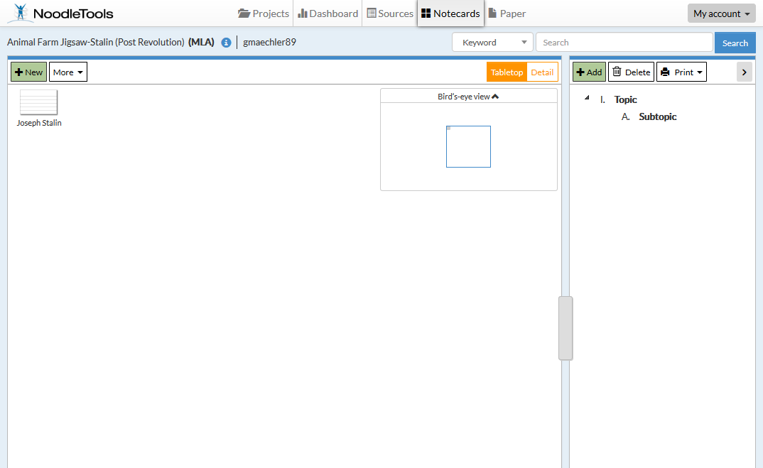

Slide 16
