Slide 1
Reminder:
Chapter 1-2 Test on Thursday for SS
*I went over the study guide last week, it’s on my

Slide 2
The Roots of American Democracy

Slide 3
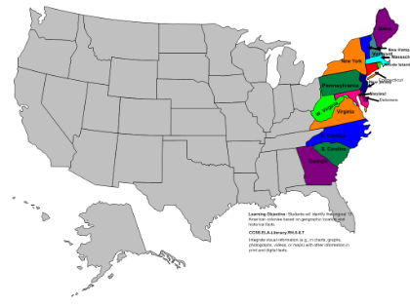
United States at this time...
Colony of Britain

Slide 4
Britian
13 Colonies

Slide 5
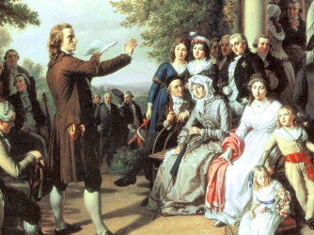
Enlightenment
1600s - 1700s in Europe
Intellectual & philosophical movement
Emphasis on using reason/rationale to solve problems
Some ideas that came out during this movement:
Individual liberty
Constitutional gov
Separation of church and state
Religious tolerance

Slide 6
Enlightenment Thinkers - Philosophes
Five main concepts behind their beliefs
Reason – truth could be discovered through logic or reasoning
Nature – what was natural was also good Happiness – be happy here and now
Progress – mankind can always improve
Liberty – the French philosophes wanted the same liberties that the English had won through Bill of Rights, etc.

Slide 7
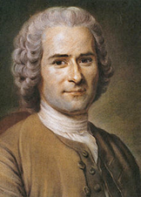
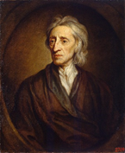
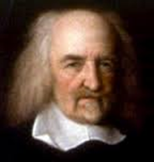
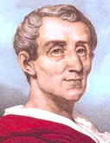
Enlightenment Philosophers
Montesquieu
Rousseau

Slide 8
Enlightenment Philosopher Reading
At your table…
Each group member chooses a philosopher to read about
Read about your philosopher & answer the questions for your philosopher
After each group member is done, share out while other group members record

Slide 9
Read Ch 3, Section 2
Create a Mind Map on Colonial America’s View on Government
Your Mind Map must have 4 major branches:
French Enlightenment
English Enlightenment
English Roots
Religious and Classical Roots
Each branch must have:
an explanation of why it contributed to Colonial America’s view on gov’t
key vocab (with definition) -- highlight
key philosophers & their ideas -- underline

