Slide 1
September 11th
TURN IN: Parent Signature sheet for syllabus if you haven’t
TAKE OUT:
“Who are they”, SS notebook, pen/pencil
Today’s Agenda
Week’s agenda
Who are they
Middle Age Europe
Geography
Learning Objective:
Review Ancient Romans
Intro to the Middle Ages

Slide 2
A week’s preview…
Take a couple of minutes to write down HW & Quiz dates
Monday | Tuesday | Wednesday | Thursday | Friday
11 Fall of Roman Empire & Middle Ages (lecture notes) Map of Europe HW: Finish map Read & take notes Ch. 7, Section 2, pp. 219-224, use Cornell notes style | 12 Reading quiz Feudalism & Medieval Society HW: Study for Map Quiz | 13 The Catholic Church The Crusades HW: Study for Map Quiz | 14 Map Quiz – turn in Map Finish The Catholic Church & Crusades HW: Read & take notes Ch. 8 Section 4, pp. 262-268 | 15 Reading Quiz Learning & Culture during the Middle Ages
Go to my website to find the reading

Slide 3
Text Reminder
6th period:
Text @nguyenwh6 to the number 81010

Slide 4
Text Reminder
5th period:
Text @nguyenwh5 to the number 81010

Slide 5
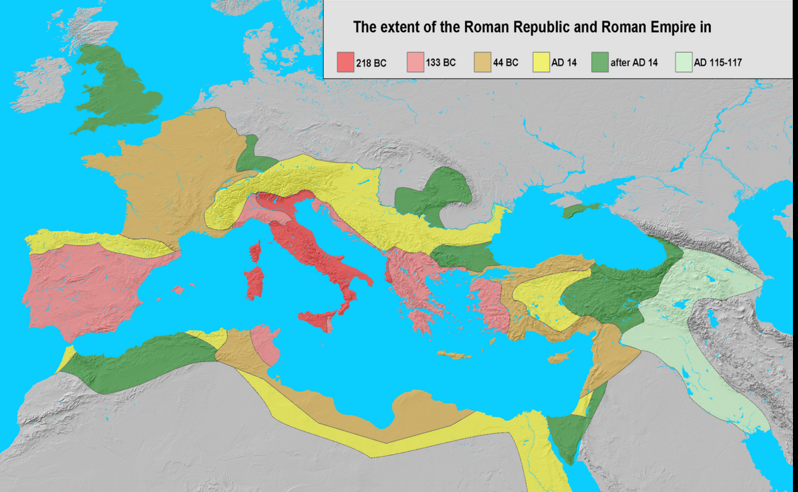
Ancient Roman
Began in Italy as small city states.
They established a republic: a system of government where people choose their government.
133bc Roman power reached from Spain to Egypt.
Riches flooded into Rome from conquered lands
Rome’s first emperor Augustus helped the empire recover form the long period of unrest. Many civil wars!! → “Pax Romana” a time of peace in Rome

Slide 6
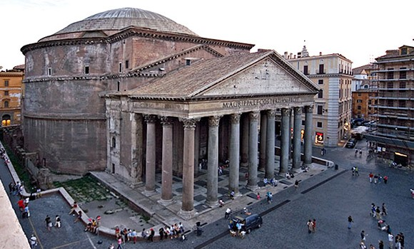
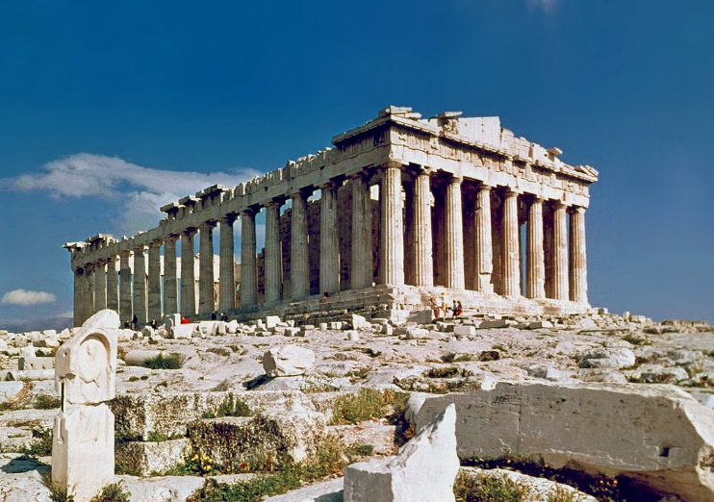
Ancient Roman
Greco- Roman: the name given to the blending of Greek and roman cultures.
Romans were greatly influenced by the Greek in their culture and government structures.
The Greatest legacy of Rome: The rule of law → Base of many legal systems in the western world today
Rome
Greece
Pantheon
Goddess Justice
Parthenon

Slide 7
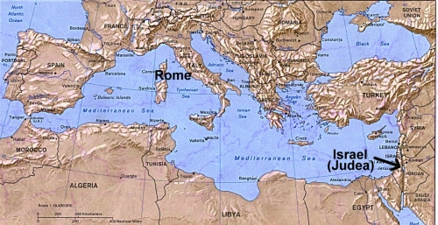
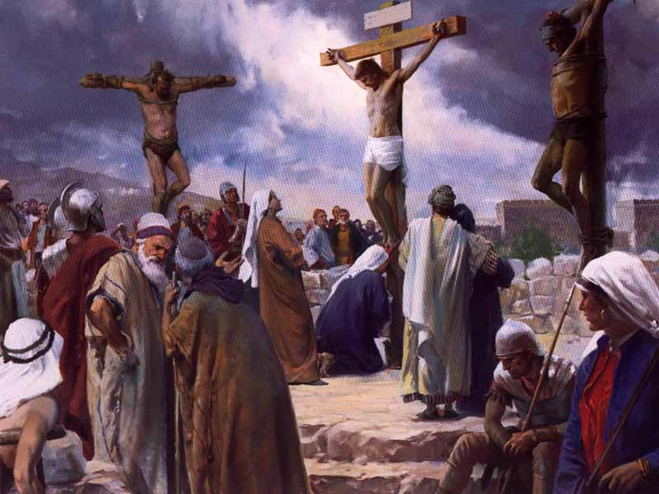
Rise of Christianity
Christianity was a new religion that developed in Roman-held lands in the Middle East.
Leading figure was a Jewish man named Jesus (Born around 4bc) → Messiah (savior sent by God)
The Roman authorities thought he was a dangerous troublemaker.
Jesus was executed by the Romans
His followers/ Students = Disciples → the first Christians
Romans persecuted Christians, however they organized and grew in power.
Christianity would shape Roman belief and society.
Crucifixion of Christ → Common method of execution

Slide 8
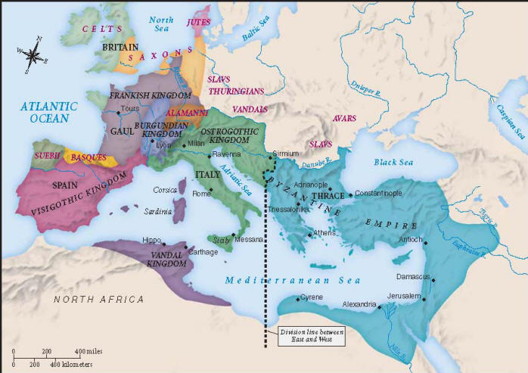
Western Roman Empire falls in 476
Death of Roman Emperor Marcus Aurelius (180 ad) turmoil rocked the empire:
The empire split!
Western Roman Empire:
Latin speaking → Capital: Rome
Eastern Roman Empire/ Byzantine Empire:
Greek speaking → Capital: Constantinople
Germanic leader Odovacar attacks and removes the last Western Roman Emperor from power in 476
Germanic tribes began to take over → Create small kingdoms: Visigoths, Franks, Vandals, Ostrogoth, Saxons, etc.
Byzantine Empire:
Lasted another 1000 years

Slide 9
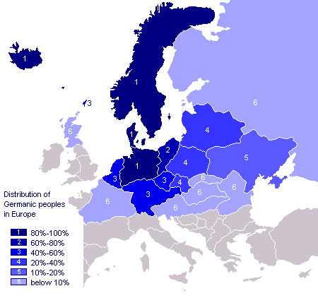
Germanic peoples:
AKA Teutonic, Suebian or Gothic in older literature
Indo-European ethno-linguistic group of Northern European origin → identified by their use of the Germanic languages

Slide 10
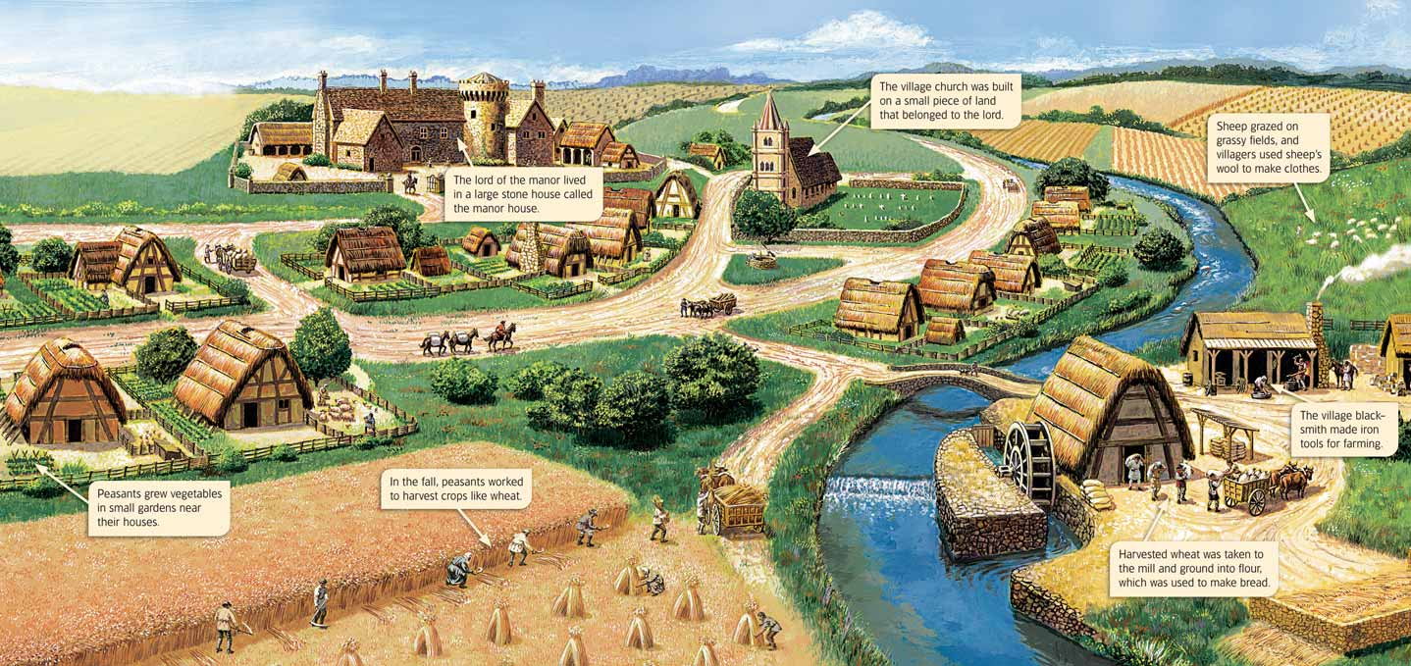
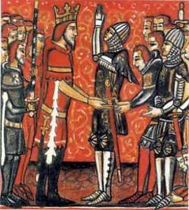
Rise of Europe:
Germanic people ended Roman rule in the West
When Germanic tribes took over, their rule differed because they did not have cities or written laws
Europe → small kingdoms between 400s and 700s
Charlemagne unified Western Europe in 800s
Holy Roman Empire
After his death Europe fell into a power struggle
New wave of invaders: Muslims and Vikings
The kings could not provide sufficient protection to the people so a system of Feudalism was born:
Feudalism: powerful lords would employ knights and armies and people would live on their lands for protection. In exchange, these vassals would give money and loyalty to the lords.
The Manor (Lord’s estates) was the center of the Medieval economy.

Slide 11
Map of Europe
Label the following cities AND their country on your map:
London
Paris
Versailles
Moscow
St. Petersburg
Rome
Florence
Berlin
Warsaw
Vienna
Munich
Prague
Dublin
Stockholm
Amsterdam
Sarajevo
Madrid
Istanbul
Using a textbook OR internet on your phone/tablet….
Label the following CITIES and it’s corresponding COUNTRIES on your map
Please be neat as you will use this to study for your map quiz on Thursday.
If you finish early → get started on your reading HOMEWORK

