Slide 1
Wednesday, September 13
TURN IN: EC with your name on the item(s)
TAKE OUT: Name tag,
Cultural Universal reading from yesterday
Objective:
Identify what it means to be human and why we have society/culture
Agenda:
Drill Extravaganza
Cultural Universals
Pi

Slide 2
Using the reading that you read last night (yellow paper - Cultural Universals)
Think about the Sammamish Plateau and the culture around here
Fill out the chart on the back as best you can
In each category write down words, groups, systems, concepts that make up the culture of the Sammamish Plateau

Slide 3
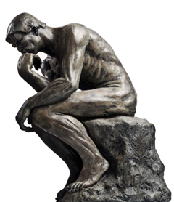
What are humans?
With your table group, brainstorm adjectives you would use to complete the following sentence:
Humans are _________

Slide 4
The dictionary defines humanity as...
group of humans
OR
quality or state of being human
WHAT MAKES US “HUMAN”?

Slide 5
Case Studies
We will spend the first month studying the emergence of humans and the development of human societies.
250,000 years in one month.
We will look at many civilizations.
Mesopotamia, Egypt, Assyria, Persia, Greece, Rome, China, India…
We will not become experts in each.
We are studying human beings. Each civilization tells us something interesting about human beings.
Facts and concepts.
Themes: romance, death, conflict,
Continuity and change (why do things change?)
Cause and effect thinking (how do things change?)
The individual and society.

Slide 6
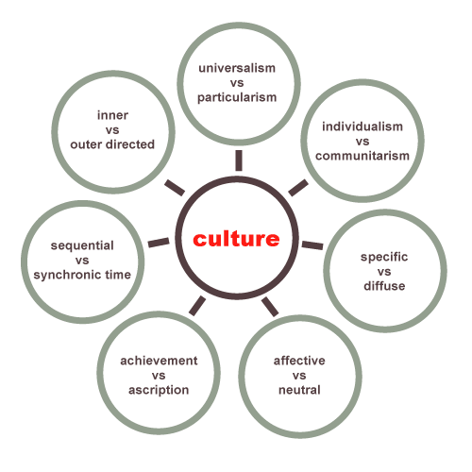
Culture
Culture is complex.
To understand it, it must be categorized and examined in parts.
As historians, we have created “8 Traits of Culture”
YOU will be reading the article, “Definitions Cultural Universals”

Slide 7
Cultural Universals
Yep, there are 8.
Memorize and apply!

Slide 8
Culture
Culture is all the things that make up a people’s way of life. Culture is the customary beliefs, social forms, and material traits of a racial, religious, or social group. The characteristic features of everyday existence shared by people in a place or time. Culture is the set of shared attitudes, values, goals, and practices that characterize a group.
(Source: “Culture,” Merriam-Webster’s Collegiate Dictionary, Eleventh Edition, 2005.)

Slide 9
Culture
Religion/World View
Arts and literature
Technology
Language
Economics
Government
Social Organizations
Customs and Traditions

Slide 10
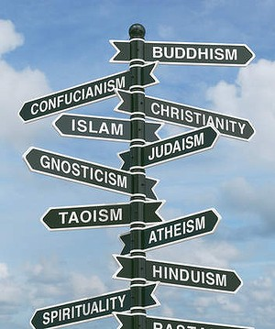
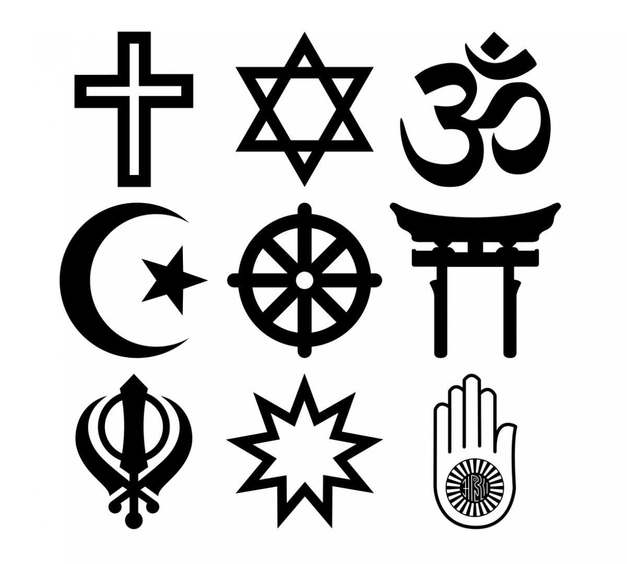
Religion/World View
The service and worship of a god or the supernatural
How did the universe begin? Why do humans exist? What is the meaning of life? How should we live? What is right/wrong? What happens to us when we die?

Slide 11
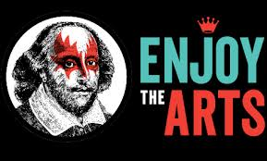
Arts and Literature
The conscious use of skill and creative imagination.
Aesthetics: An appreciation of the beautiful.
What forms of art do people value? What role do the arts play in people’s lives?

Slide 12
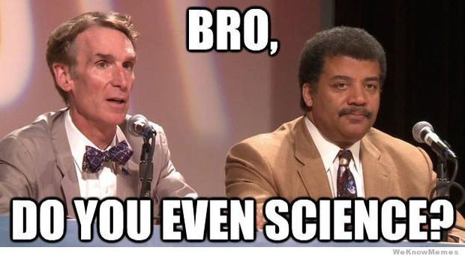
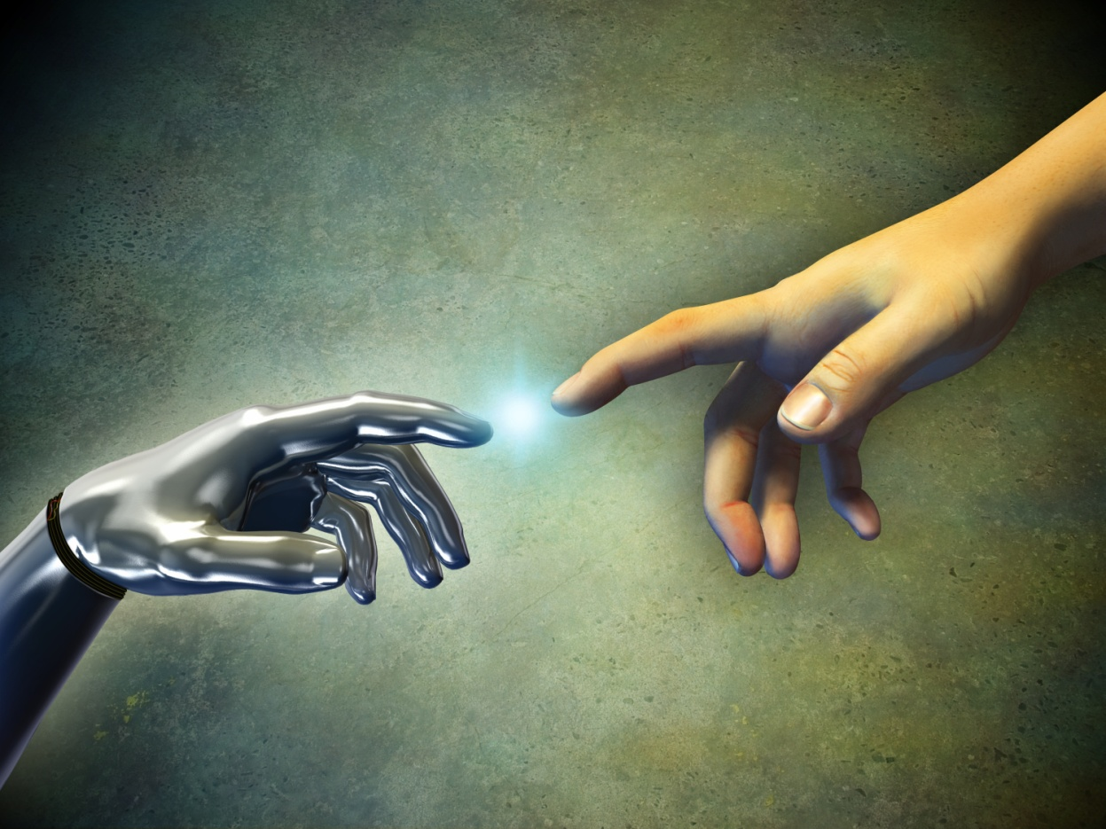
Science and Technology
Established systems of investigation, knowledge about, and manipulation and control of the natural world. This includes types of tools, weapons, shelter, agriculture, transportation, irrigation, and other methods of controlling and changing our environment.
How do people change their environment? What type of structures do people live in? What do people use technology for? What types of problems do people use technology to solve? What types of technology are considered important? How do people explain the workings of the natural world?

Slide 13
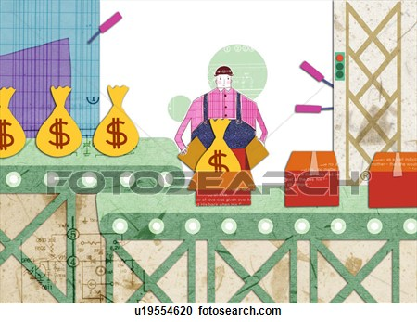
Economic Systems & Commerce
Methods dealing with the production, distribution, and consumption of goods and services. This how the society handles the problem of scarcity.
Scarcity: There is not enough of the things that people want.
Who gets what and why? What is used as currency? What is owned by individuals? What is owned by the community? How do people make a living?

Slide 14
Communication & Language
The process by which information is exchanged between individuals through a common system of spoken expression, symbols, signs, or behavior.
What language do people speak? How do people communicate? How do you display your status?
**What pictures should go in here? Talk with table mates & be prepared to share with large group!**

Slide 15
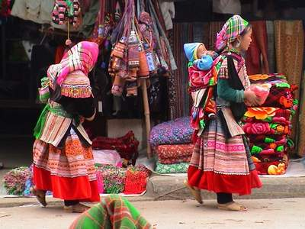
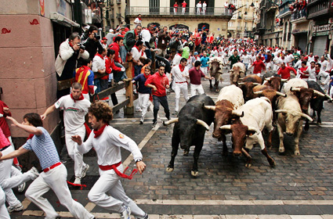
Customs and Traditions
A binding custom or practice of a community. Rituals, games, holidays, greetings, important values, etc.
What are the important holidays? What values and traditions do these holidays celebrate? What rituals mark changing status (adolescent→adult, or student→graduate)

Slide 16
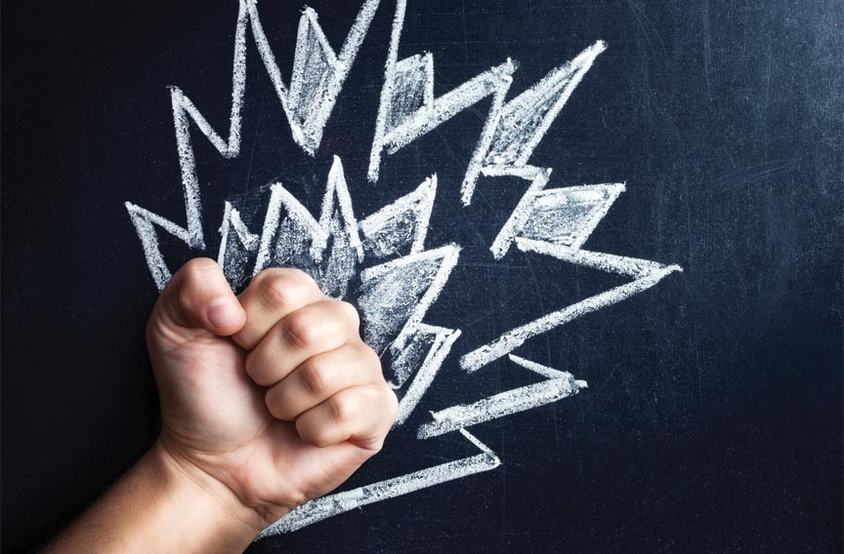
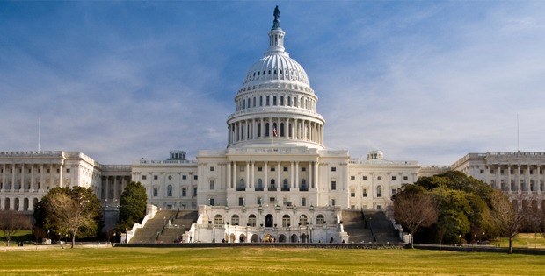
Forms of Government
The organization through which a group exercises authority.
Who makes the laws? Who enforces the laws? How is power distributed? How do we decide who gets power? What are the most important rules and laws?
Politics: The art or science concerned with gaining power and influencing or controlling government.

Slide 17
Social Organization
An established system of hierarchical relationships or status. Informal groups, families, types of relationships, etc.
How is status assigned? What is the status of women/ men? How does your age affect your life/ responsibilities?
**What pictures should go in here? Talk with table mates & be prepared to share with large group!**

Slide 18
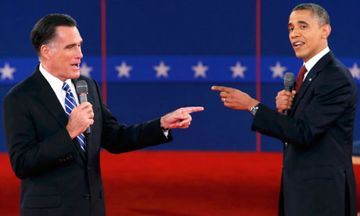
Which aspect of culture?
Notes:
Government
Language
Customs & traditions

Slide 19
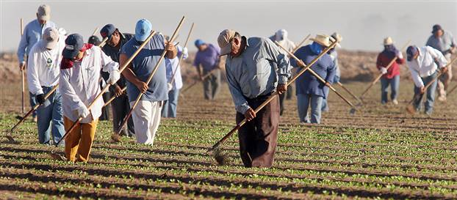
Which aspect of culture?
Notes:
Science & tech
economics

Slide 20
Which aspect of culture?
Notes:
social org, customs & traditions

Slide 21
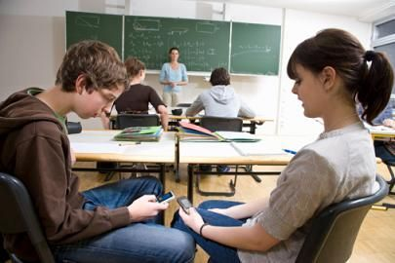
Which aspect of culture?
Notes:
technology

Slide 22
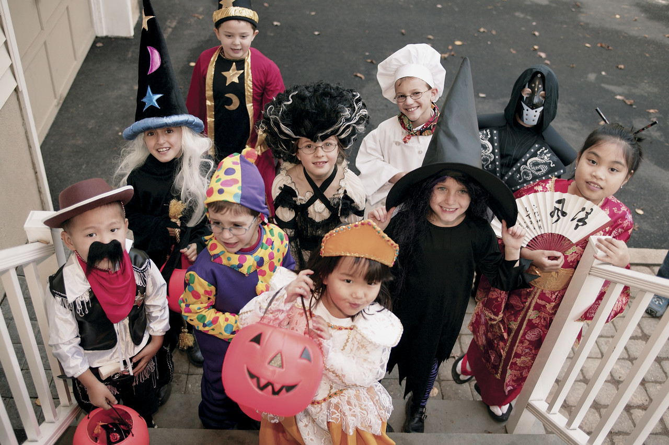
Which aspect of culture?
Notes:
customs & traditions

Slide 23
Which aspect of culture?
Notes:
science & tech

Slide 24
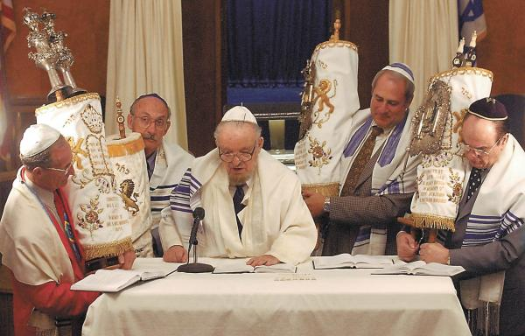
Which aspect of culture?
Notes:
religions

Slide 25
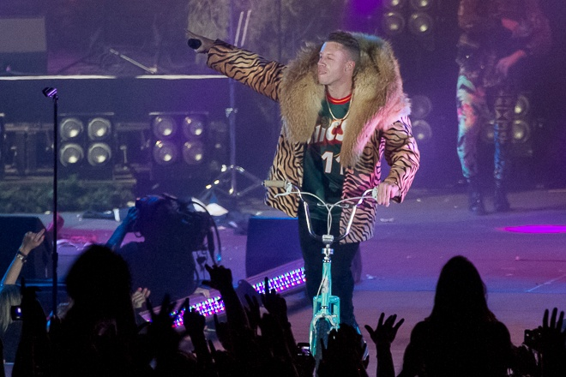
Which aspect of culture?
Notes:
customs & traditions
art & literature

Slide 26
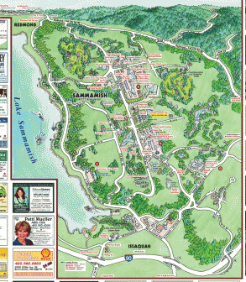
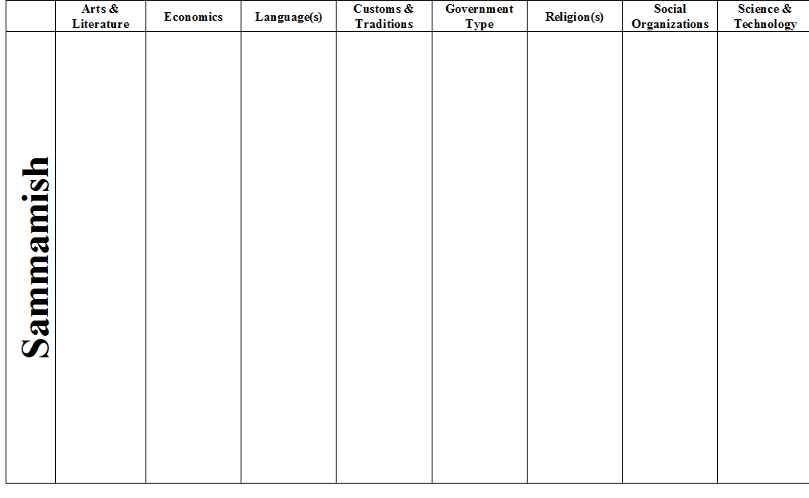
Sammamish Culture
I’m from Seattle & live in Bellevue
Please, help me understand Sammamish Culture.

