Slide 1
Wednesday, September 14
TURN IN: nothing
TAKE OUT: Name tag
PICK UP: Nacerima reading (yellow)
Objective:
Identify what it means to be human and why we have society/culture
Agenda:
Cultural Universals
Maslow

Slide 2
The Nacirema (extract from original articles by Horace Miner in American Anthropologist, 1956)
Use the reading strategies you learned in LA
Recalling
Visualize
Make connections
Make inferences
Ask Questions
Analysis
Self-monitoring

Slide 3
STRATEGY 1: RECALLING
Recalling text is your ability to accurately summarize what happened.
If you don’t know what happened, you can’t analyze—or deduce meaning from—the text

Slide 4
STRATEGY 3: MAKING CONNECTIONS
There are three types of connections:
TEXT-TO-SELF (This reminds me of that time I…)
TEXT-TO-TEXT (This reminds me of this other book…)
TEXT-TO-WORLD/HISTORY (This reminds me of the current/past event/issues…)

Slide 5
STRATEGY 4: MAKING INFERENCES
When you draw an inference, you take what the reader has explicitly said and add your knowledge of the world/history in order to make a logical assumption
Aka, you “read between the lines”
Drawing inferences is important because it forces you to relate (in some way) to what’s happening to the text, and then interact with the text in order to piece in the missing information
Doing this helps you care more and remember more easily!

Slide 6
STRATEGY 5: ASKING QUESTIONS
We have tons of questions while reading—but we rarely write them down.
Surfacing uncertainties and tracking questions is actually crucial to understanding.
Questions may include: What does this word mean? Why would the author write this text? What is the historical context? What do you wonder?

Slide 7
STRATEGY 6: ANALYSIS
TRY TO MAKE SENSE OF THE PAST WITH THE ARTIFACTS (TEXT, ART, etc) THAT WE HAVE
This may include:
Noting what what’s going on at the time when this source is produced, major events/movements
Writing WHY you think the author would have written this
How does this artifact help add to our understanding of the time period, another document, concept, or theme?

Slide 8
Thoughts on the Nacirema?
What aspect of culture do we see described in the text? (connection to Cultural Universals)

Slide 9
Thoughts on the Nacirema?
NACIREMA = AMERICAN
daily mouth-rite = brushing our teeth
holy-mouth-man = dentist
Why do you think we made the judgments we did on those people?
What’s the author’s purpose?

Slide 10
ETHNOCENTRISM
judging another culture by the values and standards of your own culture.

Slide 11
ETHNOCENTRISM: HOW DOES IT HAPPEN?
Members of a group make strong connections with other members.
This bond produces positive feelings toward members of the group.
Sometimes causes negative feelings toward outsiders.

Slide 12
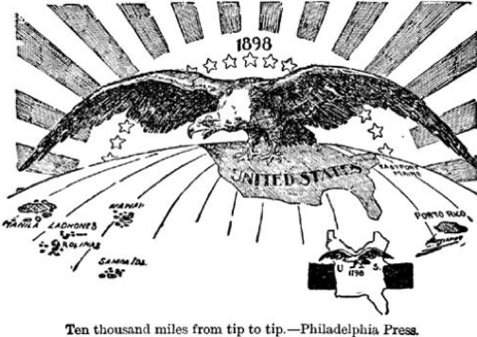

Slide 13
