Slide 1
Africa Unit & Research Paper
Keep all notes and handouts because you will need it for your Africa Research paper
We will start in 2 weeks!

Slide 2
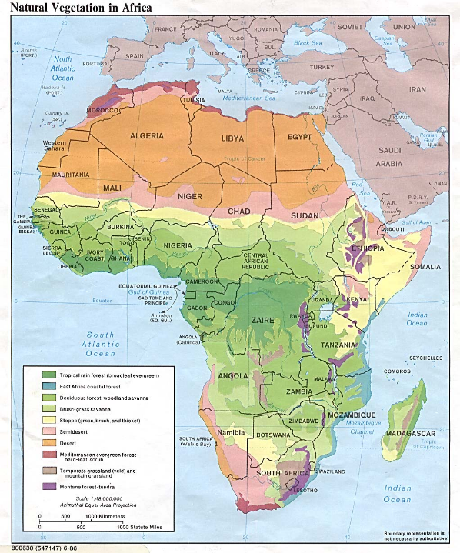
Early Civilization of Africa
Geography
Geography affected migration, cultural development, and trade during the time of early civilizations in Africa.
Sahara dried out (desertification) → migration
Bantu Migration
West African farmers & herders migrated south and east between 1000 BCE and 1000 CE
Cultural diffusion → Bantu culture/language spreads down to southern Africa where there were already different cultures and peoples there

Slide 3
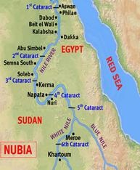
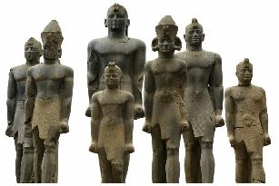
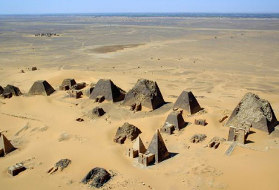
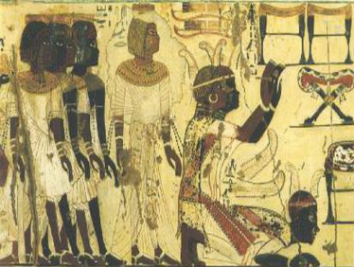
Early Civilization of Africa
Egyptian & Nubian Civilizations
Civilizations developed around the banks of the Nile River
Northern banks of the Nile → Egypt
Southern banks of the Nile → Nubia
Trade lead to contract between Egypt and Nubia
1500 BCE Nubia falls under Egyptian control for 500 years
Egyptian culture diffused into Nubian culture
Egyptian gods, art & architecture was borrowed into Nubian culture
Nubians will gain independence and conquer Egypt by 730 BCE
Cultural diffusion

Slide 4
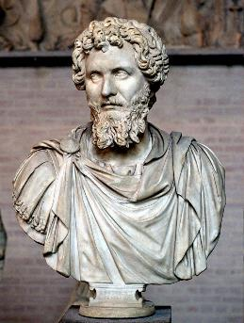
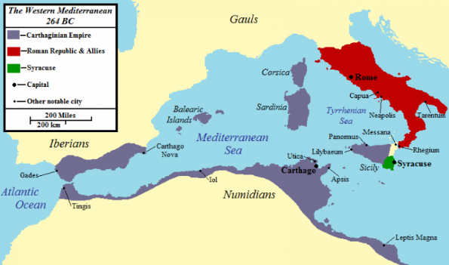
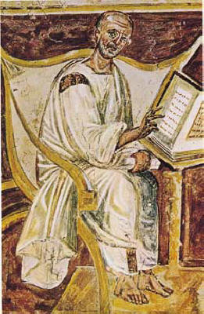
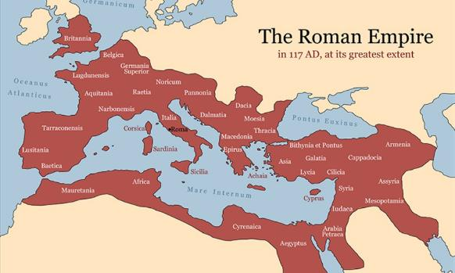
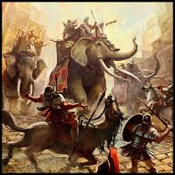
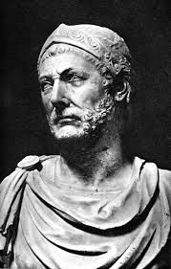
Early Civilization of Africa
Outside influences affect North Africa
Phoenicians
Semitic people from between Mediterranean and Fertile Crescent (Mesopotamia/Iraq)
Phoenician trades founded a kingdom in North Africa called Carthage (800 BCE – 146 BCE)
Carthage stretch from present day Tunisia, Algeria, Morocco, to southern Europe
Roman will ultimately conquer Carthage
Romans
North Africa farmlands feed the Roman Empire
North Africa provided soldiers for the Roman Empire
Under Roman rule, Christianity spread across North Africa

Slide 5
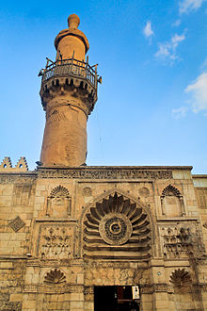
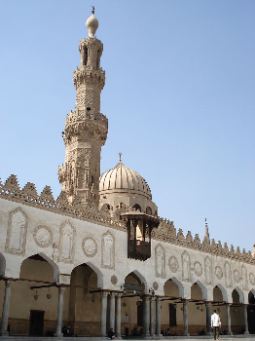
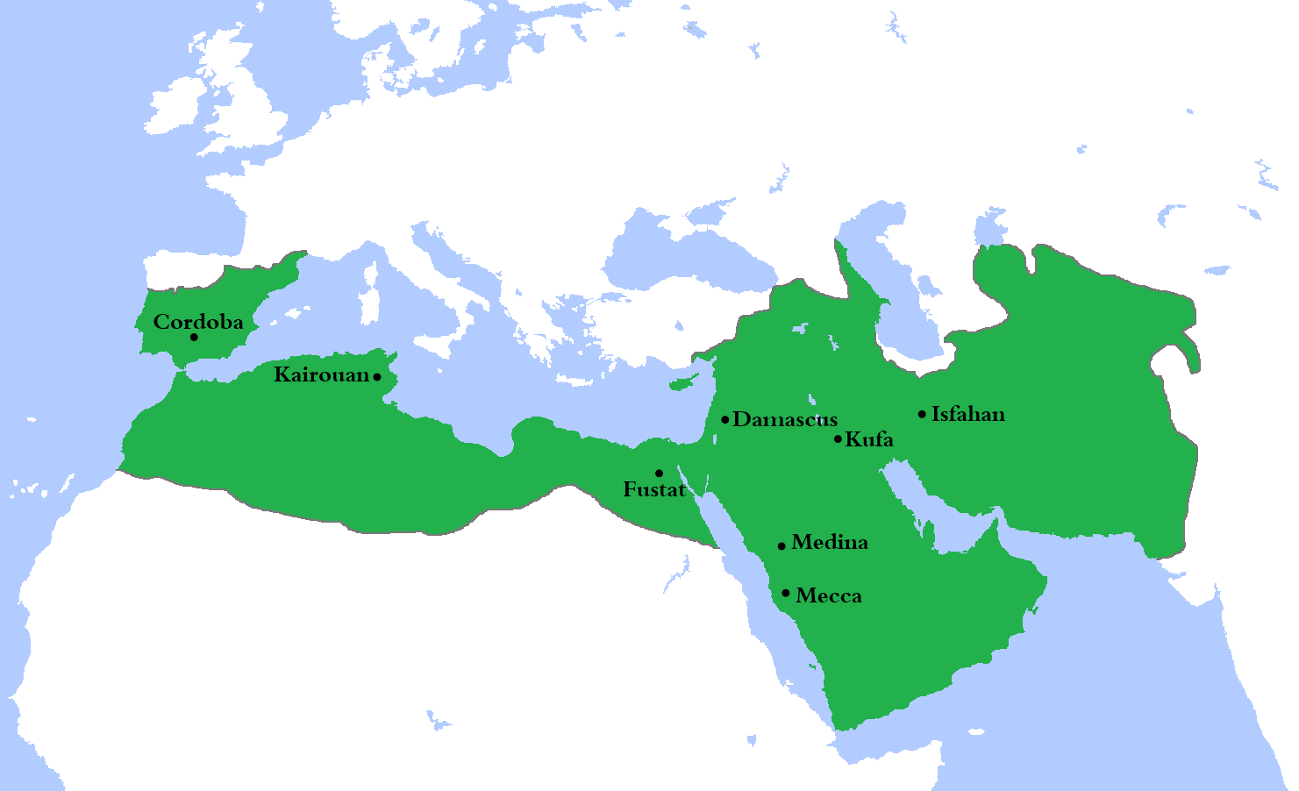
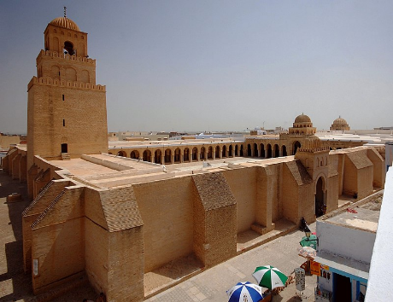
Early Civilization of Africa
Outside influences Affect North Africa
Arab/Islam
690 CE Arab Muslims conquered North Africa
Islam replaced Christianity as a the dominate religion in the region
Arabic replaced Latin as language
Arabization of North Africa → adopting Arab culture, customs, language, and identify

Slide 6
Turn & Talk - Cultural Diffusion
American culture as a major impact around the world, can you think of examples of American cultural diffusion?
What are some costs and benefits of cultural diffusion?

Slide 7
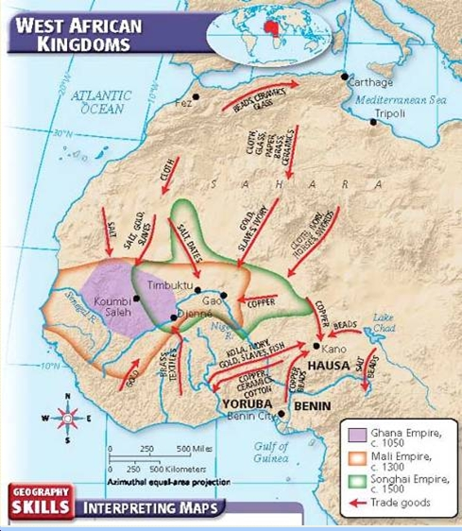
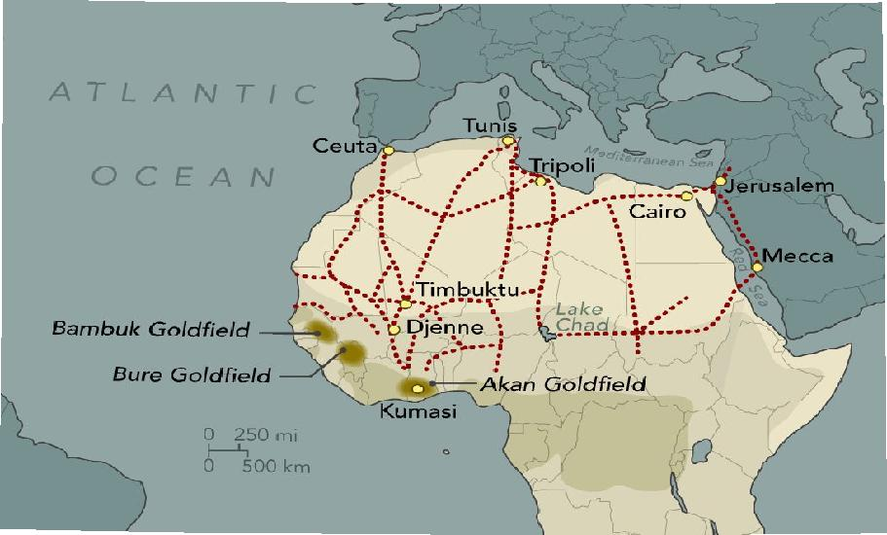
Kingdoms of West Africa
Sahara desertification → people migrated south → towards savanna (grasslands)
Trading cities & kingdoms
Major commodity in the region: salt & gold
Gold: present-day Ghana, Nigeria, Senegal
Salt: the Sahara

Slide 8
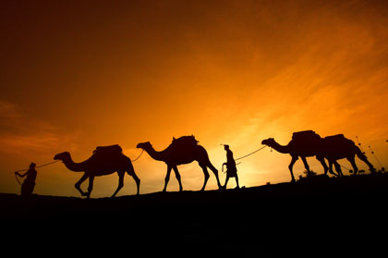
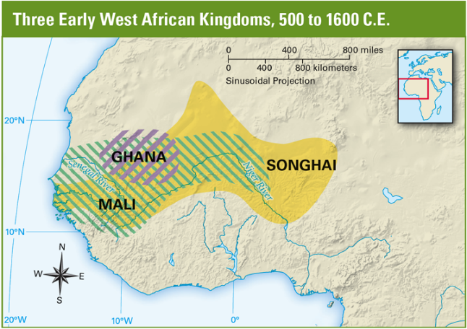
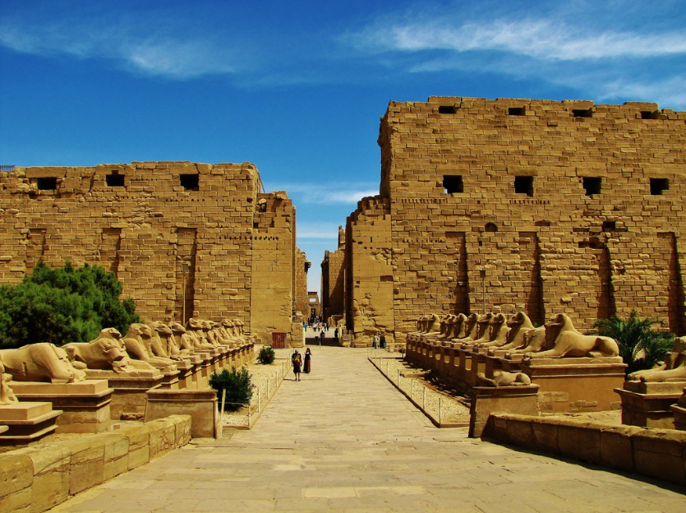
Kingdoms of West Africa
Ghana Empire
Soninke people united farm village into kingdom 800 CE
Located between Niger and Senegal River
Ghana kings controlled the salt & gold trade with Muslim merchants →
Arab writers called Ghana, “the land of gold”
Muslim merchants brought Islam to Ghana
North American Muslims conquered Ghana but was not able to maintain control

Slide 9
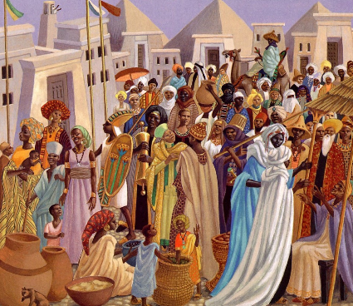
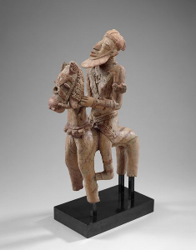
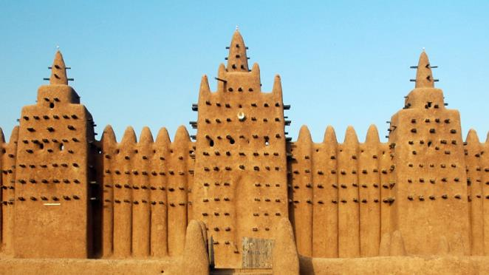
Kingdoms of West Africa
Mali Empire
Mandinka people on the upper Niger River
Won control of the gold trade routes, absorbed Ghana
Mali acquired Islam from merchants
Practiced a syncretic version of Islam
Mixed Islam with their own cultural practices
Ex. Mali culture was semi-matrilineal, women had lots of authority & respect, this practice continued even with the adoption of Islam
Syncretism

Slide 10
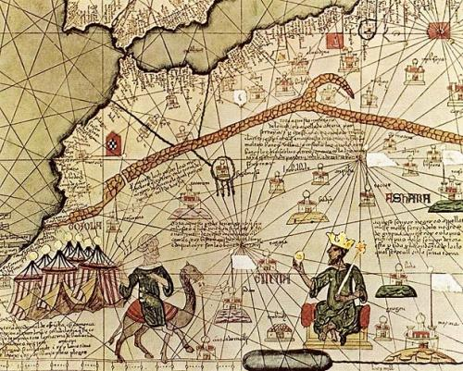
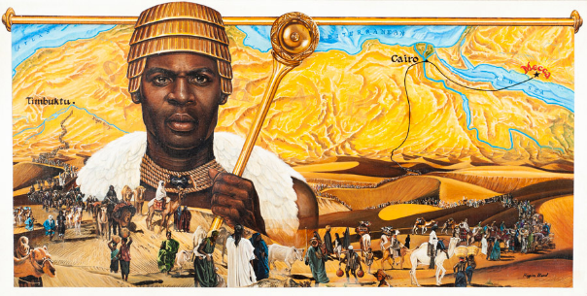
Kingdoms of West Africa
Mansa Musa (1312-1337)
Greatest ruler of Mali
Expanded Mali’s border westward
Ensured peace & order
Converted to Islam, based his system of justice on the Qu’ran
Did not impose Islam on his kingdom → religious freedom & tolerance
Went on an epic pilgrimage to the Mecca
Notes:
Started around 1324 - 1325
60,000 men
12,000 slaves each carrying 4 pounds of gold bars
heralds dressed in silks who bore gold staffs
80 camels each carrying 50 – 300 pounds of gold dusk
Musa provided all necessities for the procession
Gave gold to the poor he met along his trip
Gave to cities he passed on the way (Cairo, Medina, etc)
Traded gold for souvenirs
Some writings claimed that he built a mosque (Islamic holy house) each & every Friday
Musa's generous actions inadvertently devastated the economy of the regions through which he passed. In the cities of Cairo, Medina, and Mecca, the sudden influx of gold devalued the metal for the next decade.
Prices on goods and wares greatly inflated. To rectify the gold market, on his way back from Mecca, Musa borrowed all the gold he could carry from money-lenders in Cairo, at high interest.

