Slide 1
Annotated Bibliography
an annotated bibliography includes a summary and evaluation of each of your sources

Slide 2
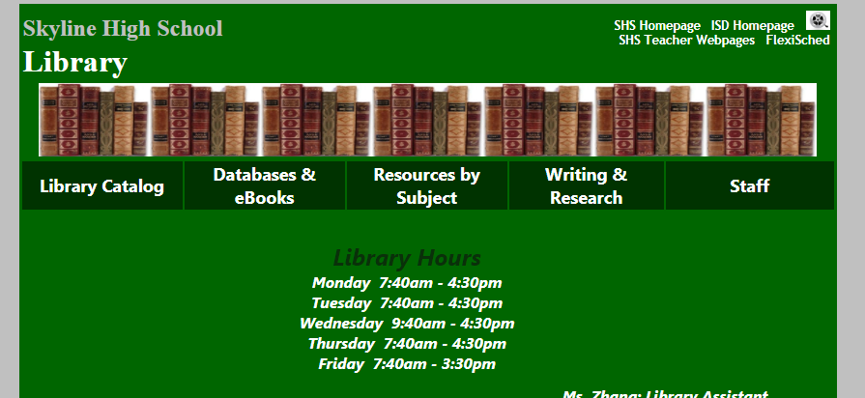
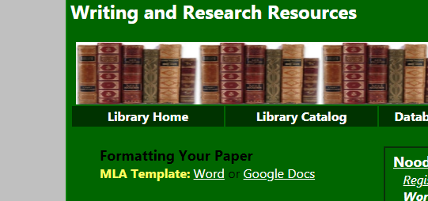
Create a new, MLA formatted document
Skyline Library page:
Writing & Research
MLA Template which ever you prefer: Word or Google

Slide 3
Personalize the document
Notes:
Due date: check with teacher
Required title: Annotated Bibliography
And remove
“Begin fist paragraph…”
And page 2 of the template
you do not need a Works Cited page for an annotated bibliography

Slide 4
The four parts of an annotated bibliography:
Citation
Summary
Evaluation
Reflection

Slide 5
1. MLA Citation
Complete and formal MLA citation

Slide 6
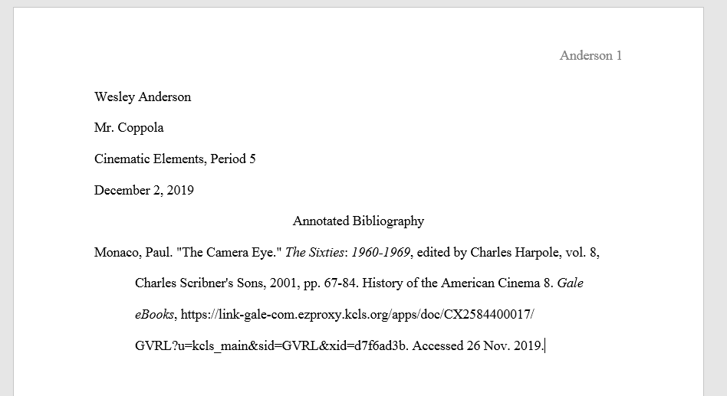
1. MLA Citation
Monaco, Paul. "The Camera Eye." The Sixties: 1960-1969,
edited by Charles Harpole, vol. 8, Charles Scribner's Sons,
2001, pp. 67-84. History of the American Cinema 8. Gale
eBooks, https://link-gale-com.ezproxy.kcls.org/apps/doc/
CX2584400017/GVRL?u=kcls_main&sid=GVRL&xid=
d7f6ad3b. Accessed 26 Nov. 2019.
Complete and formal MLA citation

Slide 7
2. Summarize
What are the main arguments?
What is the point of this book or article?
What topics are covered?
If someone asked what this article/book is about, what would you say?

Slide 8
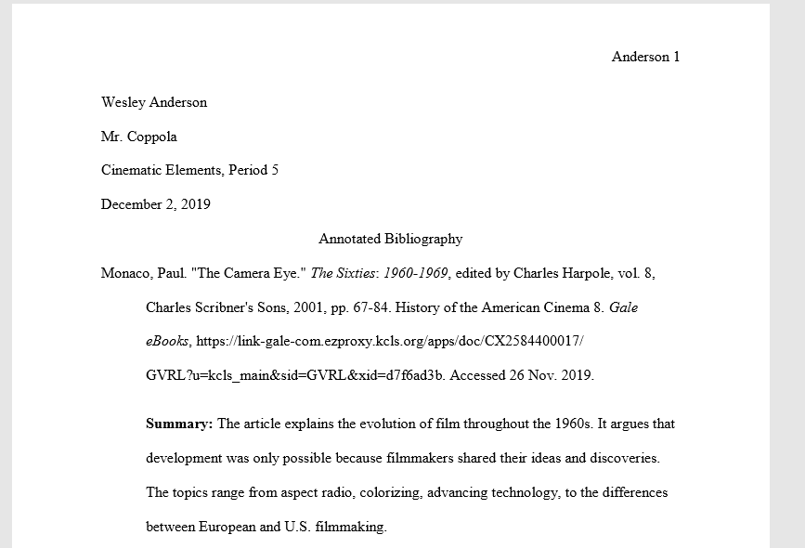
2. Summarize
The article explains the evolution of film throughout the 1960s. It argues that development was only possible because filmmakers shared their ideas and discoveries. The topics range from aspect radio, colorizing, advancing technology, to the differences between European and U.S. filmmaking.
What are the main arguments?
What is the point of this book or article?
What topics are covered?
If someone asked what this article/book is about, what would you say?

Slide 9
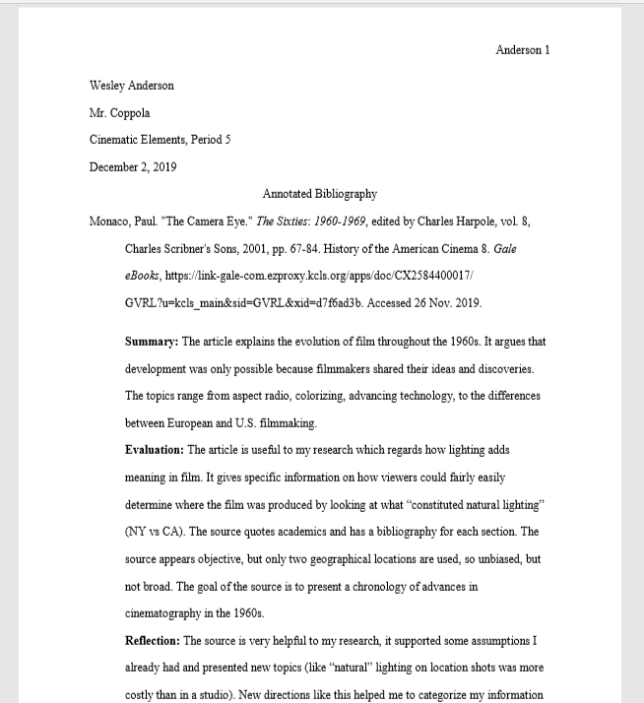
Last note: all your annotated text must be indented
the author's last name (or if no author, the article title) is the only text that is flush left

Slide 10
3. Evaluation/Assessment
Is it a useful source?
How does it compare with other sources in your bibliography?
Is the information reliable?
Is this source biased or objective?
What is the goal of this source?

Slide 11
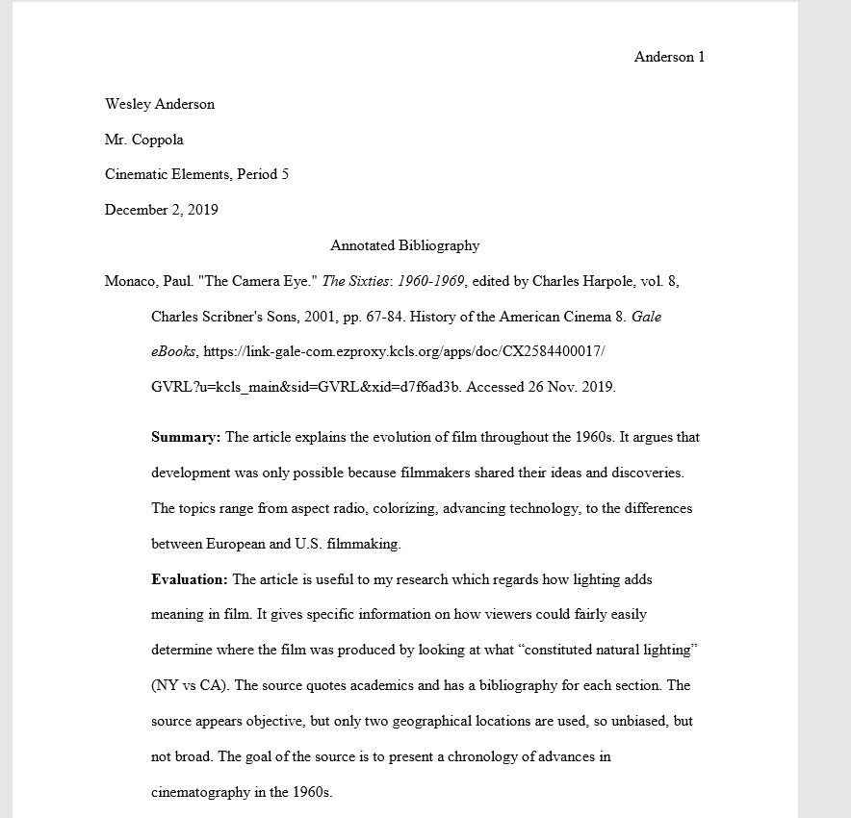
3. Evaluation/Assessment
The article is useful to my research which regards how lighting adds meaning in film. It gives specific information on how viewers could fairly easily determine where the film was produced by looking at what “constituted natural lighting” (NY vs CA). The source quotes academics and has a bibliography for each section. The source appears objective, though comparisons are made from just two geographical locations so unbiased, but not broad. The goal of the source is to present a chronology of advances in cinematography in the 1960s.
OPCVL Evaluation
Consider the language of the source (particularly your poem and the fact that it’s a work in translation)

Slide 12
4. Reflection
Was this source helpful to you?
How does it help you shape your argument?
How can you use this source in your research project?
Has it changed how you think about your topic?

Slide 13
4. Reflection
The source is very helpful to my research, it supported some assumptions I already had and presented new topics (like “natural” lighting on location shots was more costly than in a studio). New directions like this helped me to categorize my information and formulate an outline. This source has made me even more curious about my topic and help me learn more rather than get frustrated with the same information over and over.
Was this source helpful to you?
How does it help you shape your argument?
How can you use this source in your research project?
Has it changed how you think about your topic?

Slide 14
Works Cited
Purdue Writing Lab. “Annotated Bibliographies // Purdue Writing Lab.” Purdue Writing Lab, https://owl.purdue.edu/owl/general_ writing/common_writing_assignments/annotated_bibliographies/ index.html.

