Slide 1
Homework
Research a current fascist group in Europe & the reason behind their appearance in modern Europe
Where are they from?
Who are they? What is their message?
Who do they hate? Who do they blame for problems in their country?
Compare these organizations/groups to Fascism/Nazism of 1930s-40s

Slide 2
WHO?
Allies
Axis
(major powers)
(major powers)
Great Britain
Germany
Russia
Italy
United States
Japan
France
(note: France surrendered to Germany in 1940 (after 6 weeks of fighting)

Slide 3
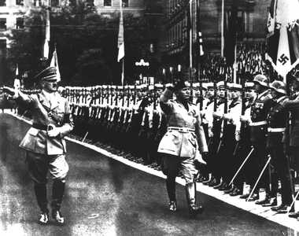
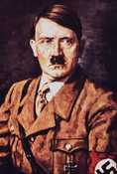
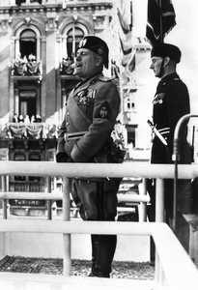
Major Leaders
Adolf Hitler
Nazi Germany
Benito Mussolini
Italy

Slide 4
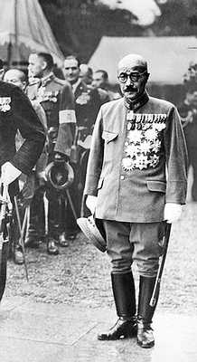
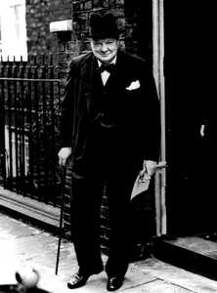
Major Leaders
Hideki Tojo
Japanese Prime Minister
Winston Churchill
British Prime Minister

Slide 5
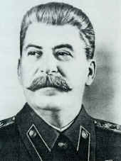
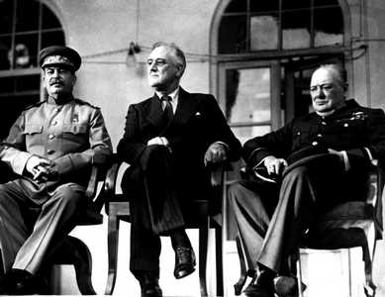
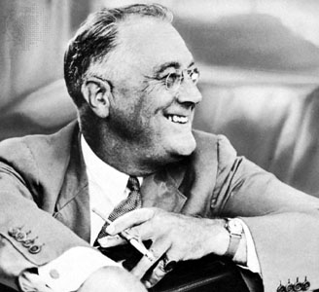
Major Leaders
Joseph Stalin
Russian Leader
Franklin Delano Roosevelt
US President

Slide 6
WHY?? (Causes of World War II)
Resentment at the harsh peace of WWI fueled the rise of Adolf Hitler.
Anxious to avoid war,
Britain and France chose to appease (appeasement) German territorial demands before finally 'drawing a line in the sand' over Poland.
United States decided to be isolationist to avoid getting involved in another European war
Political instability and economic devastation in Europe resulting from WWI
Worldwide depression
High war debt (Treaty of Versailles) owed by Germany
High Inflation
Massive unemployment

Slide 7
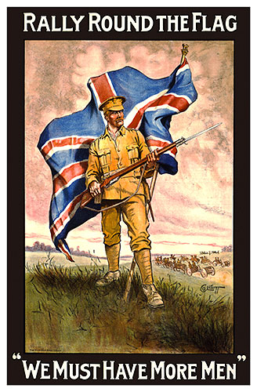
WHY?? (Causes of World War II)
Extreme nationalism (ultra-nationalism) gave rise to Fascism in Italy and Nazism in Germany and caused Japan to colonize Asia.
To support nationalism, countries increase their military strength to get what they want.
Notes:
It is an extreme form of having pride in one’s country. It creates a situation in which people think, “My country and people are the best, we deserve the best, and we’re going to take it from you.”

Slide 8
Rise of Totalitarian Regimes
In a Totalitarian country, individual rights are not viewed as important as the needs of the nation. The government controls every aspect of public and private life.
Communist Dictatorship (USSR)
Fascist Dictatorship (Germany, Italy)
Totalitarianism
Military Dictatorship (Japan)

Slide 9
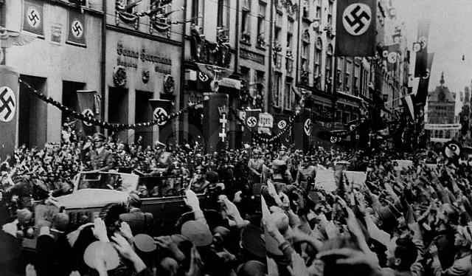
What else did Hitler get?
Hitler peacefully annexed (took over) Austria in 1938.
Hitler signed a nonaggression pact with the USSR.
They agreed not to fight each other and split Poland between them
Hitler would later break the pact and attack the USSR.
The USSR then became one of the Allies fighting Germany.
Hitler's triumphal entry into Danzig, Poland 1939

Slide 10
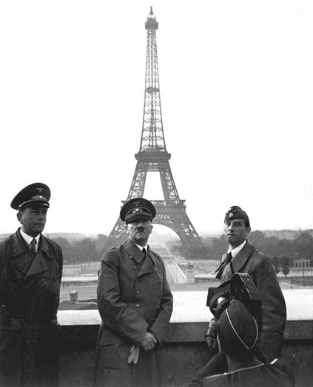
How Did Hitler Make War?
In the next year, Hitler invades:
Denmark
Norway
The Netherlands
France
Blitzkrieg = “Lightning War”
Hitler in Paris

Slide 11
Hitler is elected in Germany
1933
Treaty of Versailles Revoked
1936
Appeasing Hitler
US drops Nuclear Bombs on Hiroshima and Nagasaki
WWII ends
August 6 & 9, 1945
Francisco Franco
takes power in Spain
1939
Italy Invades Ethiopia
1935
Japan Bombs Pearl Harbor
US Enters the War
Dec 7 1941
Munich Conference
1938
1937
Japanese took over most of east China = 2nd Sino Japanese War
1931
Japan takes over Manchuria
(N. China)
Sept 1939
Nazis invade Poland
WWII Starts (in Europe)
August 1939
Nazi-Soviet Pact
April 30th 1945
Hitler Suicide
1935
US passes Neutrality Acts
US is staying the heck out of this war!!
Some say that WWII actually started in Asia in 1937

Slide 12
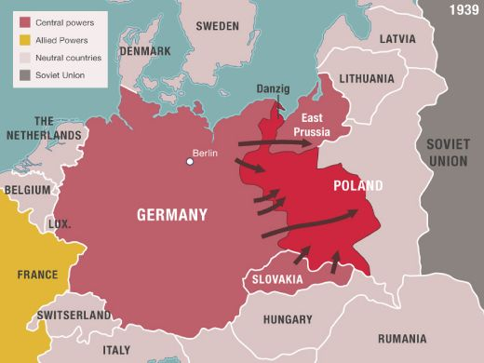
Germany invaded Poland September 1, 1939. This marks the beginning of WWII.

Slide 13
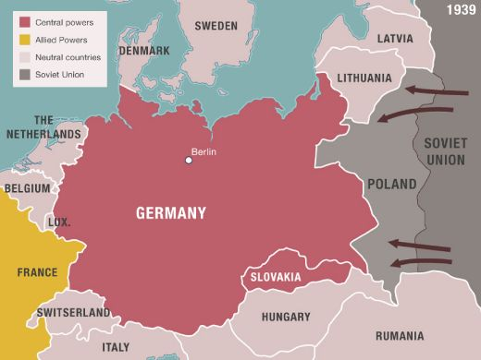
The Soviet Union also invaded Poland and the Baltic nations.

Slide 14
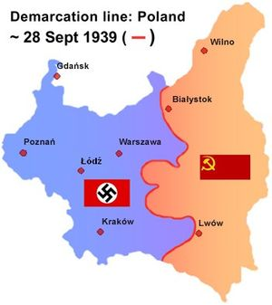
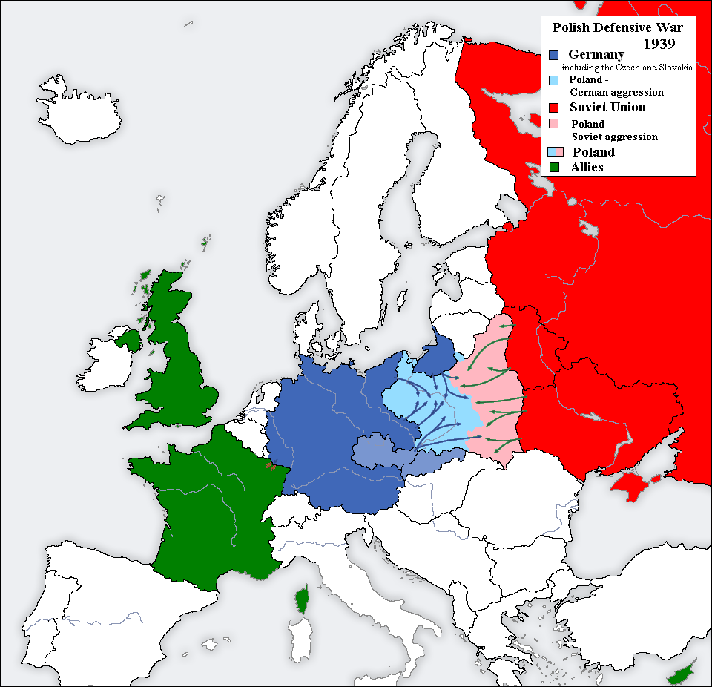

Slide 15
During WWII, the Nazis murdered more than 6 million people in the name of racial purity
Kristallnacht, “Night of Broken Class” refers to wave of violent anti-Jewish attacks throughout Germany & its occupied territories.
Sept 1938
Polish Jews are forced into ghettos & wear Star of David on body at all time
1939
Nazis take over Hungary, deport 12,000 Hungarian Jews a day to Auschwitz to die
1944
Hitler becomes German chancellor
1933
Germany attacks USSR, kills 33,000 Russian Jews
1941
Sept 1935
Nuremberg Laws: took away German Jews’ citizenship, banned them from marry or having sexual relations with Germans, identified “Jew” not by religion but ethnic (one Jewish grandparent), banned from military, universities, hospital, and restricted from doing many jobs
1940
Nazis deport German Jews to Poland.
Concentration camps are set up to mass murder Jewish people and any the Nazis saw as “undesirables”
1942
Nazis began discussing a “Final Solution” to Jewish problem.
Mass deportation of Jews from Germany, Greece, and Norway to extermination centers.
Jan-April 1945
Allies liberated the concentration camps and discover the horror
March1938
Germany annexes Austria, attacks on Austrian Jews

