Slide 1
November 30th
Take Out:
Homework
Blank notes sheet
Motives for Imperialism Notes
Pick up:
Handouts on both sides of the room
Learning Objective:
Understand the impact of imperialism in Africa by doing a case study on the Congo
Practice critical readings skills
HOMEWORK:
Read Response to Imperialism by Africans on Actively Learn

Slide 2
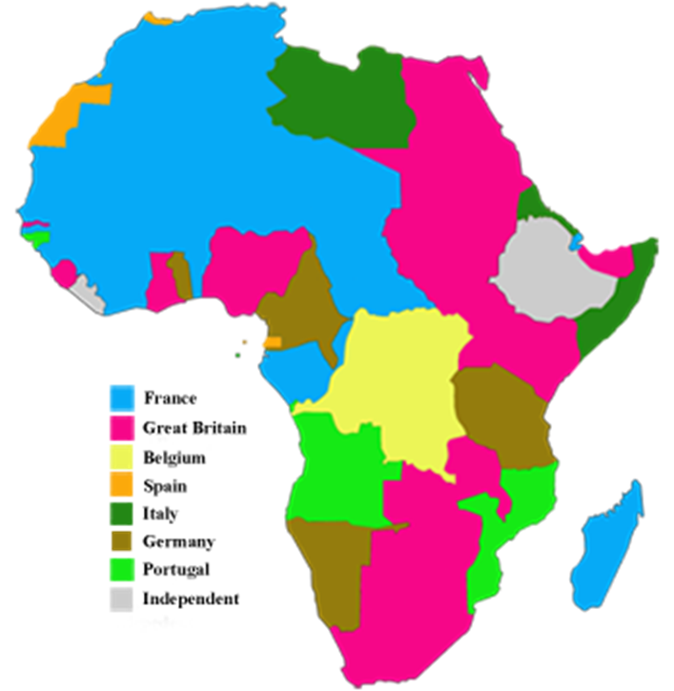
What was the Scramble for Africa?
Berlin Conference (1885): meeting between European countries to divide up Africa
Economics & nationalism was the driving force
Superior European technology lead to rapid European conquest

Slide 3
Nationalism is the loyalty of a people to their values, traditions, and geography.

Slide 4
**Add Nationalism to your Motives for Imperialism notes
Economic Interest
Military & Political Motives
Motives for Imperialism
Religious Goals
Ideological
Social Darwinism
White Man’s Burden
Nationalism

Slide 5
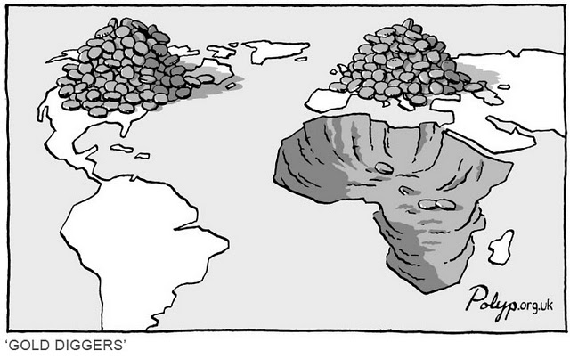
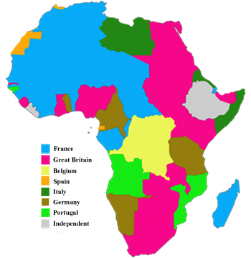
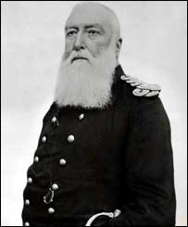
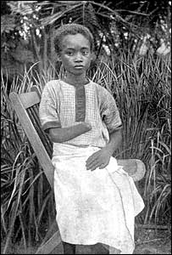
How does imperialism affect Africa?
The Case of the Congo
Notes:
https://youtu.be/qx2Sj1fhSso

Slide 6
Letter from King Leopold II of Belgium to Colonial Missionaries, 1883
Take out your handout for how to Critically Read Historical Sources

Slide 7
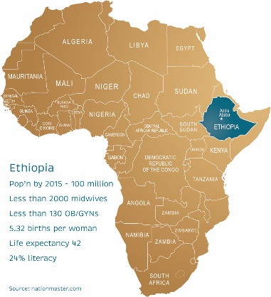
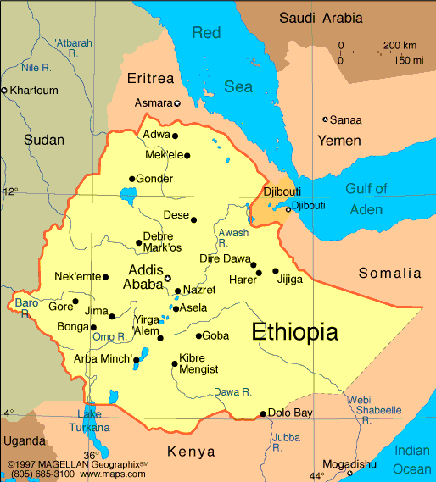
There was African resistance to imperialism: Ethiopia
Italian invaded Ethiopia in 1896
Ethiopian army defeated Italian troops in Battle of Adwa
Why could Ethiopia defeat the Italians?
Strong leader: Menelik II
Played European powers off each other
Italy was a weaker than other European countries

