Slide 1
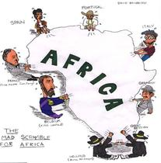
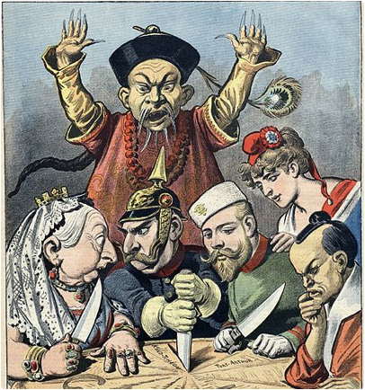
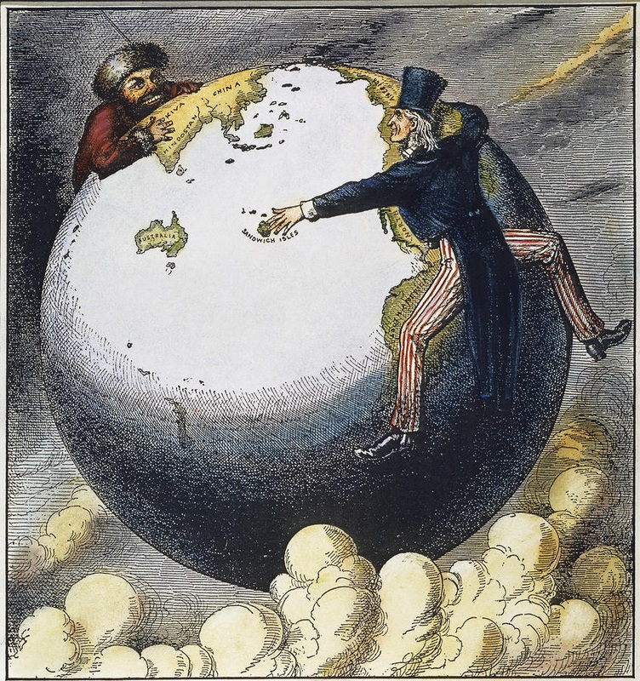
Costs and Benefits of Imperialism in Africa

Slide 2
Costs and Benefits of Imperialism
While imperialism certainly had an immediate impact, it had several powerful long-term effects which are still noticeable today.

Slide 3
Costs

Slide 4
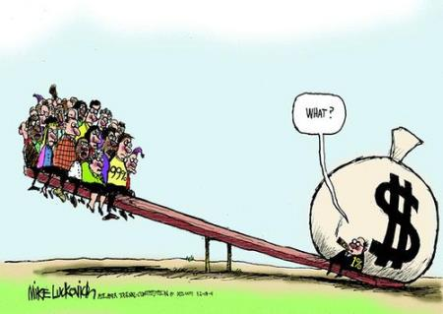
1. Income Gap
European nations took raw materials, labor, and taxes from their colonies.
Hinders their economic development after independence

Slide 5
2. Rivalry and Competition Between European Powers
European nations would fight each other in Asia and Africa for territories in Asia and Africa
Lead to major wars

Slide 6
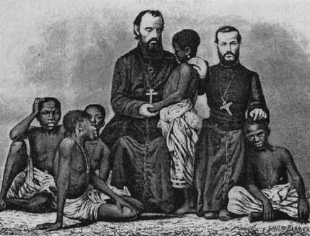
3. Destruction of Traditional Family and Village Life
Europeans often imposed their ways of life & culture on the people they imperialized.
Force labor/taxation policies also destroyed families

Slide 7
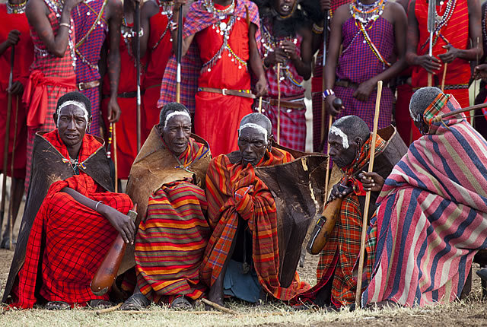
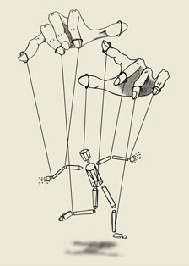
4. Loss of Self-Rule
Local governments & people no longer had a say in how their country was run
Europeans imposed their laws upon the colonies

Slide 8
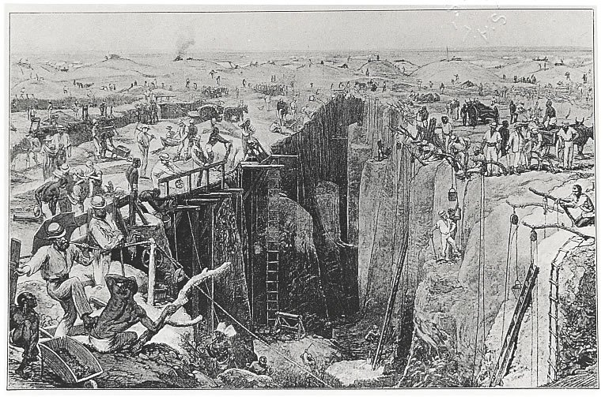
5. Widespread Famine
In many areas, European rulers implemented a forced labor system to collect raw materials or grow cash crops instead of farm real food

Slide 9
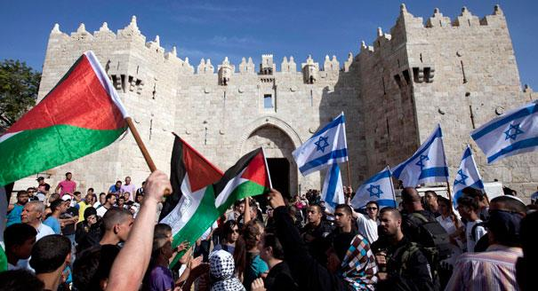
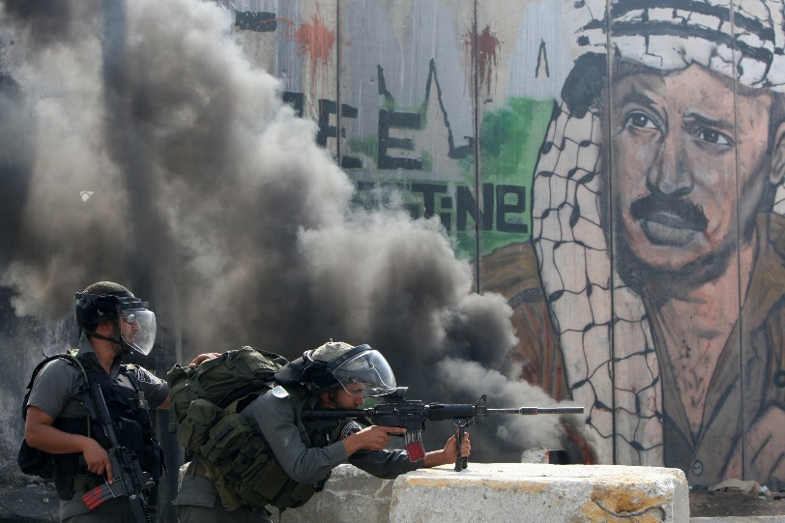
6. Internal conflict: Tension between ethnic groups
After European interference many ethnic groups began fighting amongst themselves within the imperialized countries.
Europeans did not consider pre-existing borders or issues within these countries.

Slide 10
EXAMPLE

Slide 11
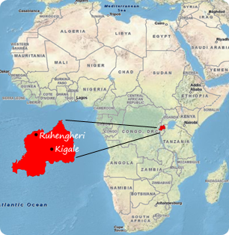
Rwanda Genocide
Genocide: The deliberate killing of a large group of people, especially those of a particular ethnic group or nation.
Rwandans: 3 ethnic groups: the Hutu, Tutsi and Twa.
Germany colonized Rwanda in 1884
Belgium colonized in 1916 during World War I
ruled through the kings (Indirect rule): put Tutsi in power
The Hutu population revolted in 1959
Independence 1961
Hutu killed Tutsi → Hutu-dominated state in 1962
The Tutsi started a civil war in 1990
1994 genocide: Hutu extremists killed an estimated 500,000 to 1 million Tutsi and moderate Hutu
The Tutsi Militia (RPF) ended the genocide with a military victory.
http://www.history.com/topics/rwandan-genocide/videos/rwanda-background-to-genocide

Slide 12
Rwanda Genocide
How did Western (European) imperialism lead to genocide (Rwanda)

Slide 13
Benefits

Slide 14
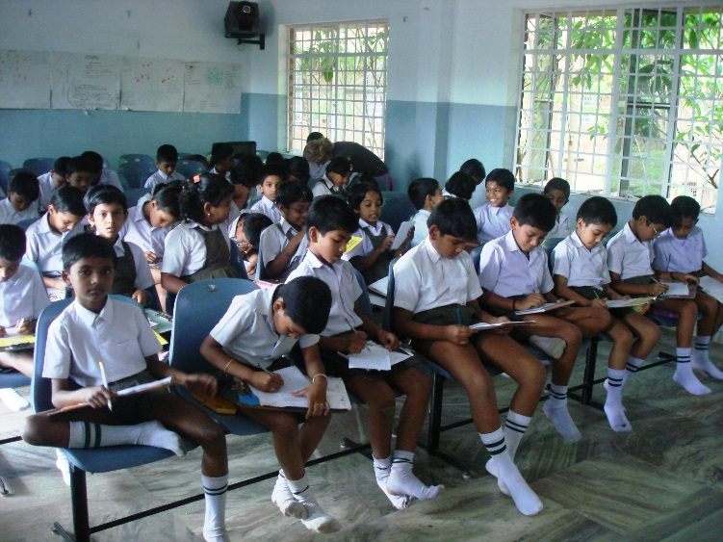
1. Improved Education, Sanitation and Medicine
Europe brought many technological advances that allowed for improved education, sanitation and medicine.

Slide 15
6. Infrastructure
Under European direction, roads were built and various systems of transportation (railroad, etc.) and communication (mail, etc.) were put in place.

Slide 16
7. Cultural Exchange
While European ideas were introduced to Africa
African ideas were also introduced to Europe.

Slide 17
Why does the costs of imperialism outweigh the benefits?
*think back to Maslow’s Hierarchy of Needs

