Slide 1
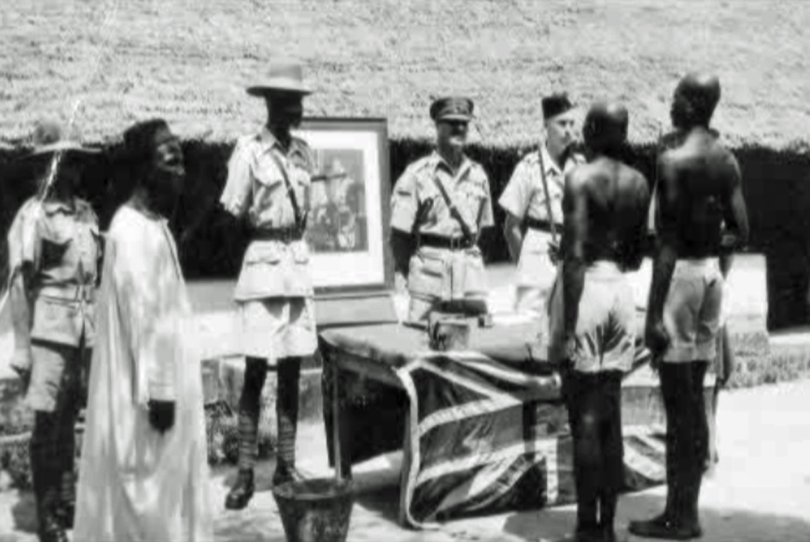
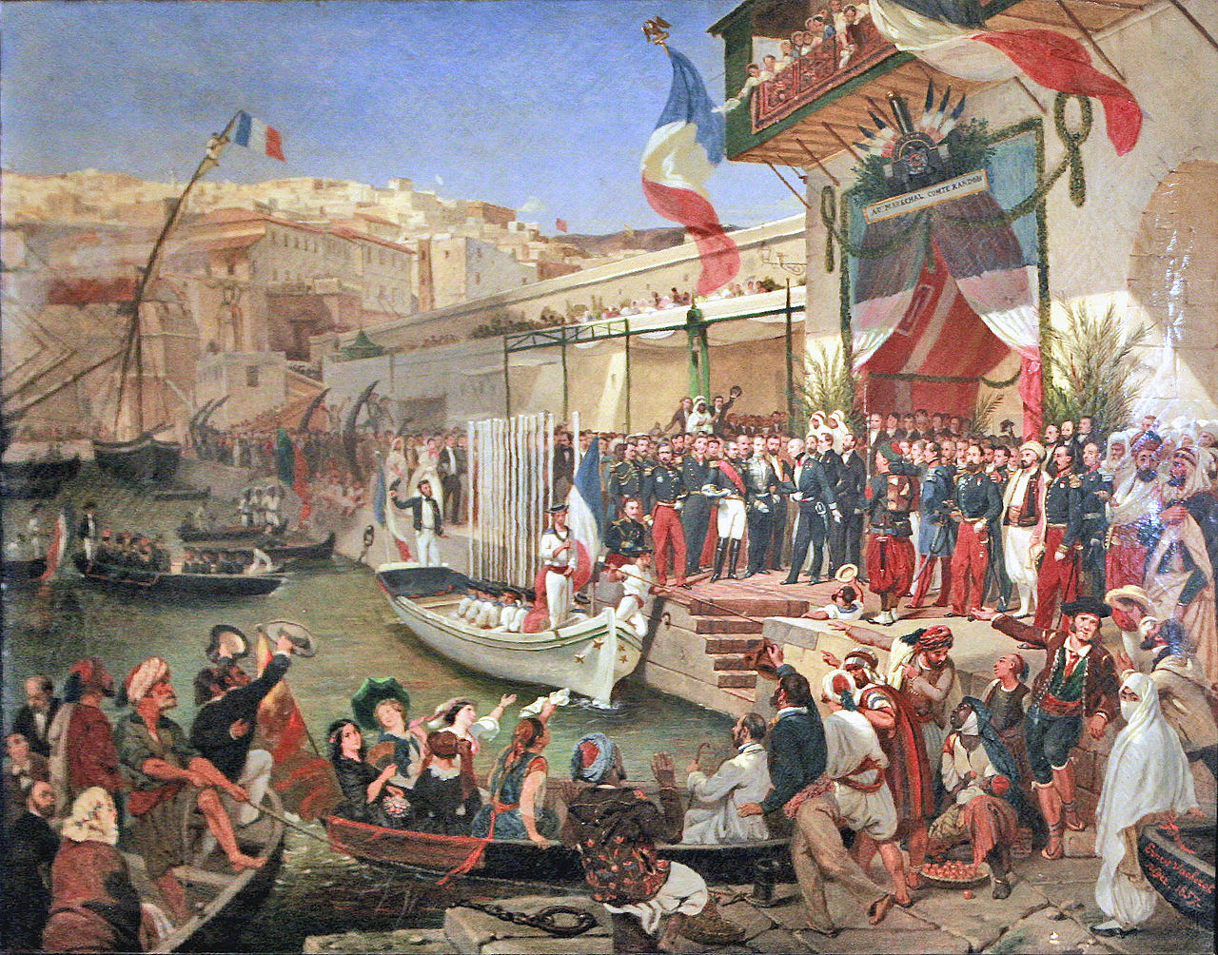
Level of Control &
Methods of Management under Imperialism

Slide 2
Colonies . Protectorates . Sphere of Influence
Levels of Control:
3 types of Imperialism
MOST CONTROL
LEAST CONTROL

Slide 3
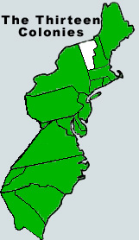
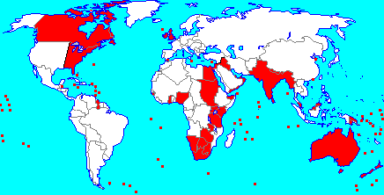
Colonies
Direct rule by one country over another
Replace local elites with officials from the mother country
Britain was the largest empire – red is all of its colonies
Britain’s American colonies
are an example

Slide 4
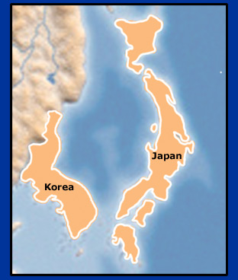
Protectorates
A country or region that is controlled by a more powerful country
Markets are only open to that country
Korea became a protectorate of Japan

Slide 5
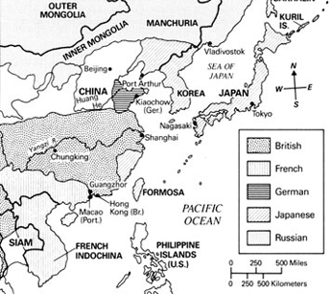
Spheres of Influence
Economically confined by a dominant nation
Territory keeps its own government
China up to 1914

Slide 6
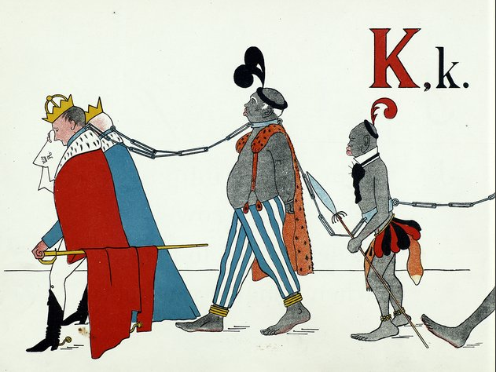
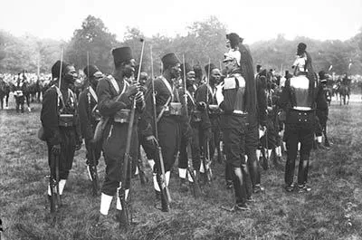
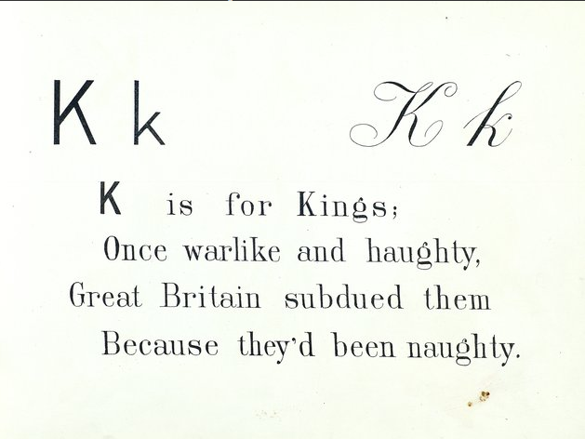
Method of Management
Direct Rule = sending officials from European country to run the country
Ex. France directly ruled over Senegal
Belgium in the Congo

Slide 7
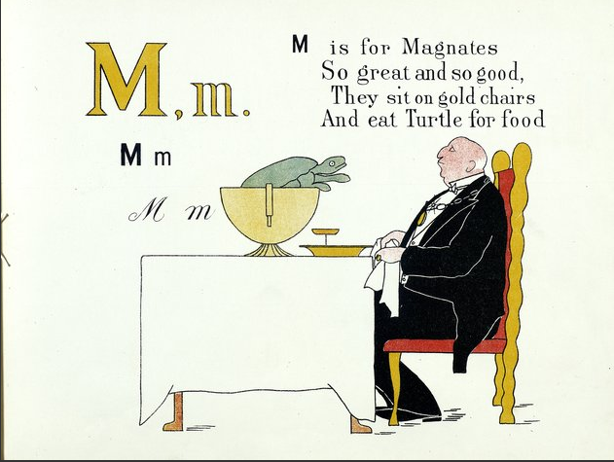
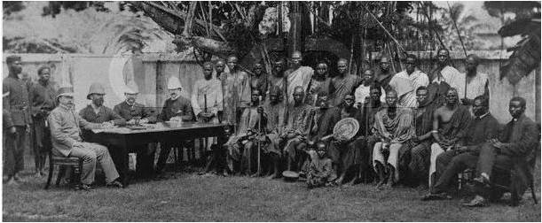
Indirect Rule = governing the country through local rulers
Method of Management
Yeah bruh, the French are idiots!
Ex.
Britain ruled Kenya & Nigeria indirectly, so they were called a “protectorate” not a colony
Why work harder, when you can have others do it for you?

Slide 8
HOMEWORK:
Reading in Actively Learn - read & answer questions

