Slide 1
Outlining and thesis revision

Slide 2
Outline example
Every BTS needs to connect to both the book and the research to help answer the prompt
What happens if you can’t find TFA direct quotes that support your conclusion?
You need to edit your thesis
What are some other options of lit to focus on
Other options
Plot
Allegory
Definition

Slide 3
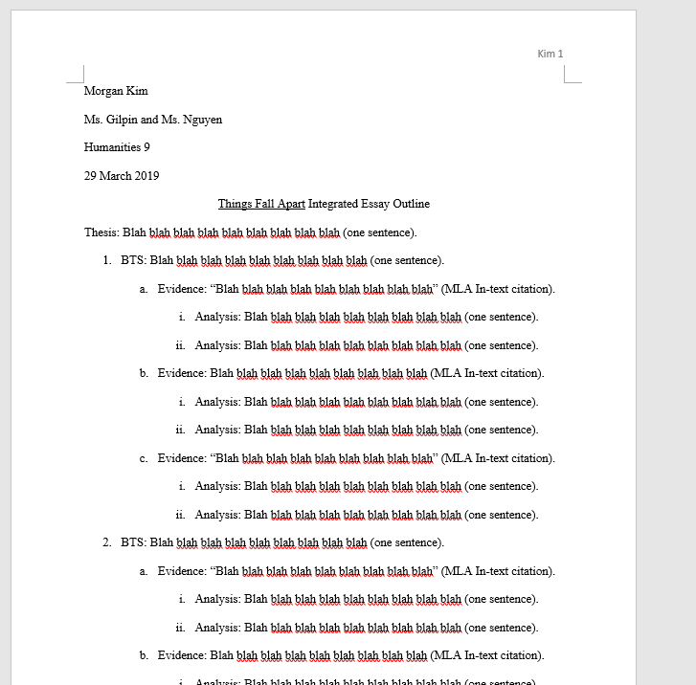
Outline example

Slide 4
Outline example

Slide 5
Outline example
This power point will be on my website but we are not giving you a word document template.
It is your responsibility to use Word or Google Docs to CREATE your own outline.
You have all of Thursday in class to work on this so if you don’t know how to do this, ASK.

Slide 6
What you need for your outline
Outline must have CORRECT FORMATTING
Every BTS should use BOTH
Things Fall Apart quotes
AND
SS research
AND MUST
answer the prompt.

Slide 7
What you need for your outline
What happens if you can’t find TFA direct quotes that support your argument?
Ask yourself: What evidence WOULD support my argument?
Consider using a different lit device.

Slide 8
What you need for your outline
Other Possible Lit Devices:
Characterization (of Okonkwo, of the missionaries, of Nwoye, etc)…
The Tragic Hero archetype (If you don’t understand this well, don’t use it.)
Allegory
Wait, what’s allegory?

Slide 9
Allegory
A work with two layers of meaning: one literal, and one figurative.
It is kind of like the entire story is a metaphor for another, hidden story.
We will discuss more in LA but if you think you need a thesis revision, consider how Okonkwo’s life and death are an allegory for imperialism’s effect on Africa.

