Slide 1
Ten Stages of Genocide

Slide 2
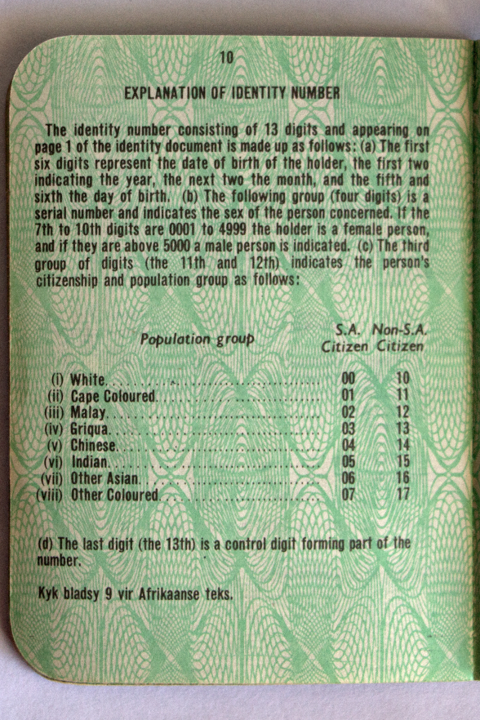
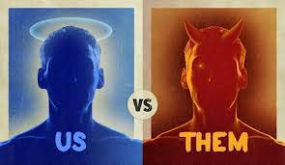
Classification
“Us vs. them” mentality by ethnicity, race, religion, or nationality
If society is too segregated (divided), they are most likely to have genocide.

Slide 3
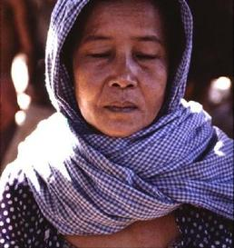
Symbolization
Give names or symbol to the classification of ethnicity, race, religion, nationality
Classification and symbolization are universally human and do not necessarily result in genocide unless they lead to the stage of dehumanization

Slide 4
Discrimination
Dominate group uses laws, customs, and political power to deny the rights of other group
Ex.
Nuremberg Laws in 1935 Nazi Germany made interracial marriages illegal, stripped Jewish people of citizenship, etc.

Slide 5
Dehumanization
When one group treats another group as second-class citizens
Viewed as less than humans
Psychological process of demonizing the other
Propaganda

Slide 6
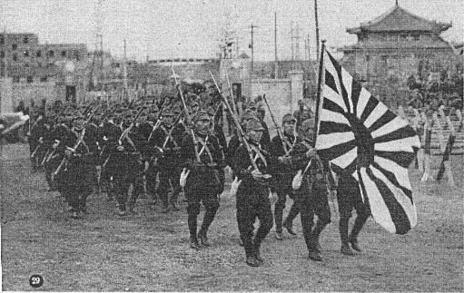
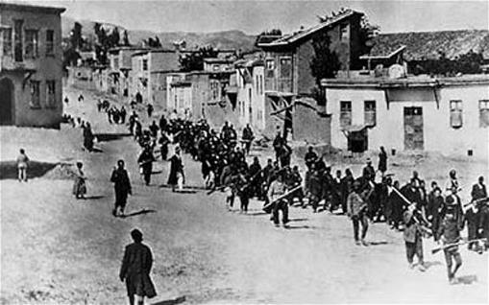
Organization
Genocide is a group crime
Always organized usually by the state
Specialized militia or army unit is armed and trained

Slide 7
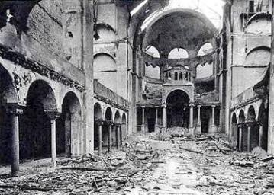
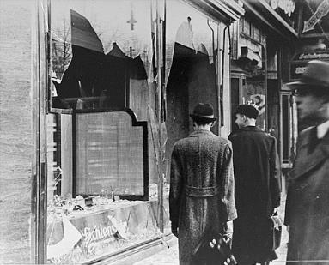
Polarization
Kristallnacht (night of broken glass), Germany 1948
Extremism drives the groups apart
Increased propaganda that reinforce prejudice and hate
Moderates are intimidated/arrested/killed

Slide 8
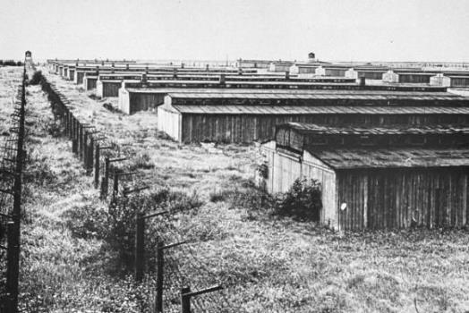
Preparation
“Final Solution” to the _____ problem
Often use euphemism to cloak intentions
Ethnic cleansing
Purification
Counter-terrorism

Slide 9
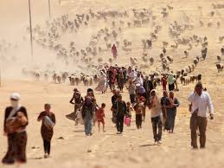
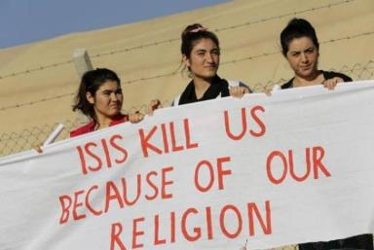
Persecution
Victims are identified & separated out into
Ghettos
Concentration camps
Starved
Executed
Death lists are drawn up

Slide 10
Extermination
Armenia: 1,000,000 killed from 1915-1923
China under Mao: 58,000,000 killed
USSR under Stalin: 20,000,000 killed (Robert Conquest, The Great Terror)
Holocaust: 5,700,000 killed from 1933-1945 (Nuremberg Trial)
Khmer Rouge (Cambodia): 1,600,000 killed between 1975-1978
Bosnia: 250,000 killed from 1992-1995 (U.S. State Dept.)
Rwanda: 1,000,000 killed in 1994
Somalia: 300,000 killed from 1991-present (IRIN, a UN agency)
Darfur: at least 450,000 killed from 2003-present (UN High Commission on Refugees)
Extermination begins
Mass killing is legal

Slide 11
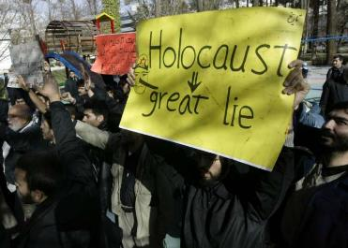
Denial
Deny crimes – blame the victims
Cover up evidence
Prevent investigations from happening

Slide 12
Identify the 10 Stages of Genocide in the Rwanda Genocide

Slide 13
What should the international community do about genocide?

Slide 14
What should the US do about genocide?

