Slide 1
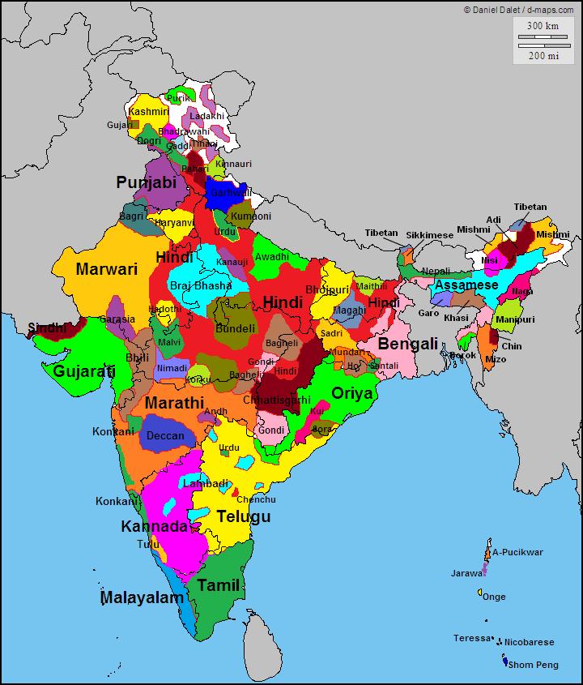
Map of all the languages of India
What can we infer about Indian civilization?
Compared to Chinese civilizations?

Slide 2
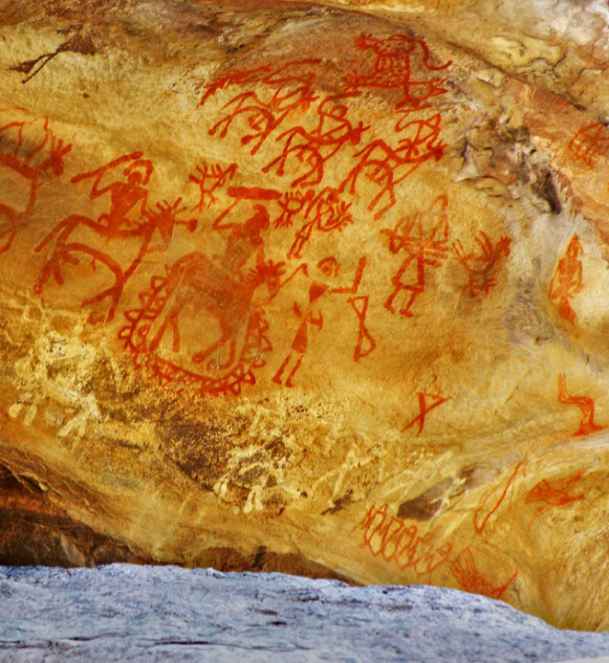
Pre-History
Indian history is OLD!!
Artifacts dating back to as much as 500,000 years have been found
Bhimetka (Madhya Pradesh) Rock shelters – up to 15,000 year old paintings & 290,000 year old petroglyphs

Slide 3
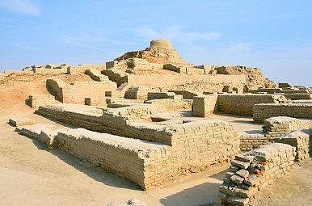
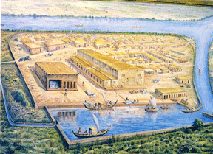
Indus & Sarasvati Civilizations
2000 BCE
One of the 4 first/oldest civilizations of the first
Complex & advance cities
  Indoor plumbing
Left a lot of ruins/artifacts
Culture is still a mystery - writing has not been deciphered
Indus Valley – Mohenjo Daro ruins
Artist recreation of Sarasvati Civilization

Slide 4
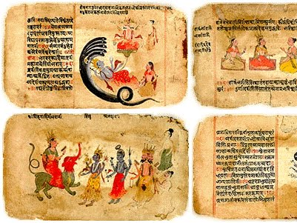
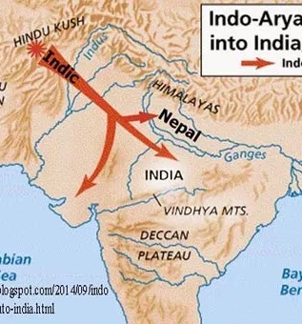
Vedic Period
1000 BCE
Ayran Migration
Vedas & Mahabharata is composed
Hinduism takes deep roots
Caste system is established

Slide 5
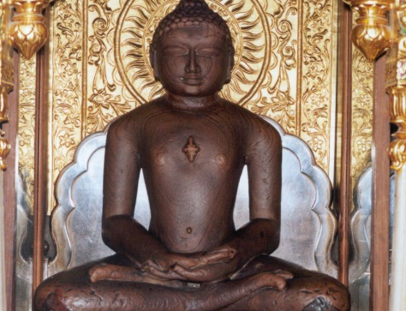
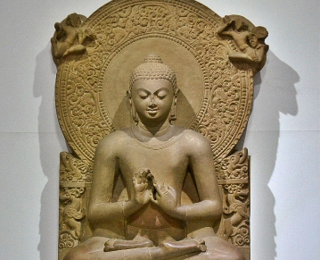
Rise of Jainism and Buddhism
600 BCE
Gautama Buddha (founder of Buddhism)
Mahavira (Jainist Tirthankara)
The Magadha Kingdom
  play a huge role in development o Jainism & Buddhism

Slide 6
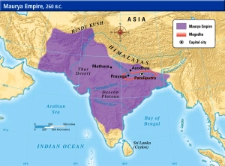
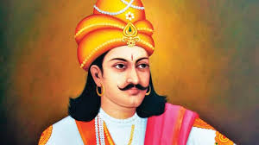
Mauryan Period
400 BCE
Alexander the Great invades parts of India
Chandra Gupta Maurya establishes the Mauryan Empire
Ashoka spreads Buddhism, codify law

Slide 7
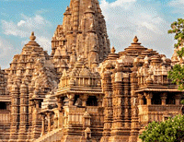
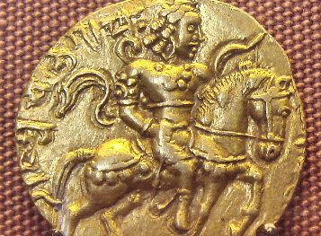
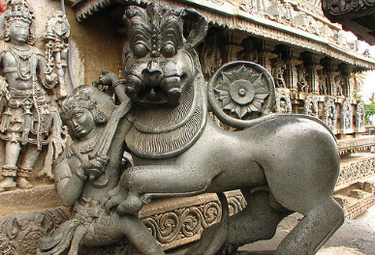
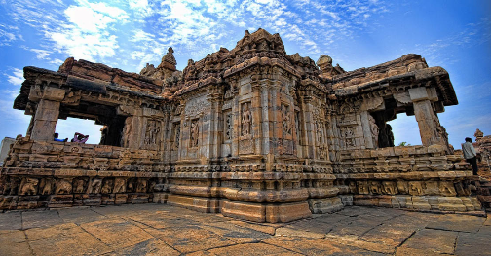
Golden Age of Indian Art & Science
Khajuraho Temples are built
Hoysala Dynastay
Gupta Empire
Pallavas Dynasty
Mohammed Ghazni loots the riches & wealth of India

Slide 8
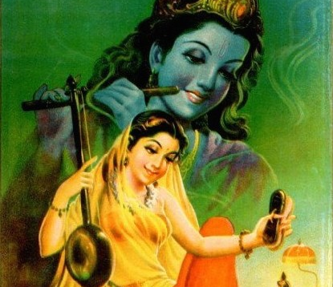
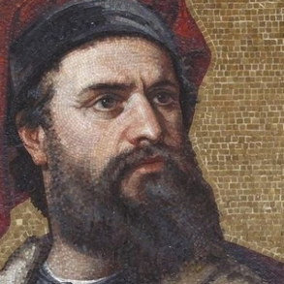
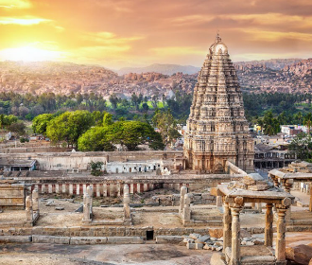
Muslim Invasion
1200 AD
Marco Polo visits India
Khilji Dynasty
Vijayanagar Empire
First voyage of Vasco de Gama to Gao
Bhakthi Movement (religious Hindu movement)
Southern Dynasties

Slide 9
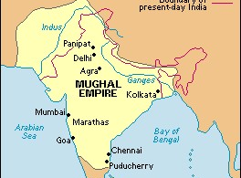
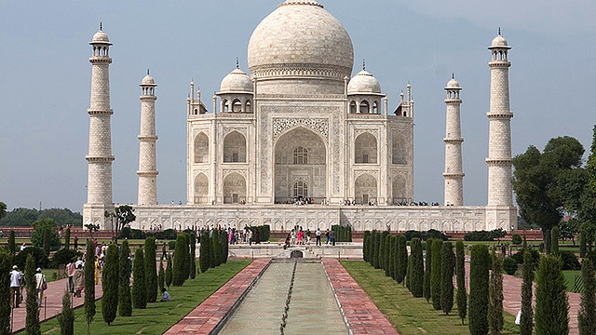
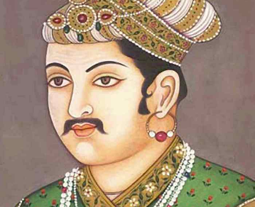
Mughal Empire
1500 AD
Akbar the Great
East India Company formed (British trading co.)
Taj Mahal is built
Hyder Ali & Tipu Sultan (in the South)

Slide 10
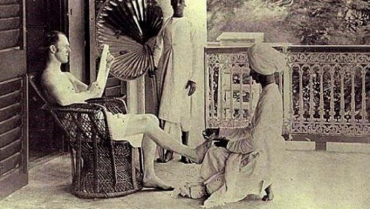
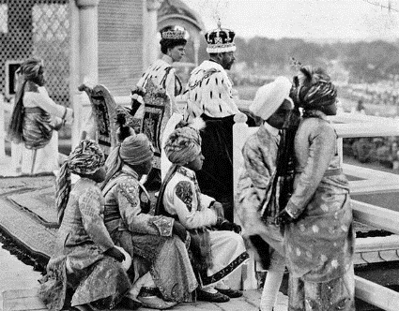
The British Raj
1800 AD
British imperialism
  Prohibition of Sati
First Indian War of Independence
Indian National Congress is formed

Slide 11
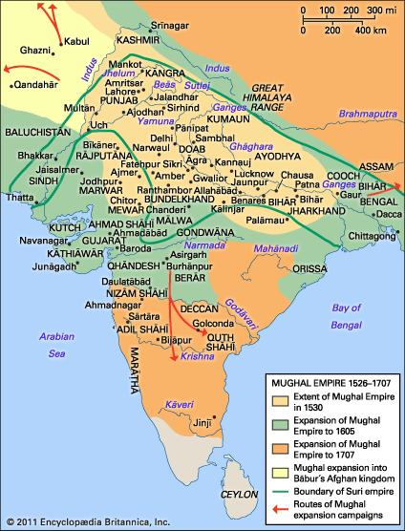
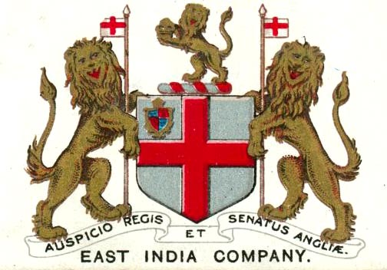
Politically – late 18th century
Mughal Empire
British East India Company

Slide 12
Political/Military-late 18th century
Mughal Empire is decentralized/weak
  Divided into separate principalities (Nawabs)
  Nawabs cooperate w/Europeans
British East Indian Company control of India grows
  Battle of Plassey-French driven out of Bengal
  Capitalize divisions w/in Mughal empire
  Captures Delhi in 1857 (capital of Mughal Empire)

Slide 13
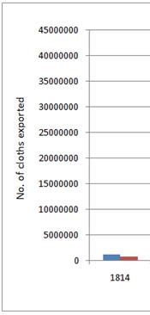
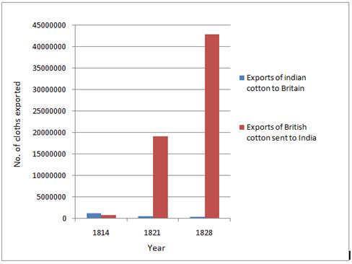

Economically… late 18th century

Slide 14
Economics & Technology
Trade with Europeans (including French)
Cotton textiles major export
Textile weavers are known throughout the world
Non-industrialized
No Railroads

Slide 15
Cultural/Social Late 18th century
Social mixing b/n British and Indians nawabs
Hindu caste system
Religion-Hindu majority/Muslim minority
  Portuguese Christian presence in Goa and South India
  Growing Christian evangelism by British
Some traditions
  Sati
  infanticide

Slide 16
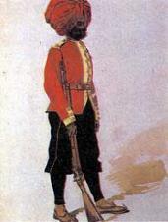
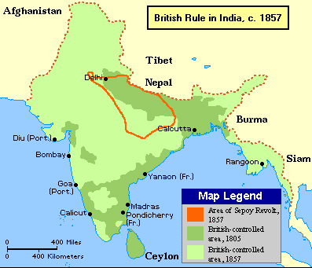
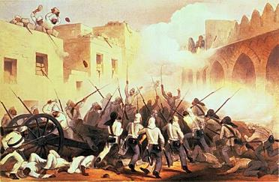
Sepoy Rebellion 1857 (major Turning Point)
Sepoy = Indian soldiers hired to work for the British East Indian Company
300,000 Sepoy compared to 50,000 British soldiers
Many reasons for rebellion

Slide 17
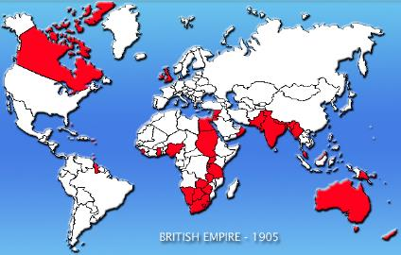
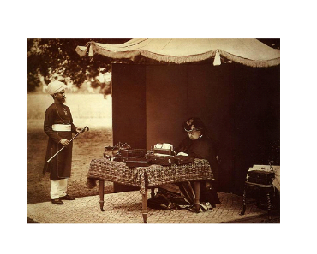
Political/Military-After
  India become crown colony
  Indian Princes kept in power but as figureheads
  More British troops/Sepoy army carefully watched
  British laws grant Indians equal protection under the laws
  Freedom to practice religion of choice
  Few Indians in upper levels of Indian Civil Service
  Less than 100,000 British governing over 250 million Indians

Slide 18
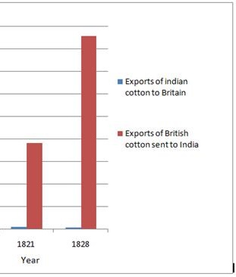
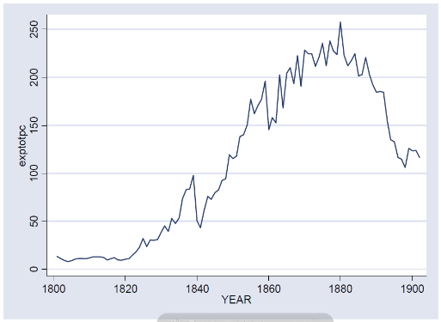
Economics & Technology-After
  Opium becomes major export to China (over 40% of exports)
  Railroads constructed (5th largest in the world)
  Irrigated land is expanded
  Coal industry established
Indian Opium Export
  Free trade decimates traditional weavers
  Over a million Indians emigrate to other parts of BE as indentured servants
  Cotton industry dominated by British imports

Slide 19
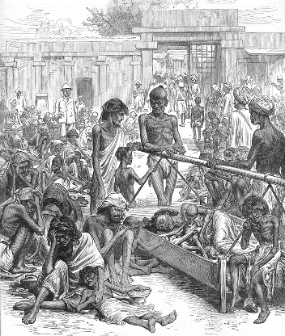
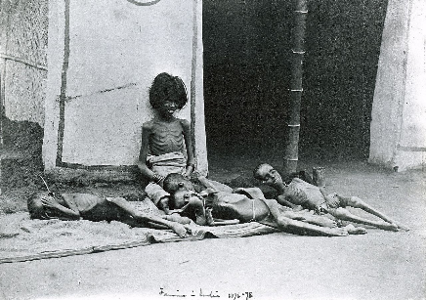
Economics & Technology-After
Widespread famine across India
Happened multiple times
Not because there was a lack of food...

Slide 20
Cultural/Social After
Cultural
Social
Hinduism continues
Limited conversion (only 2% Christian)
Sati & infanticide outlawed
English is introduced
British model of educational (over 20, 000 secondary schools)
Famine continues (1877 & 1900)
British give preference to Brahmins reinforcing caste system
Natives are deliberately kept out of social institutions
More segregation b/n British and Indians

Slide 21
British Imperialism in India = British Raj
Indian National Congress & Muslim Leagues
Rowlatt Acts
Amritsar Massacre
Gandhi & civil disobedience
Salt March
Government of India Act

Slide 22
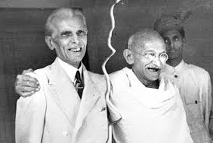
Hindu-Muslim tension/conflict? Why??

Slide 23
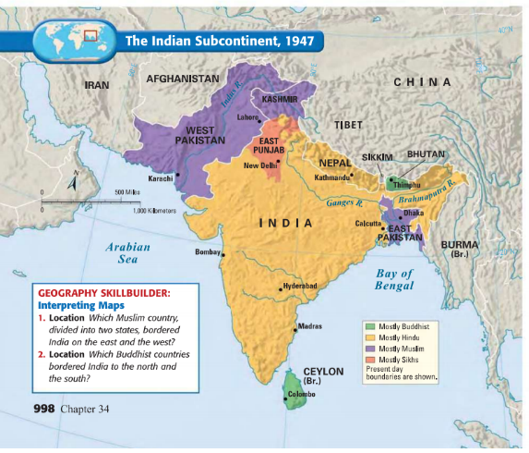
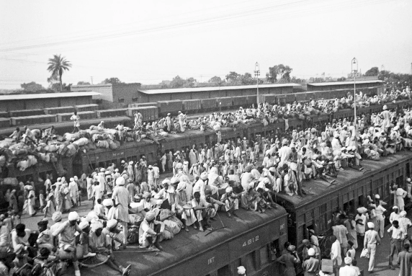
Partition

Slide 24
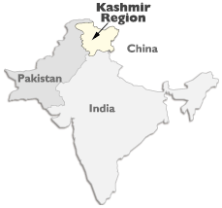
Kashmir

Slide 25
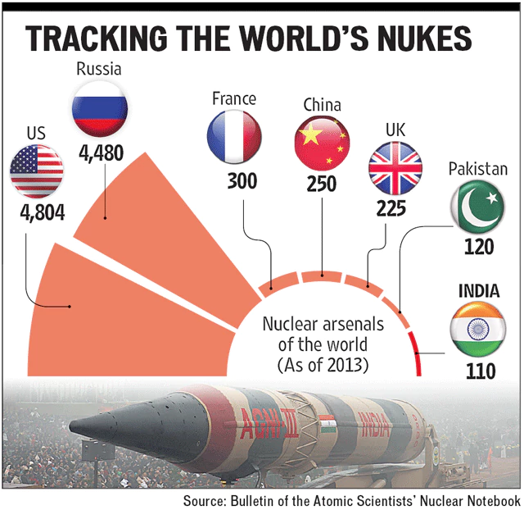
Indian-Pakistani relations today?

Slide 26
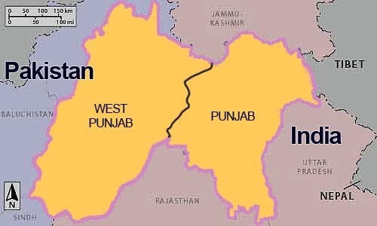
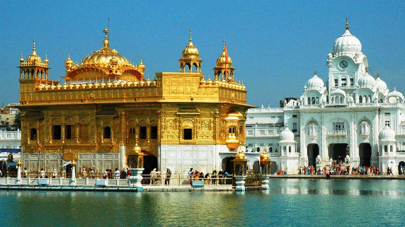
Sikh Nationalism

Slide 27
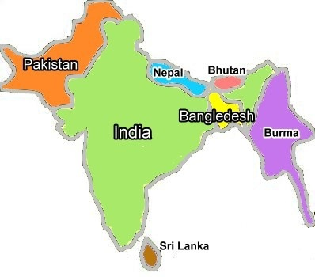
Pakistan Civil War

Slide 28
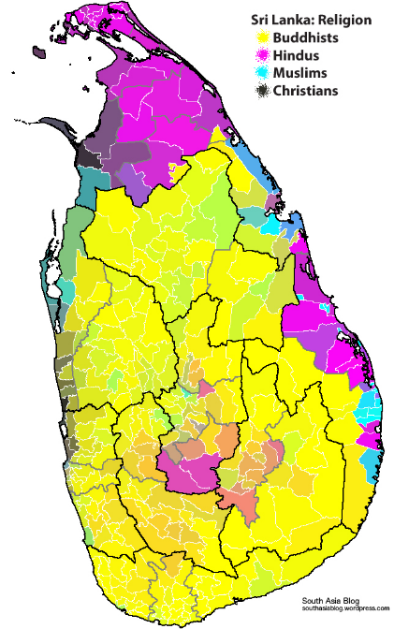
Sri Lanka

