Slide 1
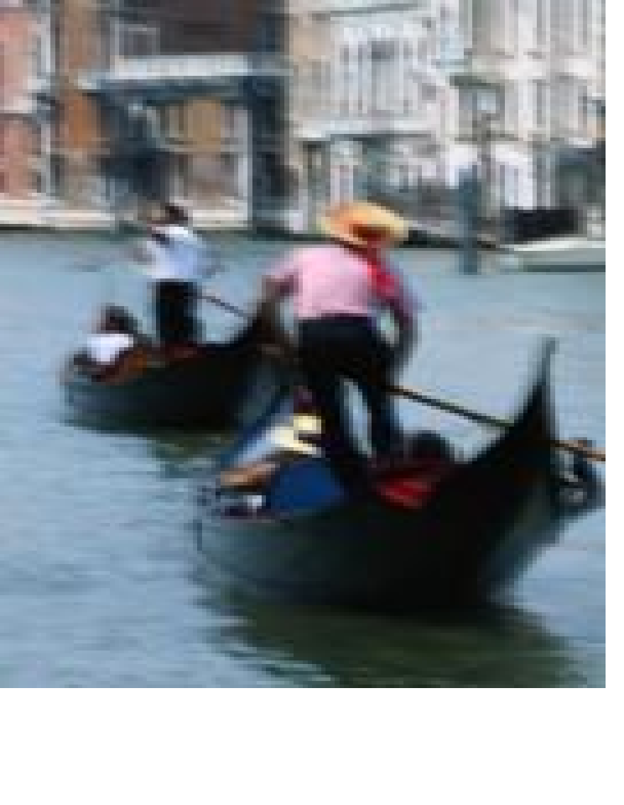
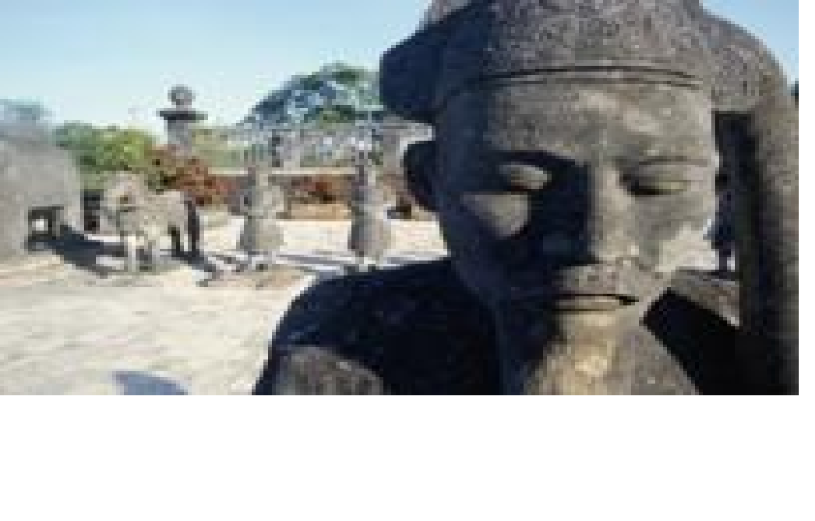
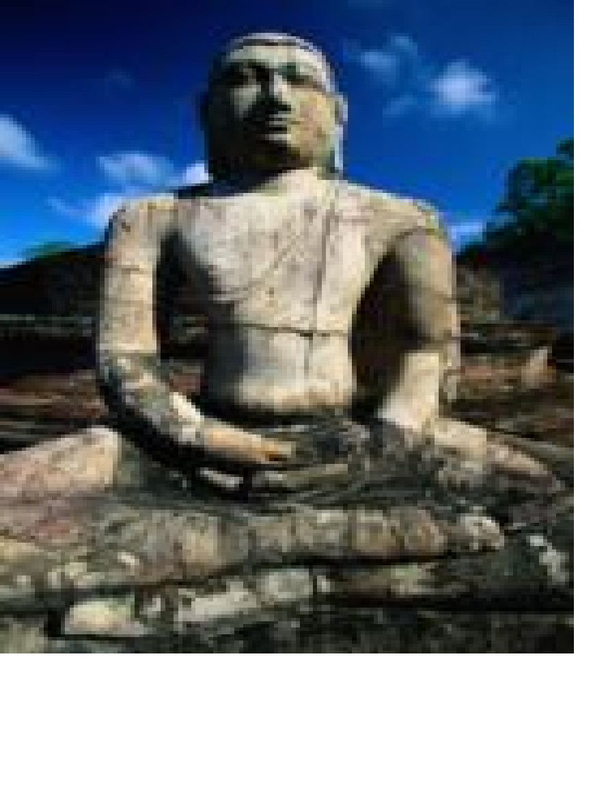
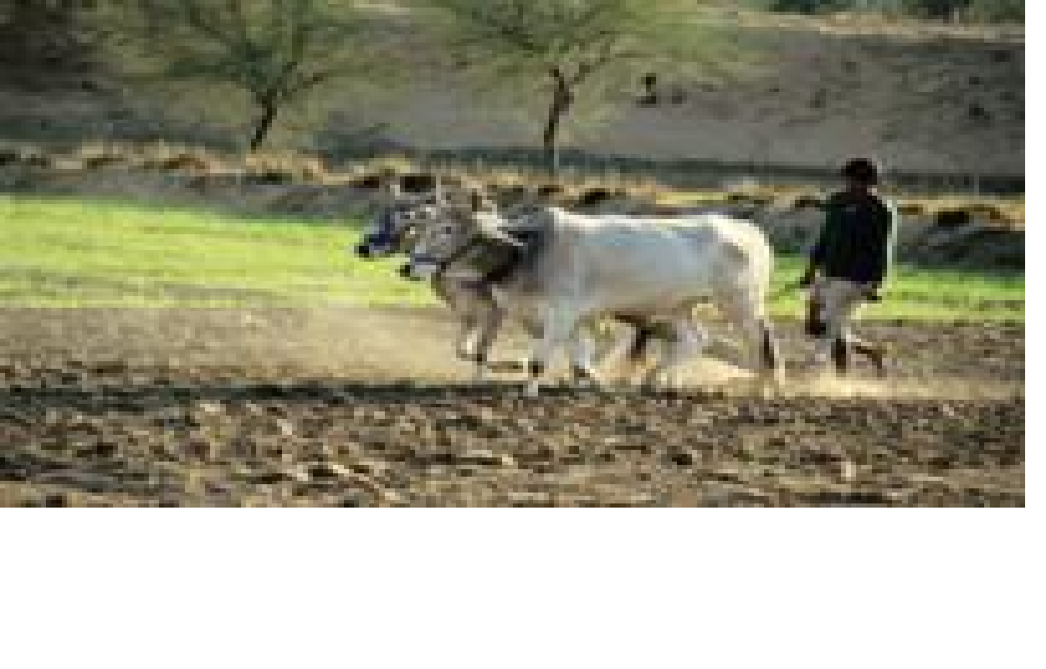
Maslow’s Hierarchy of Needs
A way of understanding different people around the world

Slide 2
WHO?
Abraham Maslow (American psychologist)
was born in 1908, Brooklyn, New York
Developed a theory of human needs
Hierarchy of Needs
Theory has influenced a number of fields, including education
Humanistic approach: interested in the welfare of humans & their motivations, behaviors, & attitudes

Slide 3
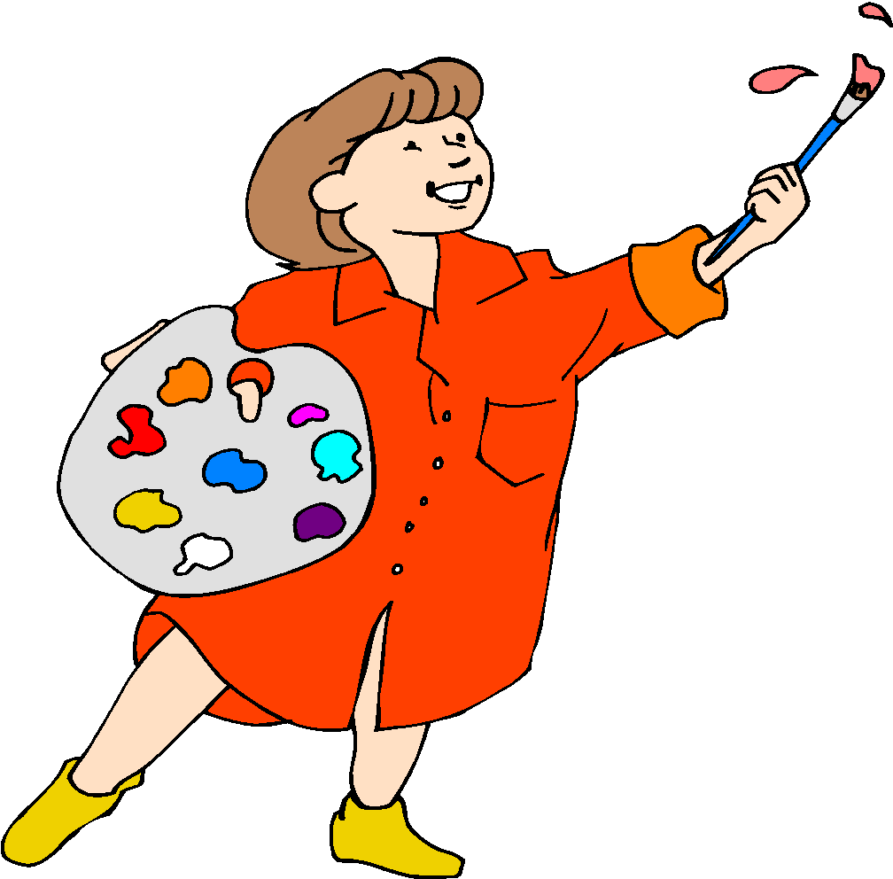
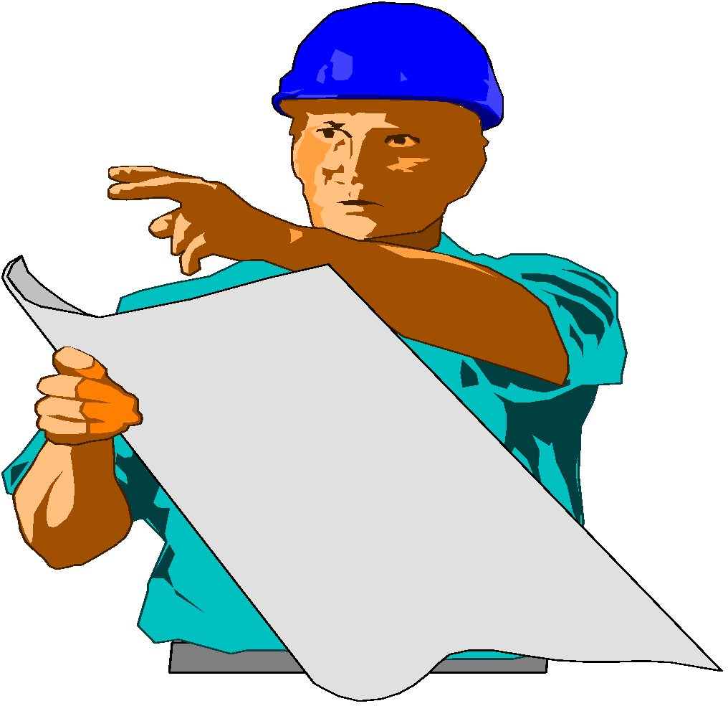
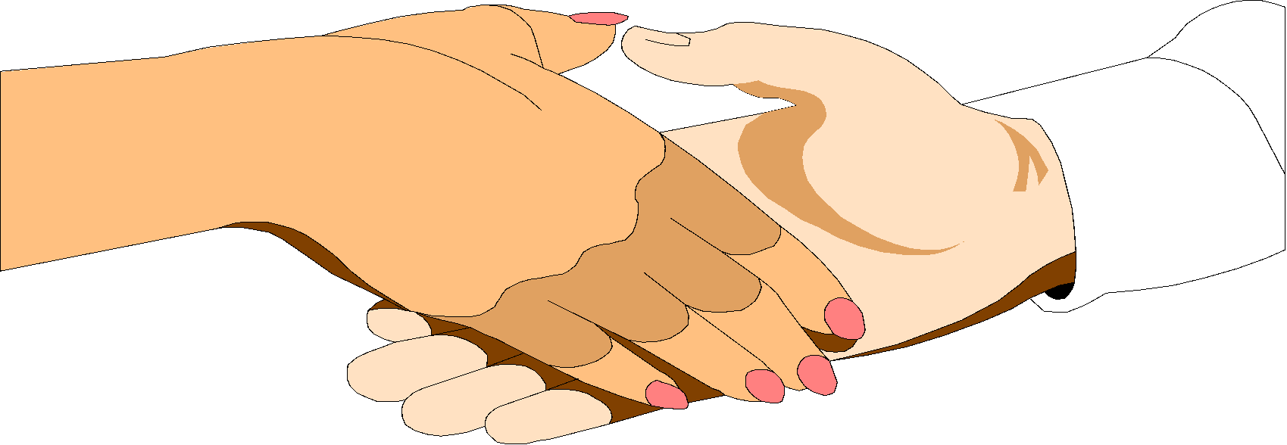
WHAT: Maslow’s Hierarchy of Needs
Self- Actualization
Status (Self-Esteem)
Social (Sense of Belonging)
Security
Survival
Source: http://www.ohrd.wisc.edu/msdresources/tools/2

Slide 4
Hierarchy of Needs
growth
emotional
physical

Slide 5
Hierarchy of Needs
Physiological Needs

Slide 6
Survival/Physiological Needs
food
water
air
sleep

Slide 7
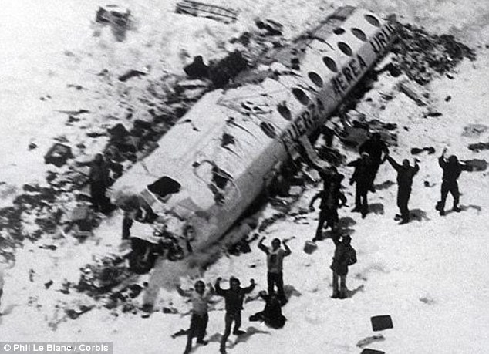
Food: A Most Powerful Need
South American Rugby team crashed in 1970
Food was the most pressing problem.
They ate human flesh for survival.
Even the strongest taboo was broken to fill the basic need for food.

Slide 8
Hierarchy of Needs
Safety Needs
Physiological Needs

Slide 9
Security/Safety Needs
from physical attack
from emotional attack
from fatal disease
from invasion
from extreme losses (job, family members, home, friends)

Slide 10
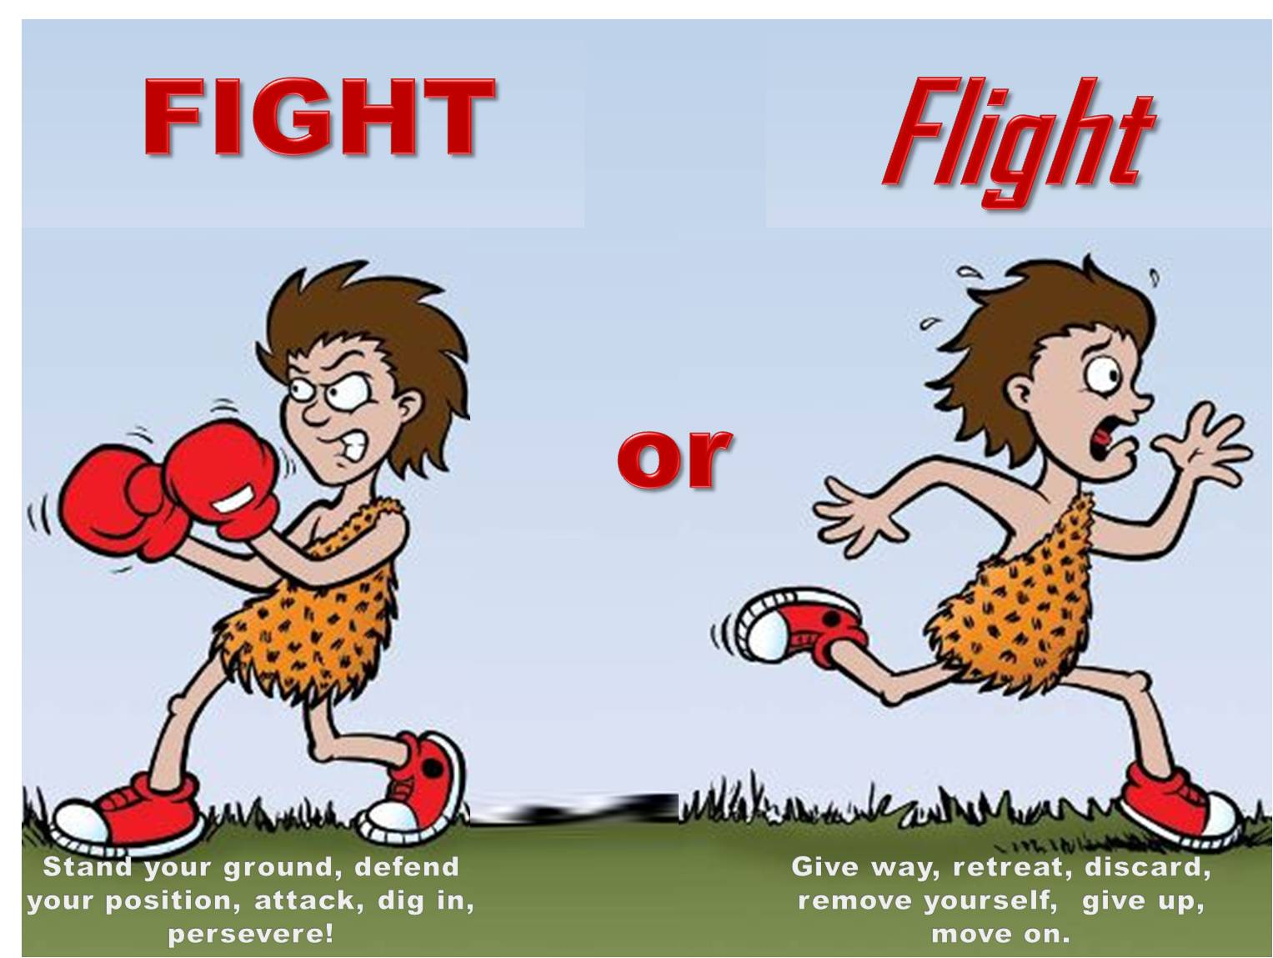
Security/Safety: A Most Powerful Need
when frightened, our thoughts and energies are diverted
threat of, or actual attack creates “fight or flight” reaction
threats to safety can be physical or emotional

Slide 11
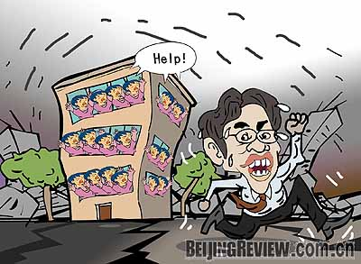
Fight or Flight

Slide 12
Hierarchy of Needs
Love & Belonging
Needs
Safety Needs
Physiological Needs

Slide 13
Love and Belonging
(social/emotional)
Inclusion - part of a group: colleagues, peers, family, clubs
Affection - love and be loved
Control - influence over others and self

Slide 14
Love and Belonging: A Most Powerful Need

Slide 15
Hierarchy of Needs
Esteem
Needs
Love & Belonging
Needs
Safety Needs
Physiological Needs

Slide 16
Esteem Needs
emotional (ego)
respect from others through: awards honors status
respect for self through: mastery
achievement
competence

Slide 17
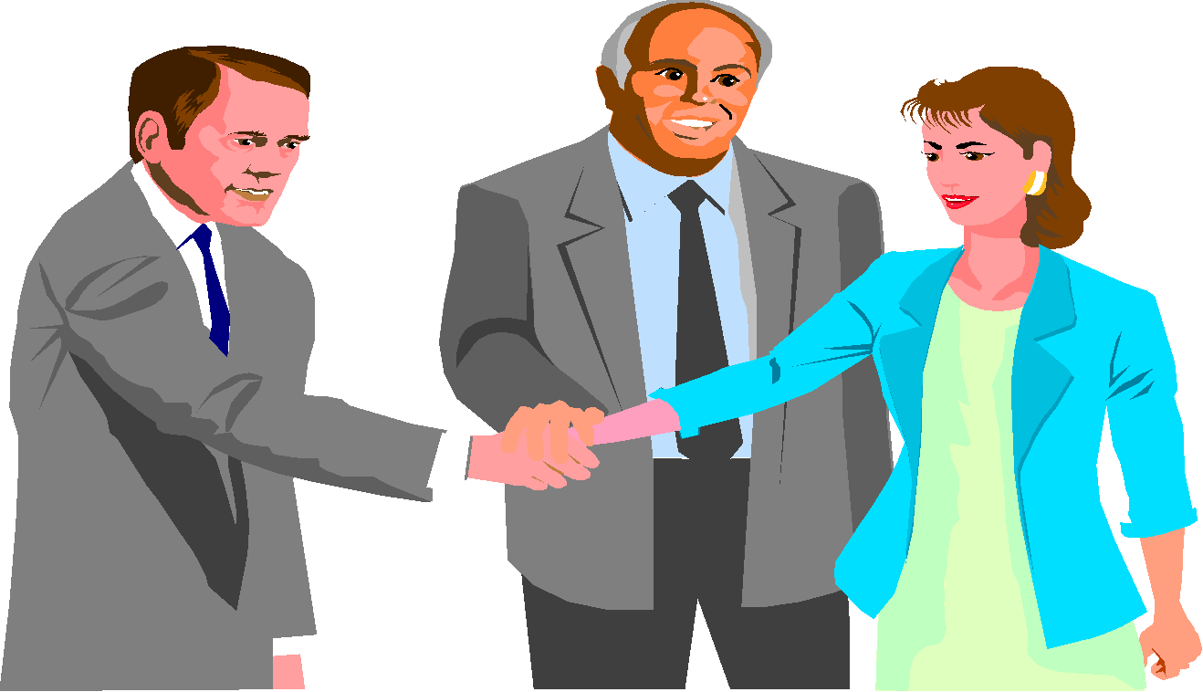
Esteem from Self and Others: A Most Powerful Need
Congratulations

Slide 18
Self-Actualization Needs
stop cruelty and exploitation
encourage talent in others
try to be a good human being
do work one considers worthwhile
enjoy taking on responsibilities
prefer intrinsic satisfaction
seek truth
give unselfish love
be just

Slide 19
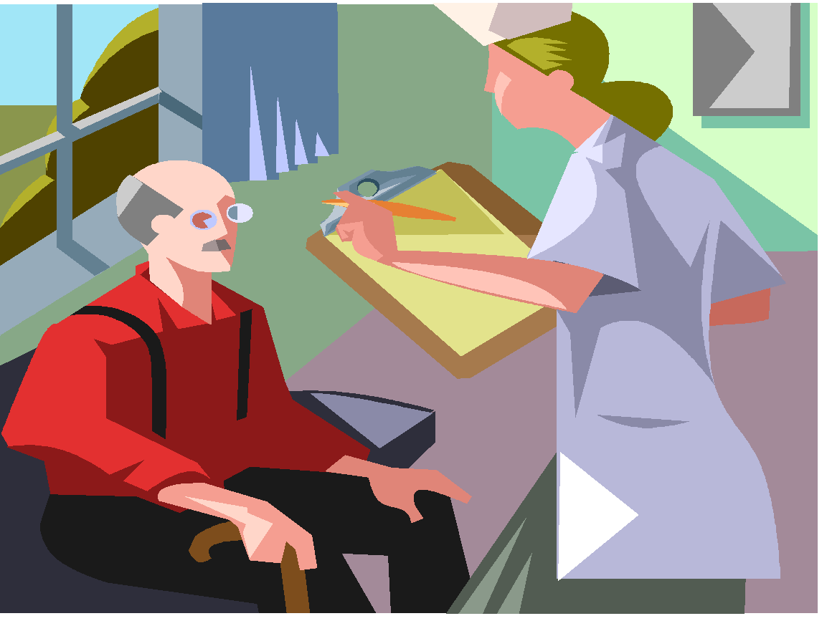
Some Self-Actualizing People from History?
Abraham Lincoln
Thomas Jefferson
Mahatma Gandhi
Albert Einstein
Eleanor Roosevelt
Who else?

Slide 20
Peak Experiences Moments of Pure Bliss

Slide 21
Hierarchy of Needs
Being Needs (B-Needs):
Higher needs
Self-Actualization
Needs
This means Self Actualization only becomes important once all other needs are met or almost met
Esteem
Needs
Deficiency Needs (D-Needs)
Love & Belonging
Needs
Safety Needs
Physiological Needs

Slide 22
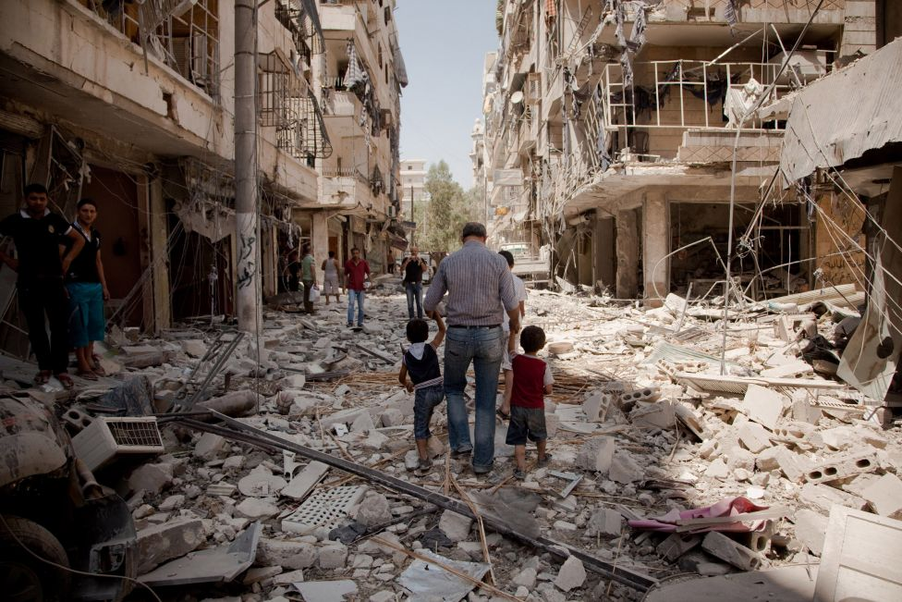

Slide 23
Think about the levels…
1. You worked hard on your 5 Themes of Geography Mind Map the other day. Mrs. Nguyen praised your neighbor’s Mind Map in front of the whole class. You know that your Mind Map is better. This bothers you. What is going on?
2. If you are simultaneously hungry for food and also want to be a computer programmer, which need will be more important?
3. You have a long homework assignment, but armed rebels are raiding your neighborhood, which need will be more important?
4. You finally get up the confidence to ask someone to homecoming and they say no. This upsets you. Why?

Slide 24
Criticism
“Here’s the problem with Maslow’s hierarchy,” explains Rutledge. “None of these needs — starting with basic survival on up — are possible without social connection and collaboration. … Without collaboration, there is no survival. It was not possible to defeat a Woolley Mammoth, build a secure structure, or care for children while hunting without a team effort. It’s more true now than then. Our reliance on each other grows as societies became more complex, interconnected, and specialized. Connection is a prerequisite for survival, physically and emotionally.”

Slide 25
Homework: Maslow Current Event
Research a current issue in the news today – print out a hard copy and bring it into class
Describe what levels of Maslow’s Hierarchy of Needs are:
being met and
NOT met,
PLUS what is needed to move the situation to the next level on the hierarchy (more needs met)
Explain your answer

