Slide 1
Chinese Dynasties Song (to the tune of "Frere Jacques”)
Shang, Zhou, Qin, Han Shang, Zhou, Qin, Han Sui, Tang, Song Sui, Tang, Song Yuan, Ming, Qing, Republic Yuan, Ming, Qing, Republic Mao and Deng Mao and Deng
Communist China

Slide 2
What led to the fall of the Qing Dynasty?

Slide 3
What conflict(s) helped escalate the downfall of the Qing & the West’s rising power?

Slide 4
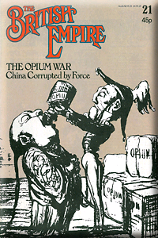
Opium Wars 1840-42
The British want to trade with the dynasties
Treaty of Nanking
Gives all power of trade to foreign influence
Treaty made by the British
Empire feels forced to sign the treaty
Trade must be under British law
Everything under British law
Hong Kong given to the British

Slide 5
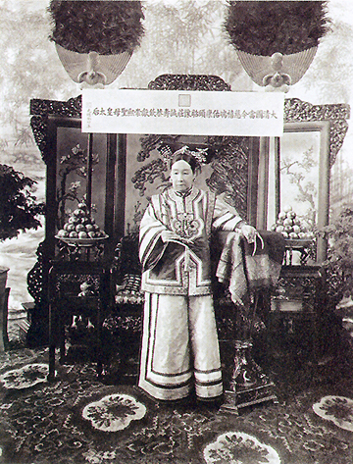
Fall of the Qing
Empress Dowager Cixi (1835-1908)
De facto Chinese monarch (1861-1908)
Mismanagement of money
Anti-foreign
HOWEVER, foreign influences were the only way for her to keep her power
Blamed by many Chinese for foreign imperialist power in China
Many see her as the reason for the end of the dynasties in China

Slide 6
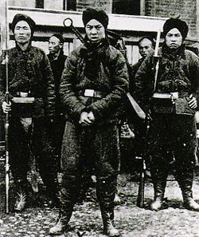
Boxer Rebellion
Boxers:
Peasants
Displaced workers and peasants
“Society of Glorious and Harmonious Fists”
Goals:
Get rid of foreign influence
Qing Dynasty (Manchurian ethnic group) is foreign to the Boxers, therefore get rid of them too
Restore the Ming Dynasty because this is when the Han (ethnic group) ruled

Slide 7
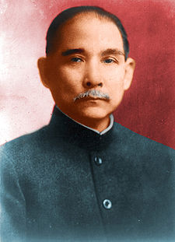
Kuomintang Revolution (1912)
Sun Yat-sen (Sun Yixian)
Founded Kuomintang (KMT) – Nationalist party
Overthrew Qing dynasty
Established a republic
President of Chinese Republic
Pro-democracy
Pro-republican form of government
Pro-western ideas (but wants to maintain Chinese sovereignty)
Democracy can help China!
Notes:
Blue Sky with a white sun – 12 hours, 12 months, → spirit of progress

Slide 8
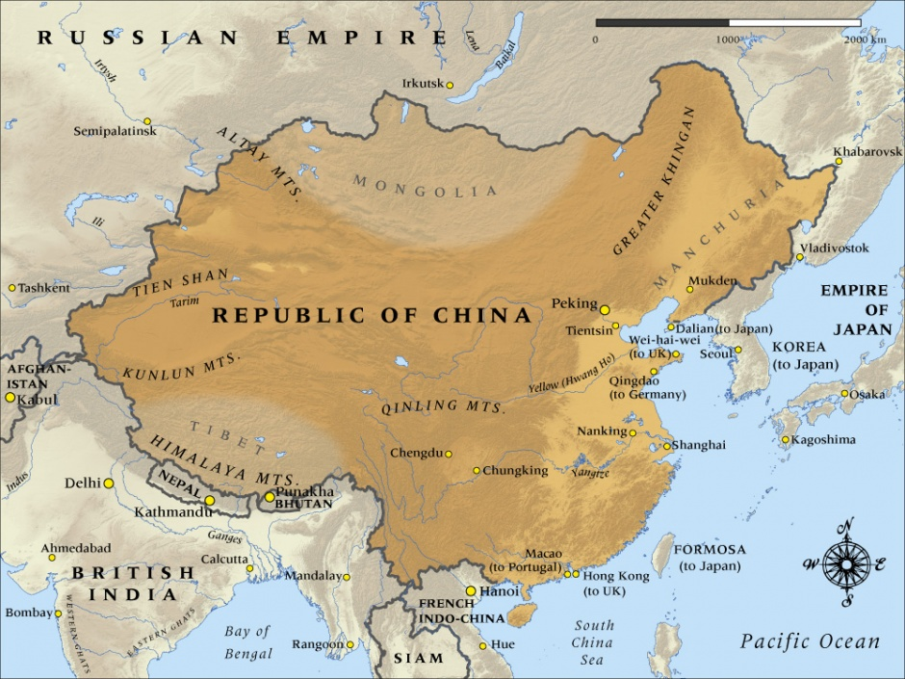

Slide 9
KMT’s 3 Principles of the People
Principle of Mínquán
Democracy – the people are sovereign
Principle of Mínzú
Nationalism – an end to foreign imperialism
Principle of Mínshēng
Social Reforms– economic development, industrialization, modernized, technology and social welfare – elements of progressivism and socialism
China is so far behind in technology at this point
Want to compete with the rest of the world

Slide 10
Kuomintang: Weaknesses
Disunity (2 PROBLEMS):
1. Local warlords fought Kuomintang for control
Greedy warlords who think the disunity will help them gain power
2. Wars raged between 1912 and 1928
Nationalists vs. Communists
Also, poor transportation
1914 – only 6,000 miles of railroad track
225,000 miles in the smaller United States
Few decent roads

Slide 11
The Kuomintang (KMT) is Split
Left wing
Communists
Intellectuals
Radicals
Students
Right wing
Business people
Politicians

Slide 12
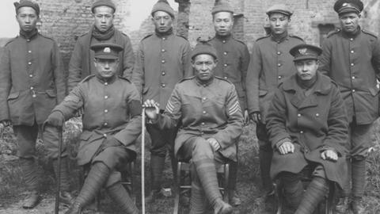
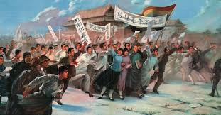
Rise of Communism in China
China joins the Allied (US, UK, France, Russia) side during WWI
Chinese leaders believed China’s participation → return of Chinese territories
WWI ends → Treaty of Versailles gives German controlled Chinese territories to Japan
Outrage swept throughout China
May 4th Movement (1919): nationalist demonstrations across the country

Slide 13
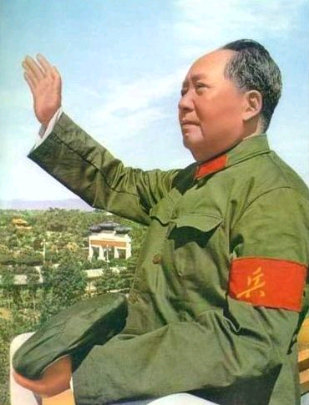
Mao Zedong
An assistant librarian in Beijing University
One of the founding members of the Chinese Communist Party (CCP)
1921 in Shanghai
Had a different vision of communism then Lenin’s
Communist revolution starts from peasants, not urban working class

Slide 14
May 9th
Clear tables, pen/pencil, testing folders
Homework: (both due Friday)
SS: Global Conflict Paper
LA: “The Balcony Scene’ 2.2 Analytical Paragraph
After reading ‘The Balcony Scene,’ write an analytical paragraph answering the following prompt:
Is this true love, or infatuation between Romeo and Juliet?
This is a formal, analytical writing assignment. Your paragraph must contain a thesis statement, evidence (at least 2 quotes from the text incorporated into complete sentences with context and citation), analysis and a concluding sentence.
Agenda:
R & J Act 1 Quiz
Modern China

Slide 15
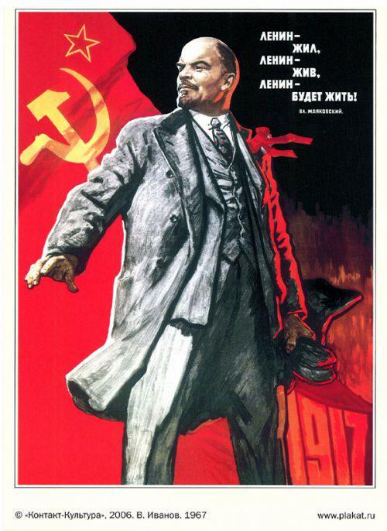
Rise of Communism in China
KMT government too weak
Sun disillusion with Western democracies for not helping his gov
Many young Chinese intellectuals turned against Sun Yat-sun’s belief in Western democracy in favor of:
Lenin’s brand of Soviet communism
Sun allies KMT with Communist Party, and welcomes Lenin’s help

Slide 16
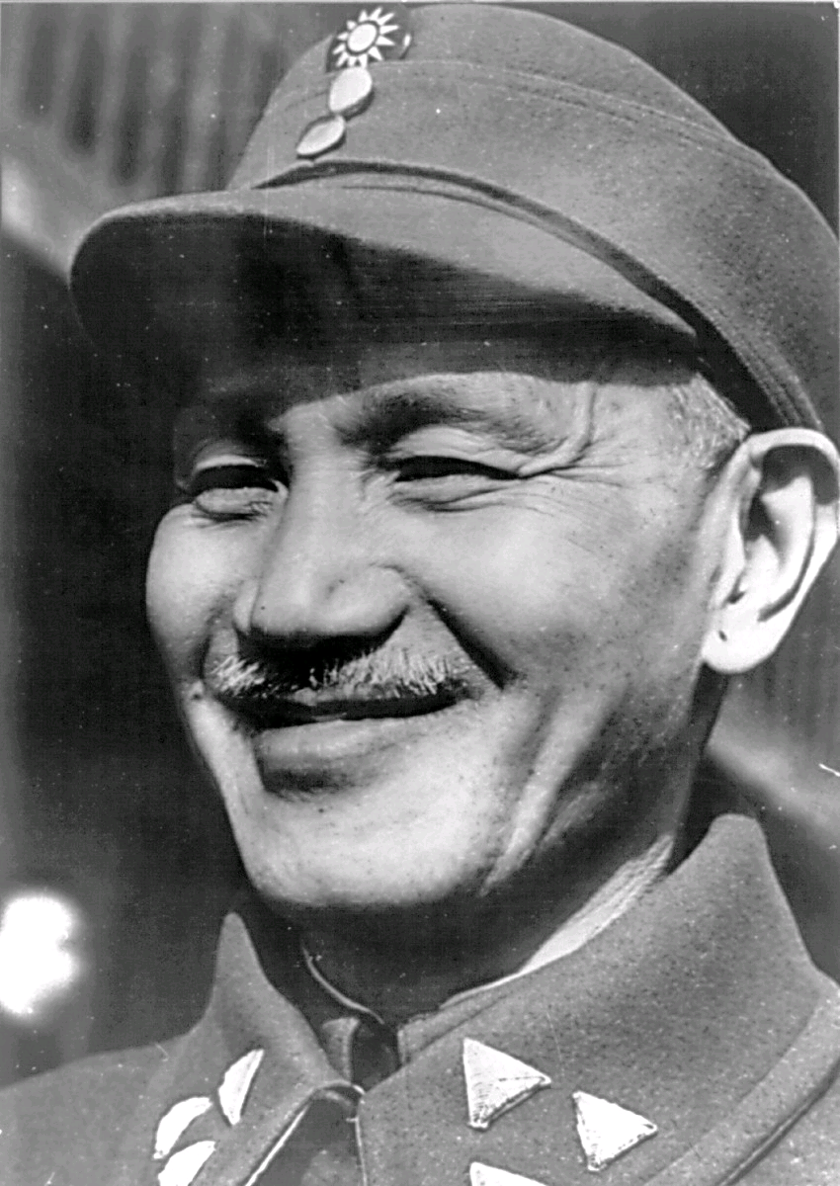
Chiang Kai-shek
Supports KMT and Sun Yat-Sen
1927 becomes commander and chief of the KMT army
Takes on leadership of KMT after Sun Yat-Sun dies
Puts down Warlords
Finally unifies the country
Notes:
Possible anecdote: The Kuomintang changed the name of Peking/Beijing to Peiping (or Beiping) in 1928.

Slide 17
Chiang Kai-shek
Didn’t trust the Communist
Son of middle-class merchants
Supported by bankers & businesspeople
Promised democracy & political rights to all Chinese
Gov became less democratic and more corrupt
Peasants began to support CCP
Notes:
Possible anecdote: The Kuomintang changed the name of Peking/Beijing to Peiping (or Beiping) in 1928.

Slide 18
Civil War in China
1927-1932 and 1933-1937
war between CCP and KMT
Communists – Mao Zedong
Nationalists – Chiang Kai-shek
War halted 1932-1933 and 1937-1945 to fight Japanese aggression in WWII
1949 - CCP ultimately wins, KMT flees to Taiwan

Slide 19
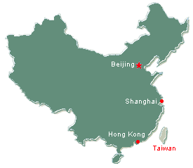
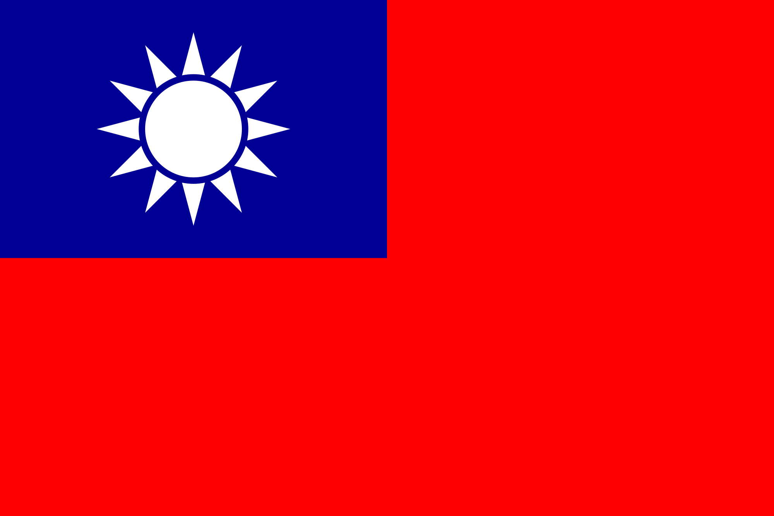
People’s Republic of China
Republic of China

Slide 20
1949
https://youtu.be/4srwSkD05ws

Slide 21
1953-1957: Mao’s first 5 Year Plan
Soviet influence
Killed landlords & divide land among peasants
Collectivism – farms owned by gov’t & ran by hundreds of families
Focused on expanding industry
Relatively successful

Slide 22
1958-1962: The Great Leap Forward (second 5 Year Plan)
Collective farms turned in massive communes
Everything done in community (working, eating, sleeping, child rearing)
Homemade steel production → BIGGEST FAIL
Triggered massive family (20 mill died) – too busy making steel to farm
State owned enterprises → little incentive to be efficient
Mao refused to accept responsibility for failure
Blamed peasants (hoarding food)
Blamed local officials (incompetence)
Blamed bad weather (affected harvests)

Slide 23
1966 – 1976: Cultural Revolution
Mao sees weakening of socialist ideals → urge youth to revolt
Students leave school → from Red Guard
Mao seeks to reassert dominance by eliminating oppositions
Claims more books read, the more unintelligent you are and seeks to re-educate youth
Teens sent to farmland to be “re-educated” by peasants/ farmers
130 million stopped attending school
Economy collapsed
Denounces the 4 olds: ideas, customs, habits, culture
Mao dies in 1976

Slide 24
Cultural Revolution
Values of proletarian society (class of wage-earners)
Religion was attacked as one of the “four olds”
Replace religion with loyalty to party (Maoism)
Doctors targeted for bourgeois lifestyle, damaging healthcare
IMPACT: Thousands of years of Chinese culture/history lost
Books burned because deemed politically incorrect
Only literature, art and media that promoted Chinese themes= allowed
Artists resisted= sent to labor camps for “reeducation”
People too afraid to resist destruction of traditional culture

Slide 25
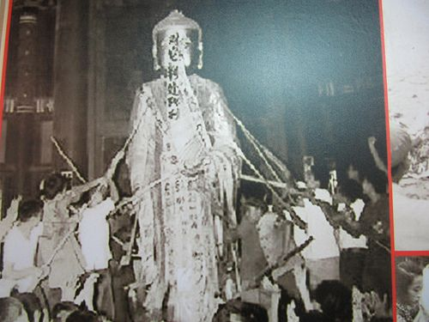
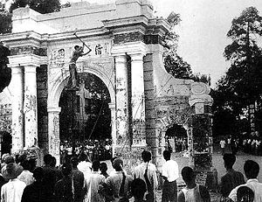

Slide 26
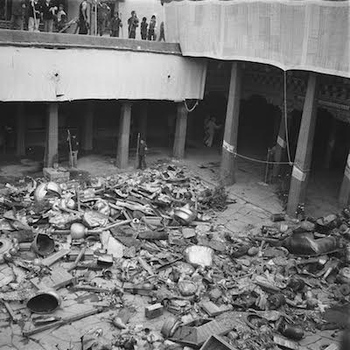
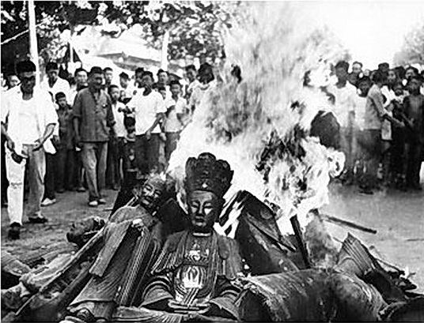

Slide 27
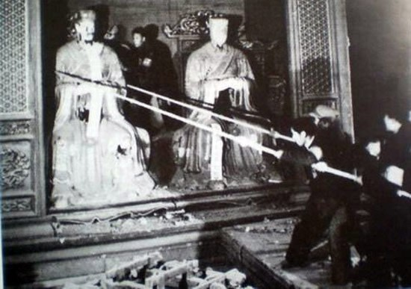
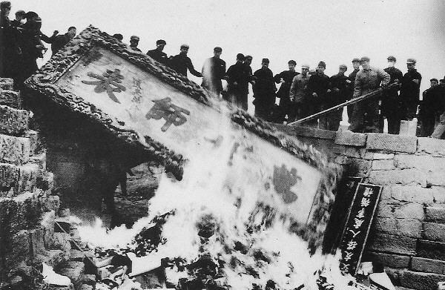

Slide 28
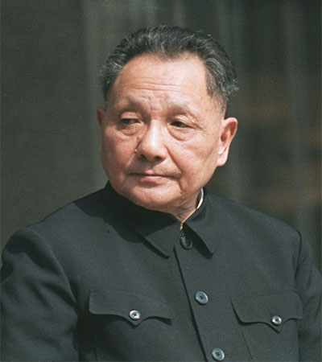
After Mao
Deng Xiaoping (Mao's successor)
Tightens government control
Doesn’t want people to question CCP authority
Replace (communist) ideology with economics
Chinese mobilized not for equality but for money
"Wealth is glorious"
Opens up China to the world/West

Slide 29
In your notes…
Republic 1912-1949
Civil War 1927-1932, 1933-1937, 1945-1949
Mao's (1st) Five Year Plan 1953-1957
Great Leap Forward 1958-1962
Cultural Revolution 1966 – 1976
Qing Dynasty is overthrown by KMT
Democracy & capitalism
Disunity, instability, lots of warlords
Life for people in urban cities gets better, everything else is same

Slide 30
To Live (Huózhe)
活着
Directed by Zhang Yimou
1994
Movie is based on a novel of the same name by Chinese author, Yu Hua
Banned in mainland China
Director and lead actress (Gong Li) was banned from filmmaking for 2 years
The film is a frank examination of China from 1940s -1960s through the lens of one family.

Slide 31
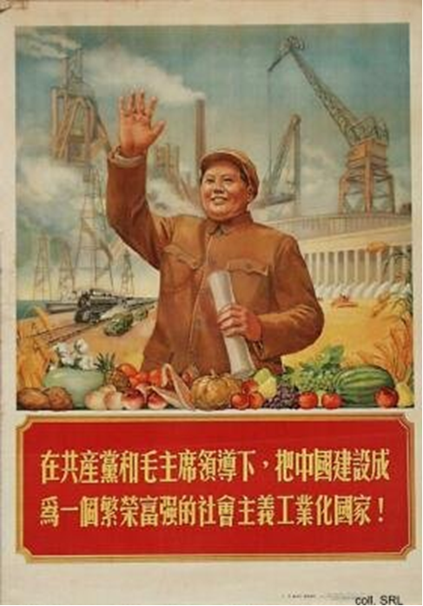
Turn China into a prosperous, rich, and powerful industrialized socialist country under the leadership of the Communist Party and Chairman Mao, 1954!

Slide 32
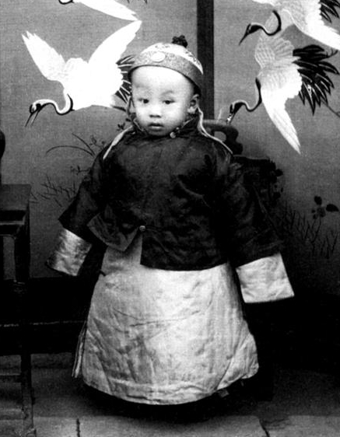
China Timeline
Last emperor of China: Puyi
1911: Xinhai Revolution overthrew the Qing Dynasty
1911 – 1949:
China ruled by a western style republic (let by Kuomintang – the Nationalist Party)
This government was influenced by the west and focused on the cities
First president of China: Sun Yat-Sen

Slide 33
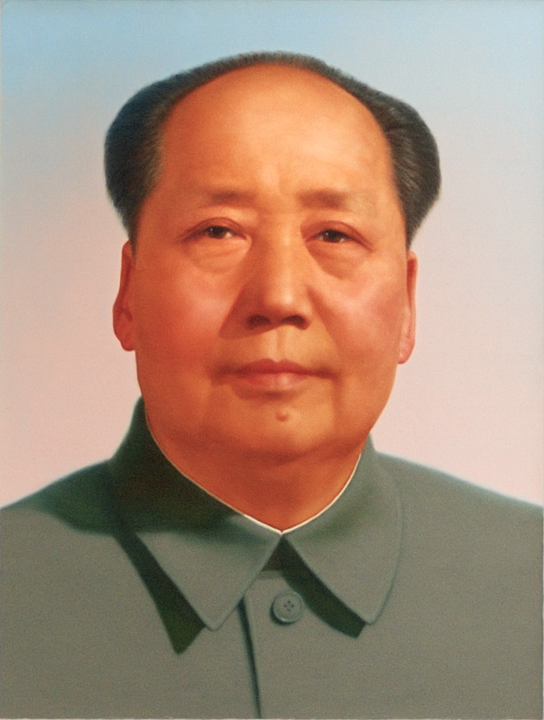
China Timeline
1921: Chinese Communist Party (CCP) founded
1927: Communists forced out of cities. Begin to influence the peasants on the countryside
1937 – 1945: During WW2: hostility between Kuomintang and CCP put on hold
CCP is seen as better at fighting the Japanese
CCP controls territory in the countryside where they help peasants & fight imperialist Japan
1949 CCP has enough support to take over the government, the Koumingtang flees to Taiwan

