Slide 1
Imperialism:
When a nation/empire/group of people takes over and rules another nation/territory/group of people politically, economically, socially. The imperialist country will tend to have superior technology and use intimidation to force the other country to submit.
government
Economy $$
Culture – force them to learn their language or religion

Slide 2
Motives for Imperialism
E.M.P.I.R.E

Slide 3
Economics
Desire to make money $$
To expand & control foreign trade
To create new markets for products
To acquire raw materials and cheap labor
To compete for investments and resources
To export industrial technology & transportation methods

Slide 4
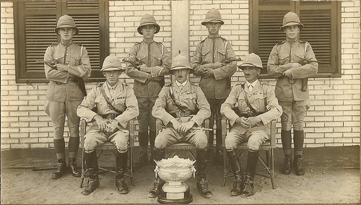
Military
To claim territory to create bases to protect the empire
To exercise military force
To use as a refuel and resupply area
To boost national pride and security
From a children’s book of the time, called, “ABC for Baby Patriots”

Slide 5
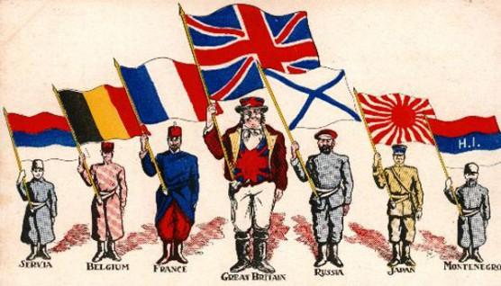
Political
Based on a nation’s desire to gain power
To compete with other European countries
To expand territory
To gain prestige by winning colonies
To boost national pride

Slide 6
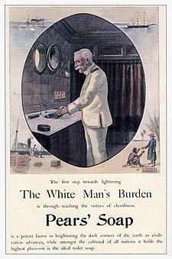
Ideological
Social Darwinism
White Man’s Burden
Cultural belief that the white race was superior
Other cultures were “primitive”
Europeans job is to “civilized” peoples in other parts of the world

Slide 7
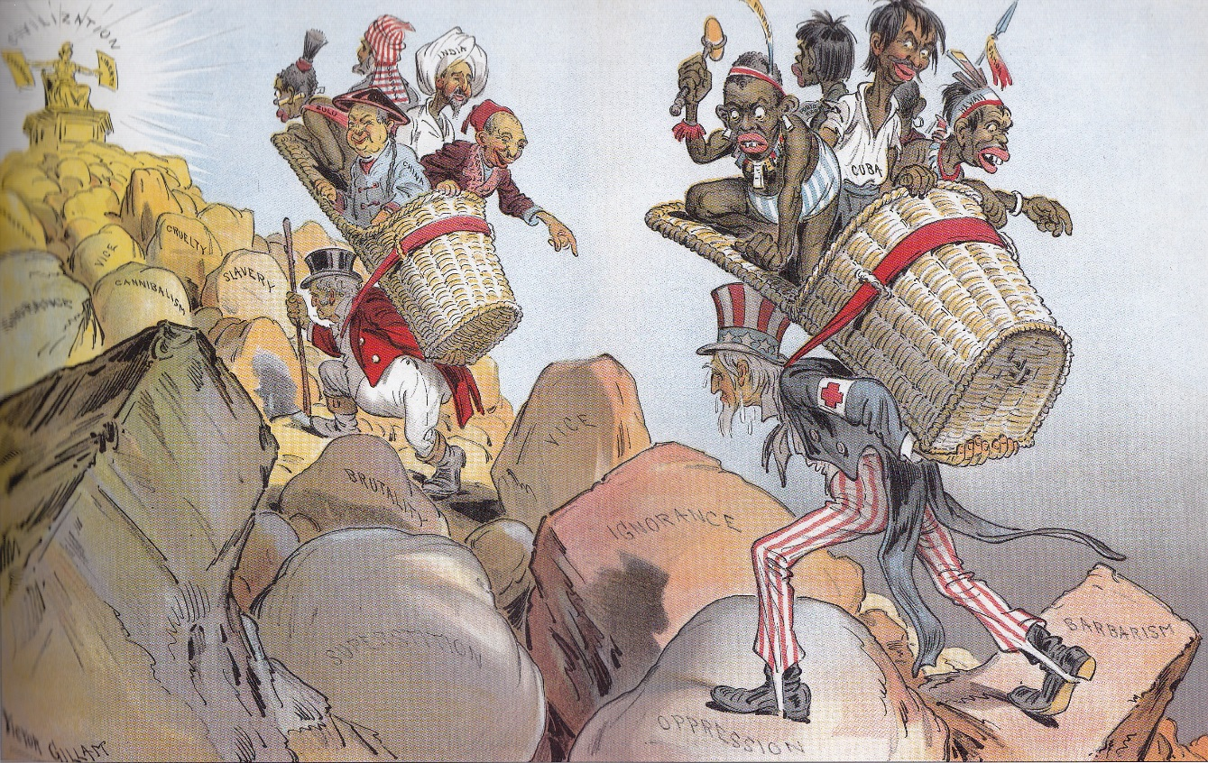

Slide 8
Excerpt of the poem, “The White Man’s Burden” By Rudyard Kipling February 1899
Eurocentric view of the world European duty to go out and civilize/help non-European people → European culture is superior
Take up the White Man’s burden—
Send forth the best ye breed—
Go send your sons to exile
To serve your captives' need
To wait in heavy harness
On fluttered folk and wild—
Your new-caught, sullen peoples,
Half devil and half child
Take up the White Man’s burden…
Description of non-European peoples:
“captives” → like slaves/animals
“flutter folk” → crazy irrational people “wild” → like animals
“new-caught” → like animals
“sullen peoples” → moody like children
“half devil & half child”

Slide 9
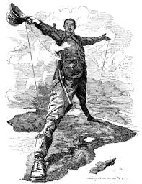
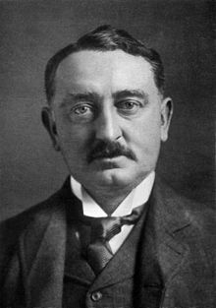
“I contend that we are the first race in the world and that the more of the world we inhabit the better it is for the human race. I contend that every acre added to our territory provides for the birth of more of the English race, who otherwise would not be brought into existence… I believe it to be my duty to God, my Queen and my country to paint the whole map of Africa red, red from the Cap to Cairo. That is my creed, my dream and my mission.”
-Cecil Rhodes, “Confession of Faith”, 1877

Slide 10
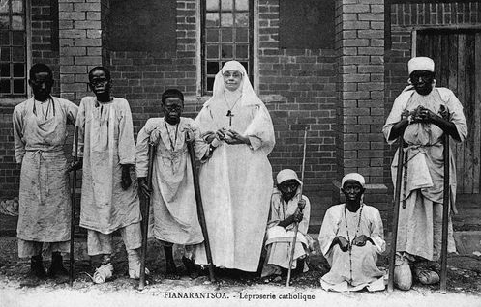
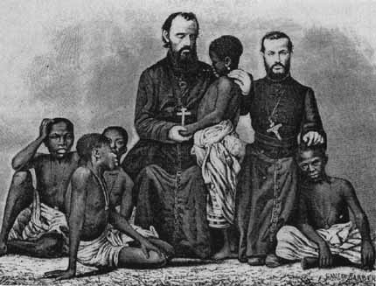
Religion
The desire to spread Christianity
To protect European missionaries in other lands
To spread European values and moral beliefs
To educate people of other cultures
To end slave trade in Africa

Slide 11
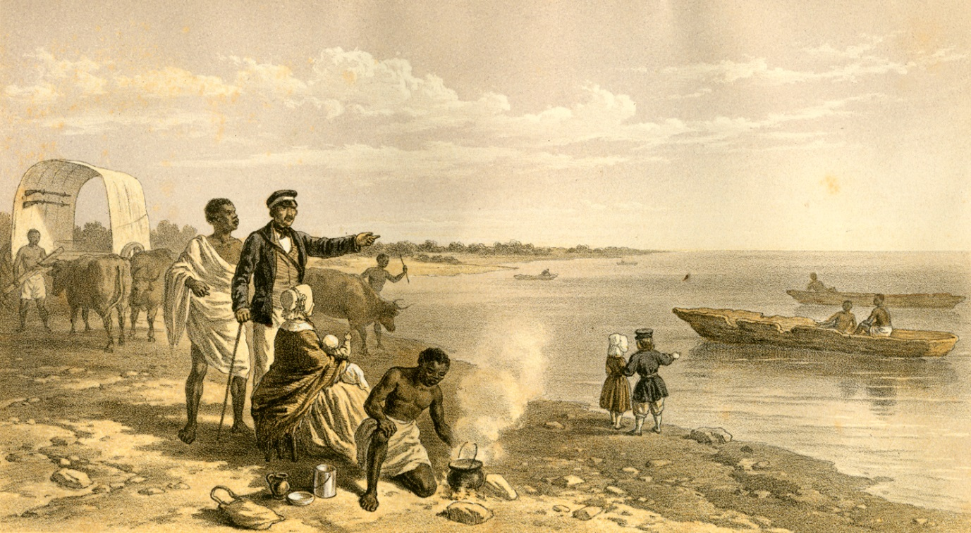
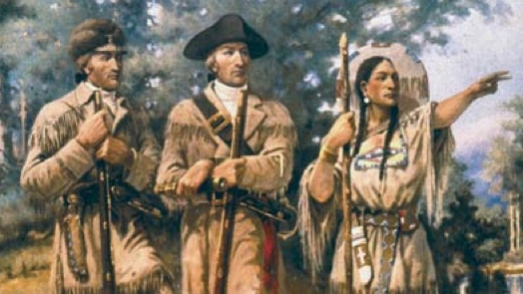
Exploratory
The desire to explore “unknown” or uncharted territory
To conduct scientific research
To conduct medical searches for the causes and treatments of disease to go on an adventure
To investigate unknown cultures

