Slide 1
Source Evaluation - OPCVL
Origin
Purpose
Content/Context
Value
Limitations

Slide 2
Origin
Primary or Secondary Source?
Questions to consider:
Who created it?
Who is the author?
When was it created?
When/where / who published it?
Is there anything we know about the author that is pertinent to our evaluation?

Slide 3
Purpose
Questions to consider:
Why does this document exist?
Who is the target audience and how can I tell?
Why did the author choose this format?
What does the document “say”?
Can it tell you more than is on the surface?
Remember: one-sided sources help us understand people’s views

Slide 4
Content/Context
Questions to consider:
When does this take place?
Who is involved? People, Leaders, Nations
Where is this?
What impact/significance does this have and on who or what?
Why did this take place/happen?

Slide 5
Value
Questions to consider:
What can you tell about the author from this piece?
What can you tell about the time period?
Under what circumstances was this piece created and how does this piece reflect those circumstances
Does the author represent a particular ‘side’ of a controversy or event?
What can we tell about the author’s perspectives from the piece?

Slide 6
Limitations
Questions to consider:
What part of the story can we NOT tell from this document?
How could we verify the content of the piece?
Does this piece inaccurately reflect anything about the time period?
What does the author leave out and why does he/she leave it out (if you know)?
What is purposely not addressed?

Slide 7
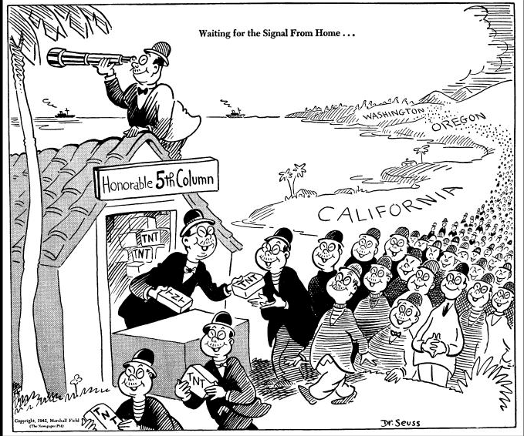
Waiting for the Signal From Home…
Originally published in PM Magazine, February 13, 1942
Sleeper spy cell
Context:
Dec 7, 1941: Japan bombs the US naval base at Pearl Harbor
Dec 8, 1948: US declares war on Japan/enters WWII
Fear & hysteria spreads across the US about Japanese Americans
Are they loyal to the US or Japan?
Feb 19, 1942: President FDR signs Executive Order 9066 – forcing all people of Japanese descent on the west coast to relocate to “special military” site
Dr. Seuss

Slide 8
OPCVL Paragraph
The origin of the source is…..the purpose is…..the context includes…..the values of the origin and purpose are……the limitations of the origins and purpose are……

